Slide 1
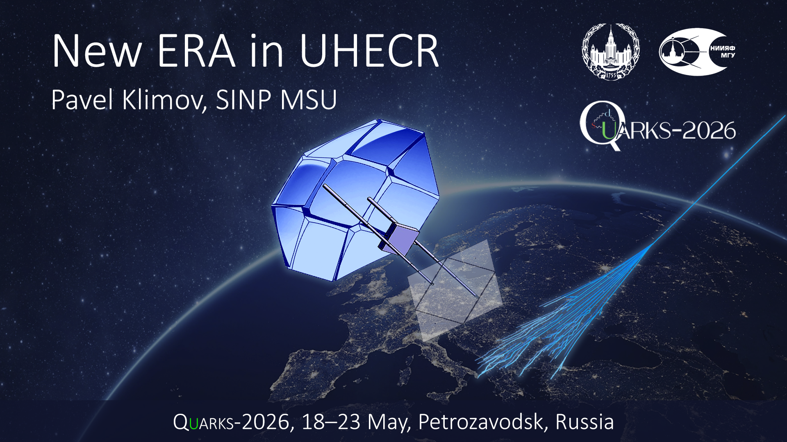

Slide 2
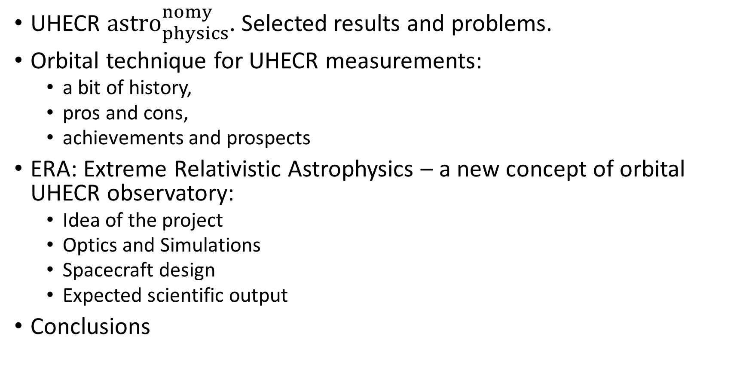
Outline
UHECR ${astro}_{physics}^{nomy}$. Selected results and problems.
Orbital technique for UHECR measurements:
a bit of history,
pros and cons,
achievements and prospects
ERA: Extreme Relativistic Astrophysics – a new concept of orbital UHECR observatory:
Idea of the project
Optics and Simulations
Spacecraft design
Expected scientific output
Conclusions

Slide 3
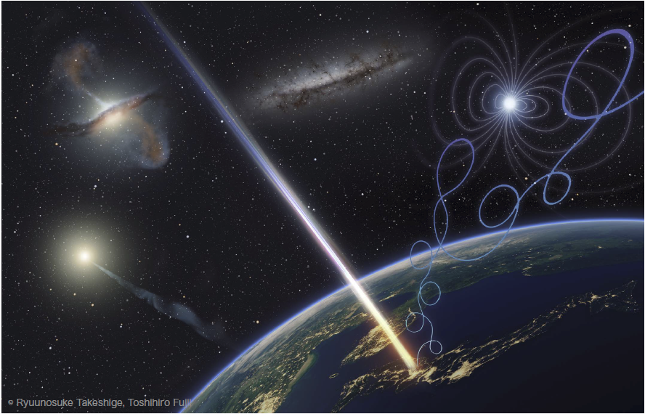
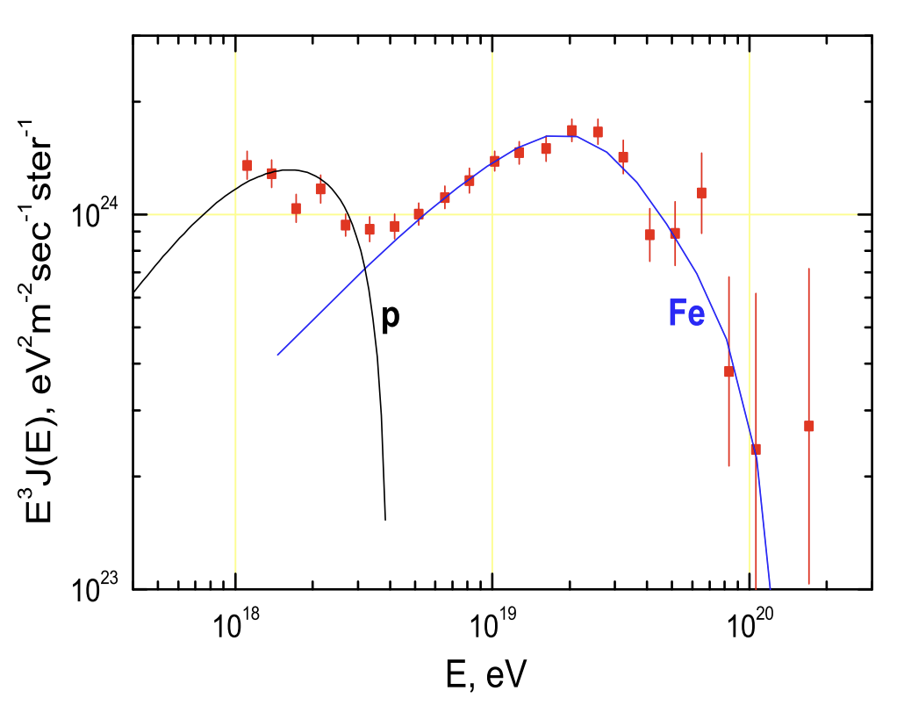
Dreams about particle astronomy
in T. Fujii, PoS (ICRC2023)
Optimistic expectations
Charged-particle astronomy with UHECRs is a potential probe of extremely energetic phenomena in the nearby Universe.
J. Cronin, 2004
II. Substantial doubts
III. An encouraging reality
Ultra high energy cosmic rays: The disappointing model
R. Aloisio, V. Berezinsky, A. Gazizov, AP, 2011
Nearby sources.
New methods of data analyses.
Telescope Array collaboration., Science 382 (2023) 903

Slide 4
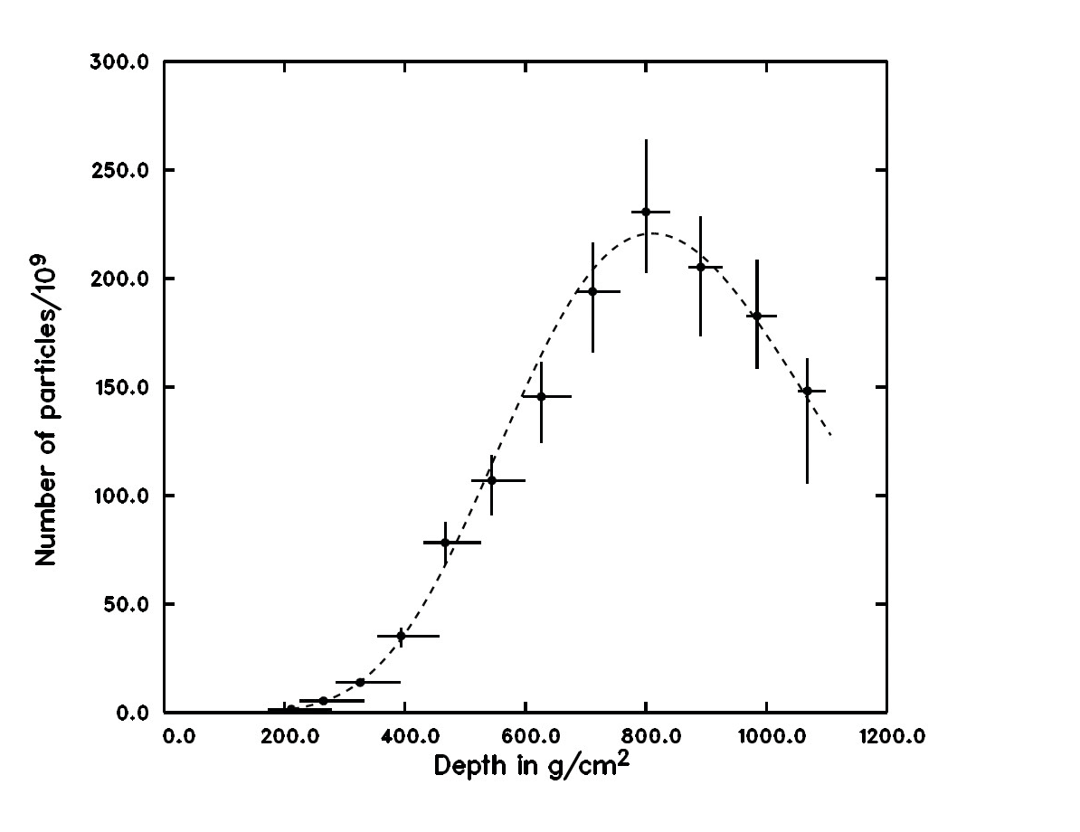
“One kind word warms the whole winter”
The “Oh My God” Particle (1991)
E = 320 ± 90 EeV
D.J. Bird et al., astro-ph/9410067
“Amaterasu” event(2021)
E = 244 ± 24 EeV
The source must be closer than ~13.5 Mpc
M. Kuznetsov, JCAP 04 (2024) 042

Slide 5
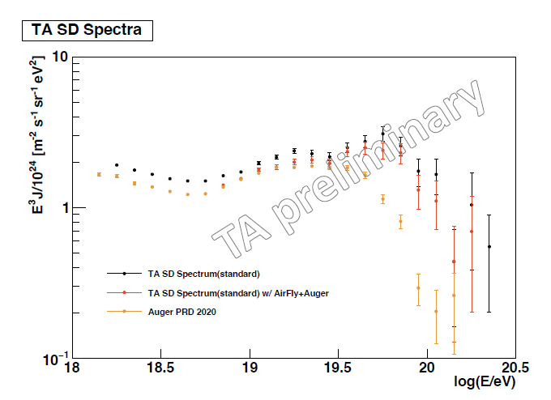
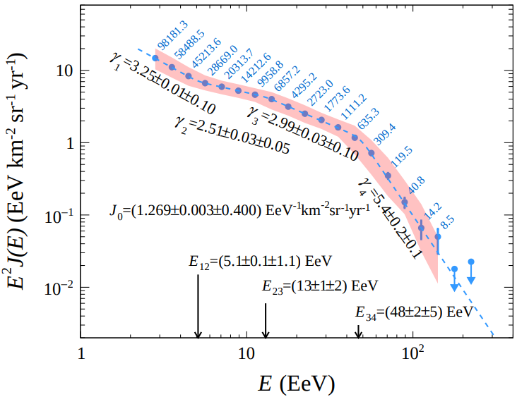
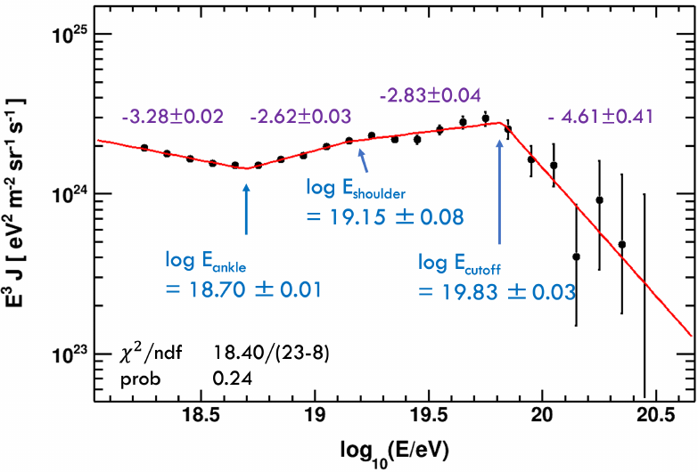
Unsolved problems of UHECR I
The cutoff of the energy spectrum above ∼50EeV
arXiv:2506.11688
K. Fujita, PoS(ICRC2023)400
Kim et al. PoS (UHECR2024) 037
When considering the full aperture of both experiments, the fit yielded an 8.0𝜎 significance difference.
There is no statistically significant difference between the spectra in the common sky at 1.8𝜎 significance level

Slide 6
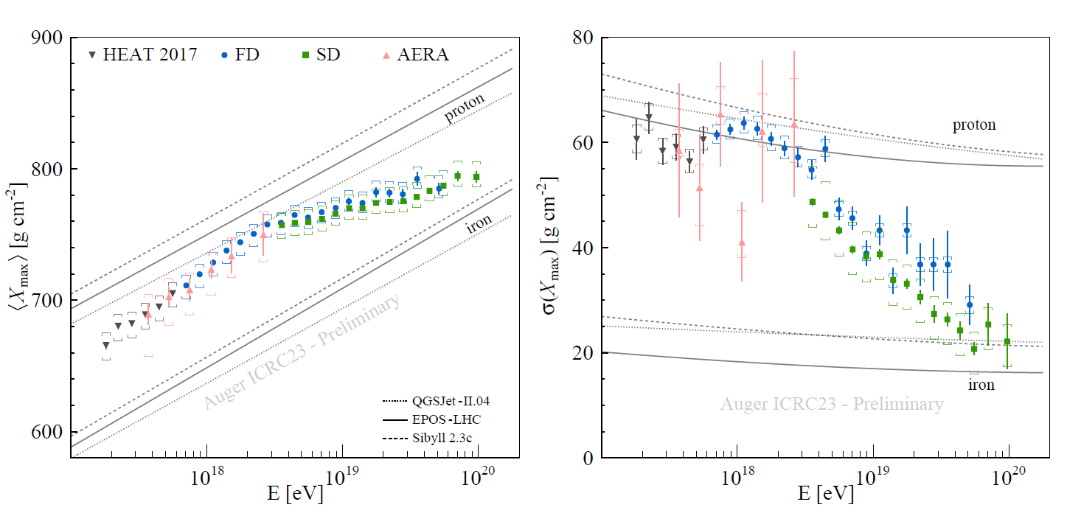
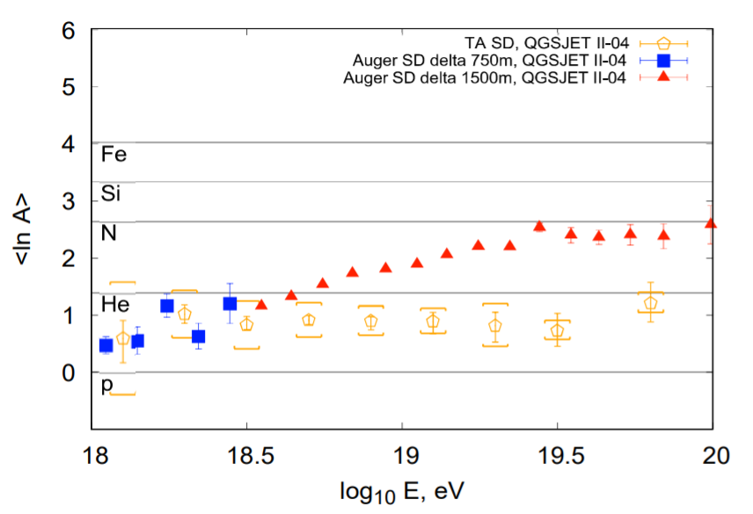
Unsolved problems of UHECR II
PAO: A heavy mass composition at the highest energies
Telescope Array collaboration., Phys.Rev.Lett. 133 (2024) 041001
Eric Mayotte, PoS(ICRC2023)365
At E > 100 EeV, CR are very isotropic - the composition must be very heavy!
J.N. Matthews for the Telescope Array Collaboration 2023 J. Phys.: Conf. Ser. 2429 012011:
“The Telescope Array data is stable and light to the highest energies.”

Slide 7
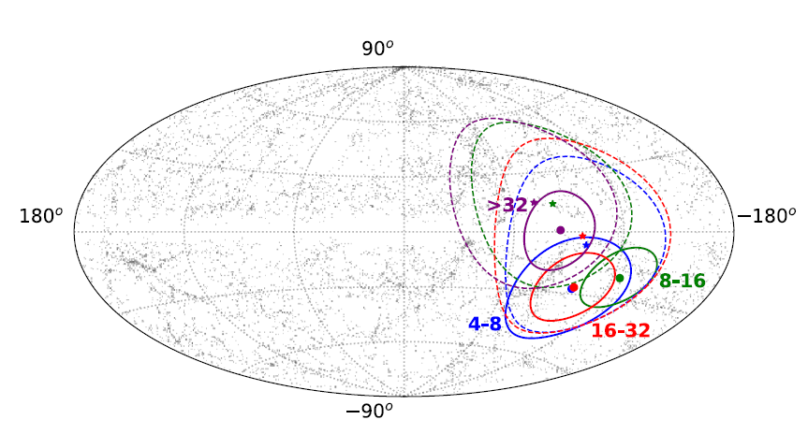
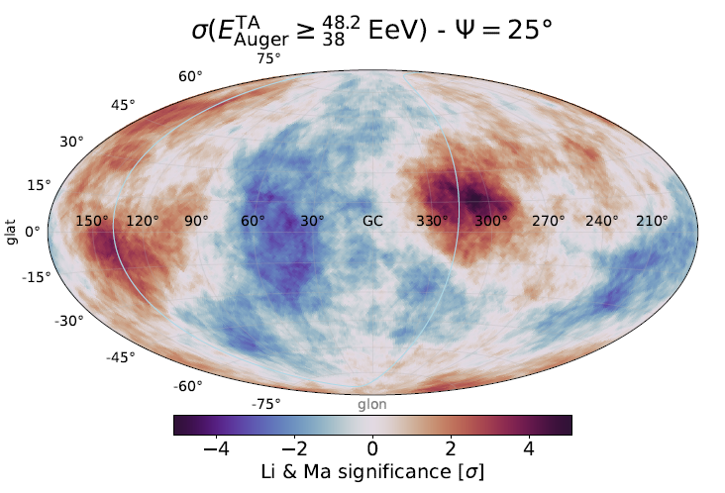
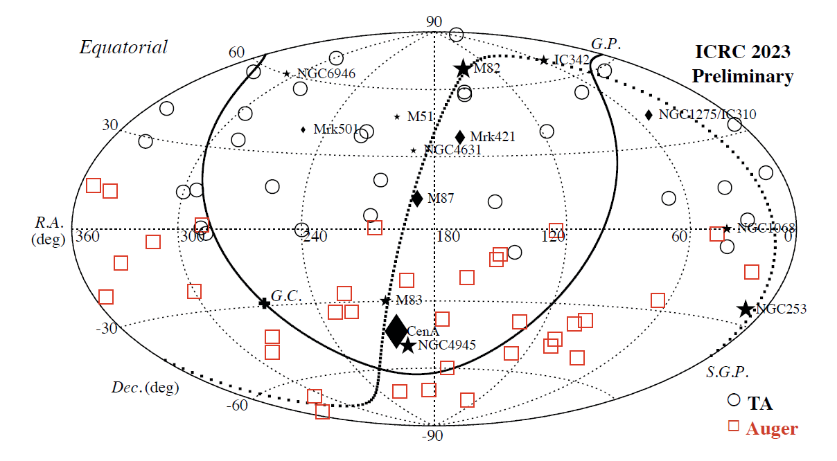
Unsolved problems of UHECR III
a significant large-scale anisotropy in arrival directions above 8EeV. The dipole amplitudes increase with energy above 4 EeV.
No significant clusterings and correlations in a direction of nearby promising source candidates are found in the current statistics above 100EeV.
This isotropic distribution may imply heavier mass compositions, stronger Galactic and/or extragalactic magnetic fields, and more abundant source densities than previously expected.
Galactic coordinates
Abdul Halim et al 2024 ApJ 976 48;
DOI 10.3847/1538-4357/ad843b
“Warm sports” are confirmed in separate data of PAO and TA.
BUT no statistically significant excess of CRs from TA “Warm sports” was found in the Auger experiment data.
A. Abdul Halim et al 2025 ApJ 984 123; DOI 10.3847/1538-4357/adbdc5

Slide 8
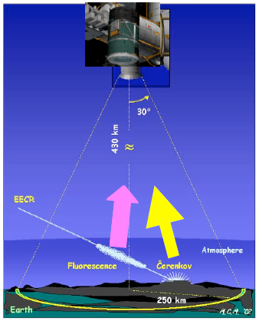
Ground-based vs orbital measurements
Existing ground based arrays:
Pierre Auger Observatory: 3,000 km²
~20 events> 60 EeV/year
Telescope Array: 700 km² Utah, USA
~5 events > 60 EeV/year
Auger + TA < 30 events/year
The ultimate dream
Earth surface ~ 5·10⁸ km²
~3.4·10⁶ events per year!
JEM-EUSO

Slide 9
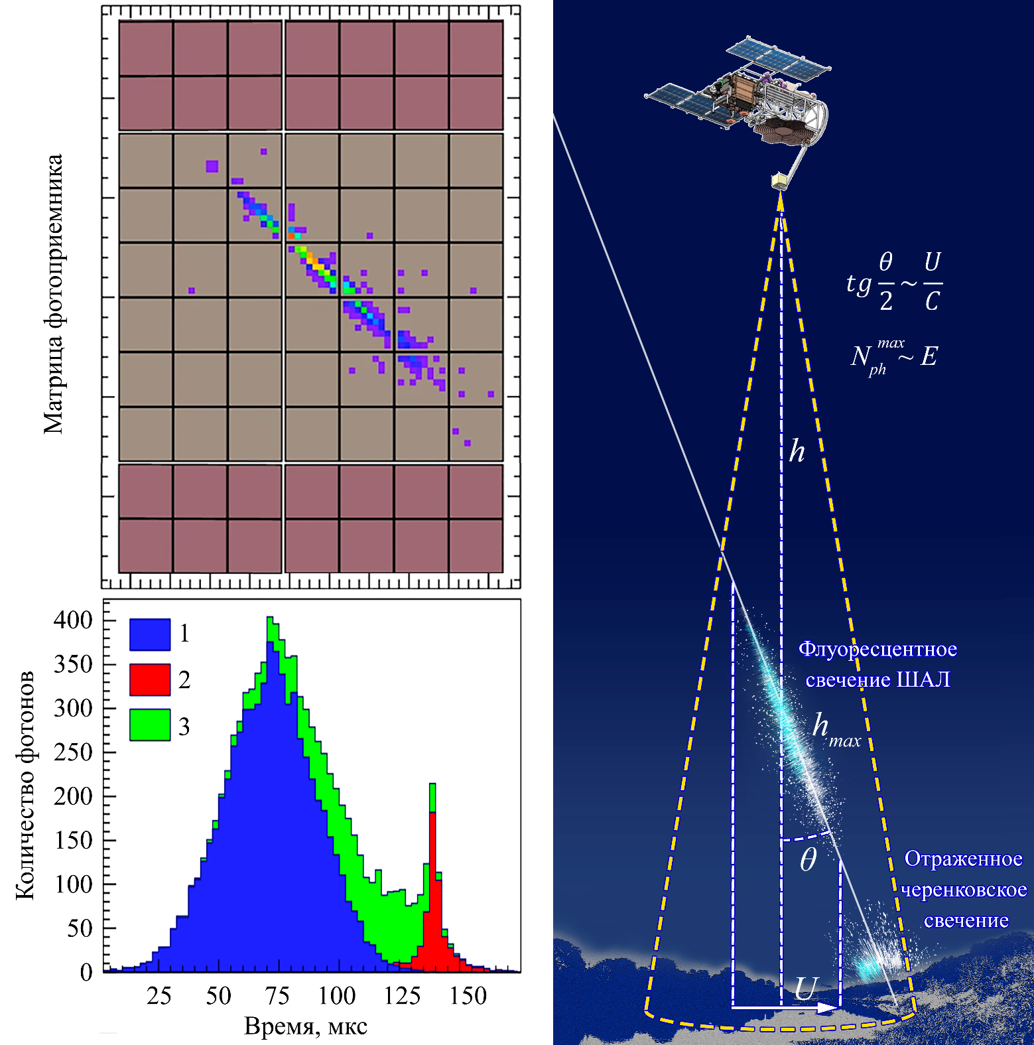
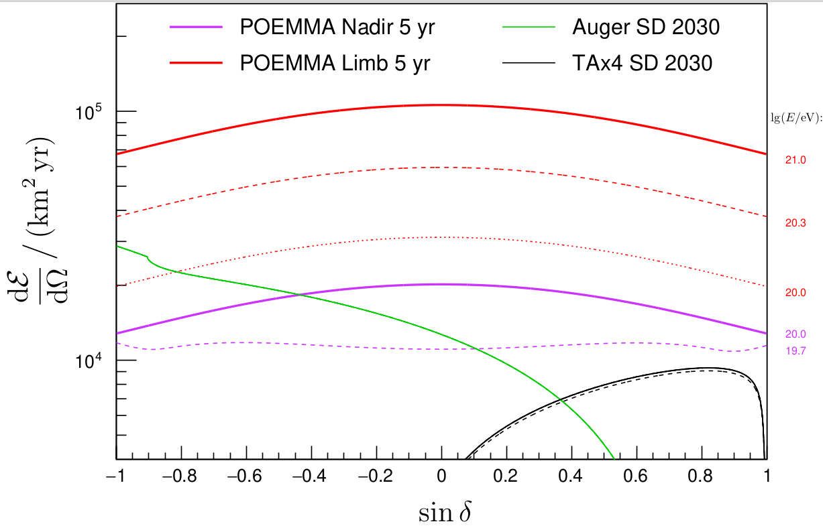
Ground-based vs orbital measurements II
Orbital detection of extensive air showers
Provides potentially greater statistics than ground-based experiments.
Ensures nearly uniform exposure of the entire celestial sphere.
Measurements of the entire celestial sphere with a single detector.
Expected exposure of POEMMA orbital UHECR project.
Anchordoqui, L. A.et al., (2020). Physical Review D, 101(2), 023012.

Slide 10
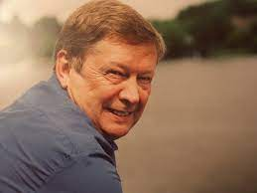
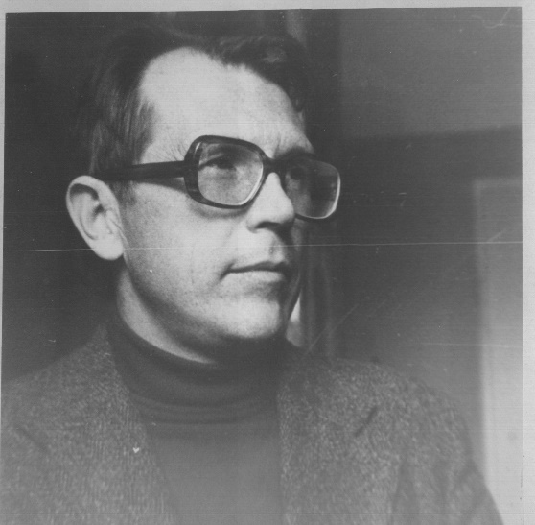
A bit of history
Benson, R. and Linsley, J., 1981, Satellite observation of cosmic ray air showers, ICRC, 17th, Paris, France, July 13–25, Conference Papers. Volume 8
OWL – two Schmidt telescopes
EUSO (JEM-EUSO) – wide field of angle Fresnel lens telescope. L. Scarsi – T. Ebisuzaki – P. Picozza – E. Parizot
TUS & KLYPVE – Fresnel mirror concept (M. Panasyuk, B. Khrenov)
ERA – new concept of distributed space observatory
POEMMA
K-EUSO
M. I. Panasyuk
B. A. Khrenov
Yoshiyuki Takahashi suggested the concept of MASS, the Maximum-Energy Auger (Air)-Shower Satellite, 1995
Figures from T. Ebisuzaki, Space-based observation of the extensive airshowers, EPJ Web of Conferences 53, 01014 (2013)

Slide 11
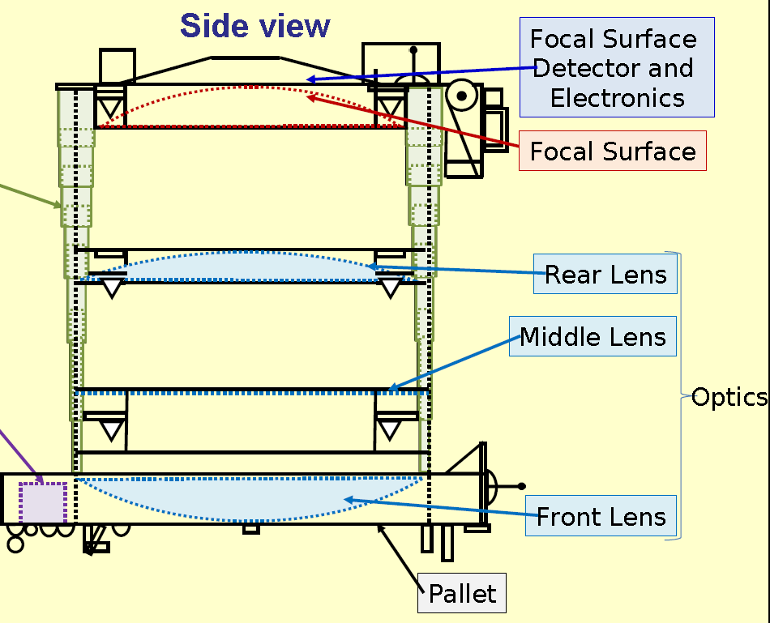
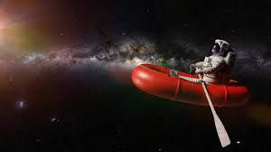
Challenges for orbital missions
1. Operation in conditions of rapidly changing UV emission of the Earth's night atmosphere
2. The need to combine three characteristics in a single device:
Large field of view (wide angle)
Large aperture (optical system area)
High temporal resolution.
JEM-EUSO instrument: 1.5 tones of complicated optics, mechanics and electronics.
3. Scientific equipment should be space qualified!

Slide 12


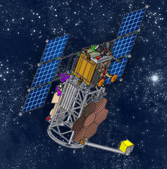
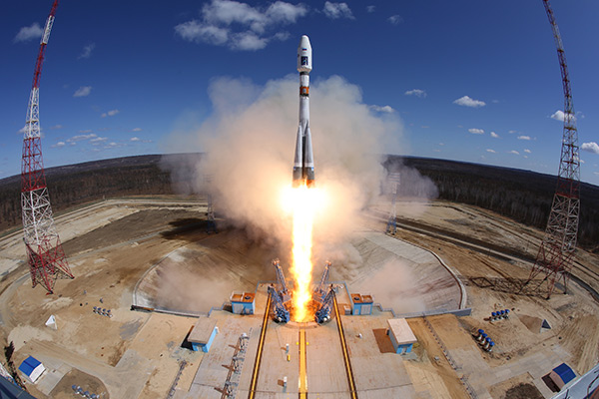
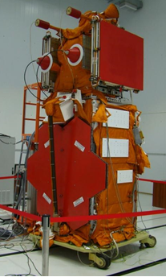
TUS – pathfinder of orbital concept
TUS was launched aboard the Lomonosov spacecraft on April 28, 2016.
In-space operation until December 2017 (with interruptions).
The world's first implementation of the UHECR orbital fluorescence telescope.
Its "modest" parameters prevented reliable detection of extensive air showers, but a major step forward was made and work was done to correct the errors!
Parameter | Value
FOV | ±4,5°
Number of pixels | 256
Pixel size | 10 mrad
Mirror area | ~2 m²
Optics efficiency | ε = 61 %
Trigger rate | 0,1 Hz
Event | Temporal resolution
EAS | τ = τ₀ = 0,8 μs
Short TLEs | τ = 2⁵τ₀ = 25,6 μs
Long TLEs | τ = 2⁹τ₀ = 0,4 ms
Meteor | τ = 2¹³τ₀ = 6,6 ms

Slide 13
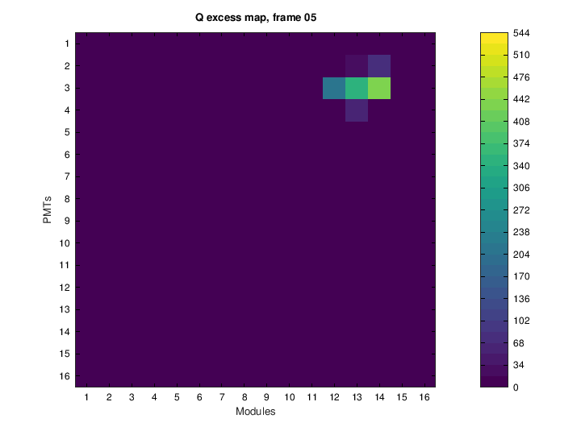
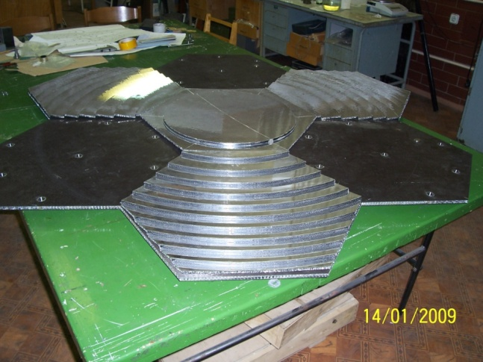
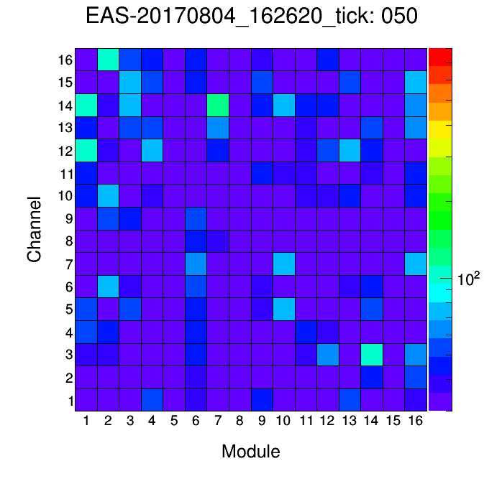
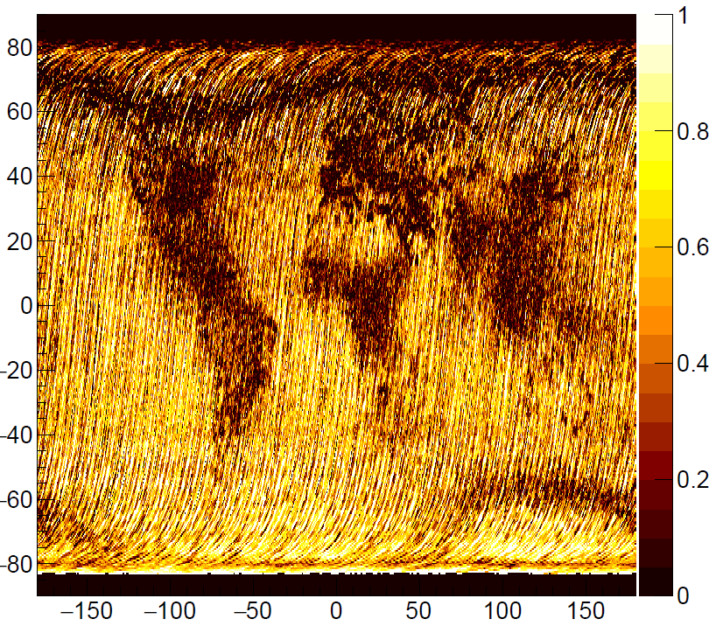
TUS – pathfinder of orbital concept
Technological advances in the development of ultra-lightweight, large-scale space-based optical systems.
A multi-level trigger system and control algorithms for a multi-channel detector have been developed.
Over 200,000 events have been measured.
Detailed information on the background conditions for detecting extensive air showers (EAS), including transient events, has been obtained.
EAS-like events have been measured.
A number of studies have been conducted in other areas: the physics of TLEs, auroras, and meteors.

Slide 14
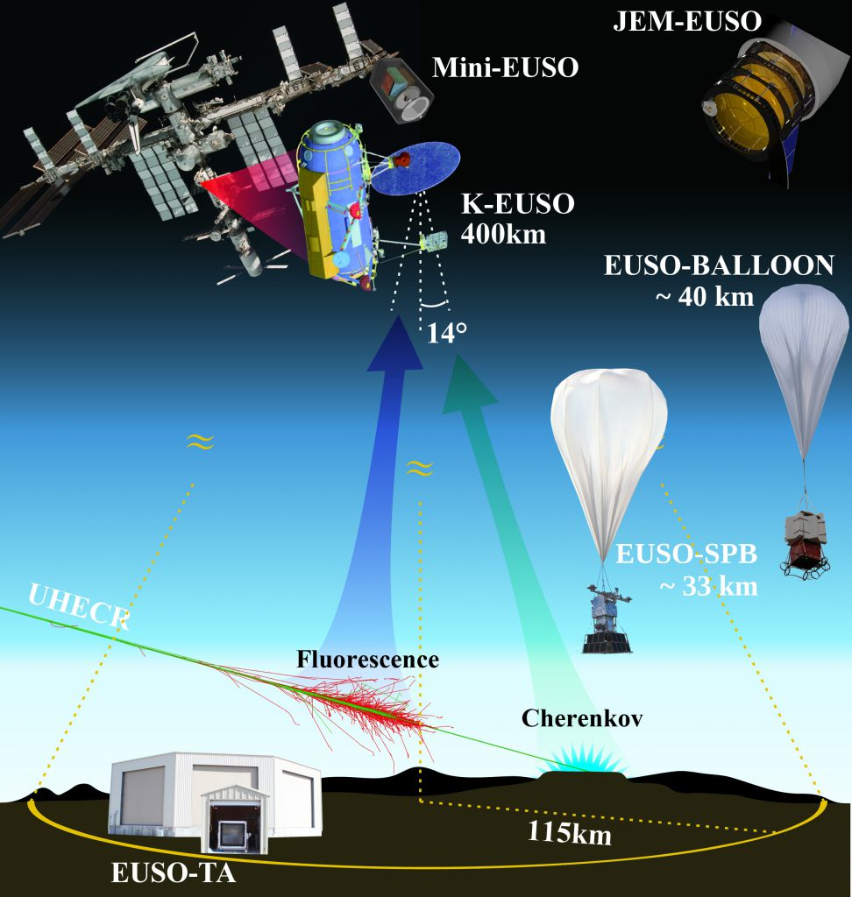
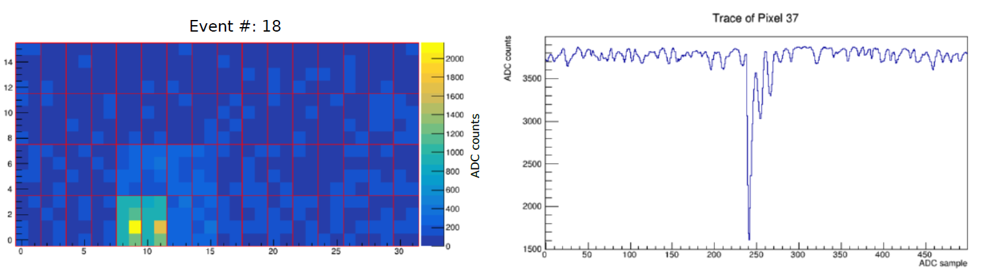
JEM-EUSO Program. A courageous path of ups and downs
2014 – First EUSO-Balloon flight above Canada
2016 – The TUS detector launch and two years of operation
2017 – EUSO-SPB1 two weeks flight
2019 – Mini-EUSO successful operation in the ISS. Russian-Italian successful project
2023 – EUSO-SPB2 two days flight: 2nd chance (apology) from NASA.
2023 – PBR development: 3rd chance (apology) from NASA
Example of above the limb CR EAS Cherenkov signal from SPB-2 mission (J. Eser, arXiv:2308.15693v2)

Slide 15
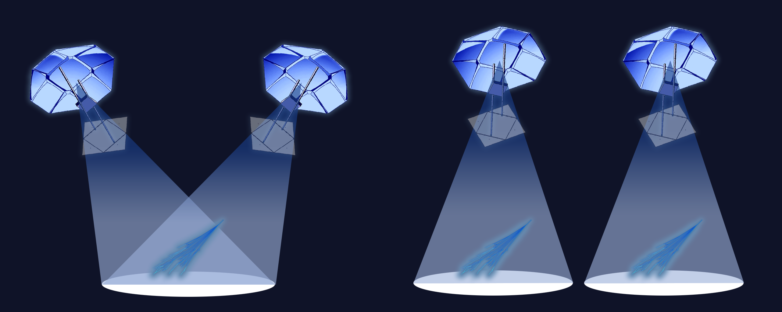
ERA (Extreme Relativistic Astrophysics) – new concept for orbital measurements
Technical challenges:
Lack of delivery vehicles and difficulty installing a large optical system on a manned spacecraft (ISS, ROS).
Difficulty creating a wide-angle (field angle >20 degrees) large-scale (entrance window area >2 m²) camera.
Solution:
A system with a distributed field of view (two or more identical telescopes with a reduced field of view).
Opportunities:
Optimization of scientific equipment while maintaining the required threshold and exposure levels using a relatively simple optical system and photodetector.
Possibility of "inexpensive" satellite launches of "small" spacecraft.
Possibility of stereo observations during experiments on autonomous spacecraft (satellites), which improves the accuracy of event reconstruction, including the depth of the EAS maximum.
Possibility of mass production of compact telescopes and satellites.

Slide 16
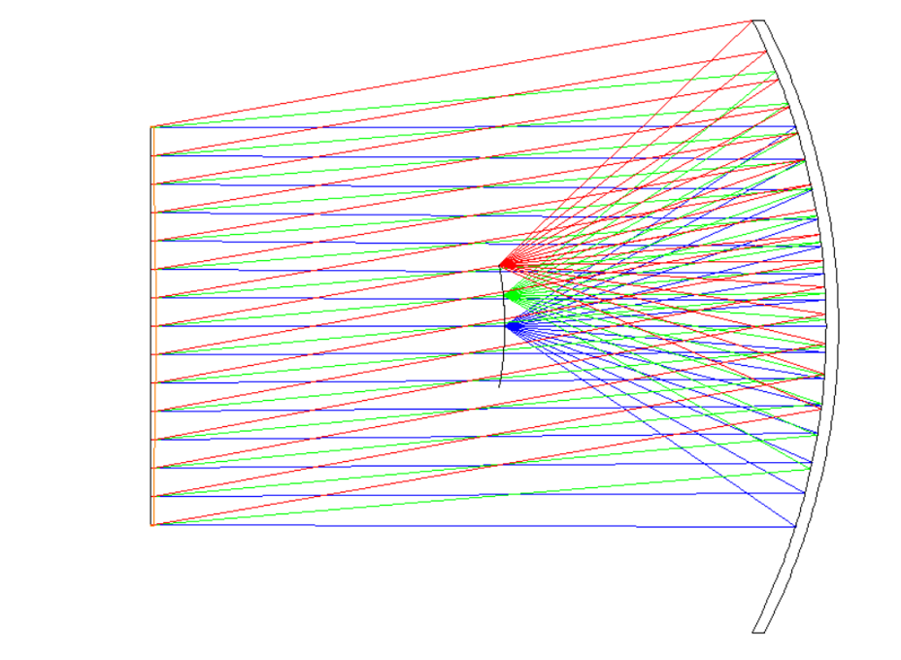
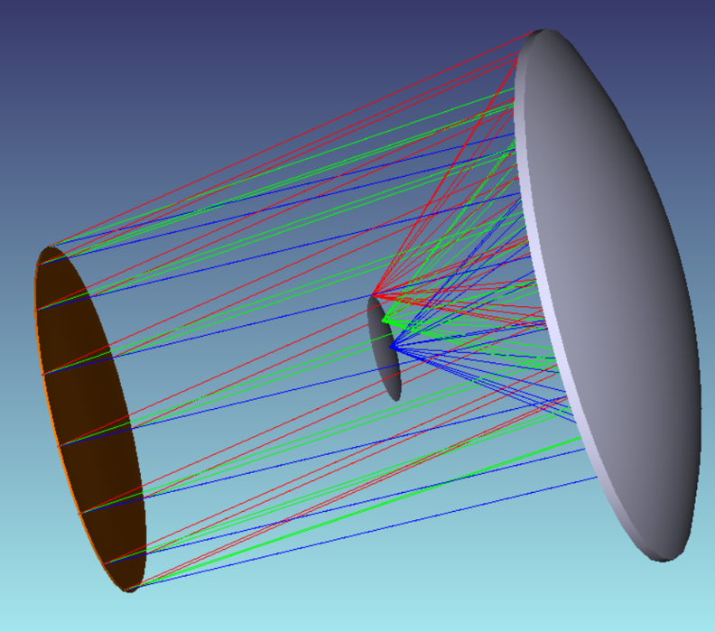
ERA optical system I
Requirements for the optical system characteristics:
The OS provides "good" focusing in a field of view from 0 to γ_{max} = 5–7°. The annual exposure will be approximately 2000 km2 sr/yr. Assuming an Auger spectrum (a conservative estimate), this will allow for the detection of at least 10 UHECRs (E>50 EeV) per year.
The OS has an entrance pupil area of ​​at least S_{EP} = 2 m². With an OS efficiency greater than 50%, this ensures an energy threshold at the GZK limit: 50 EeV.
Number of optical surfaces of the OS: no more than 2. Ensures relative simplicity of the OS (in JEM-EUSO there are 6 optical surfaces).
The OS must provide an angular resolution of Δγ = 1–2 mrad. This condition is necessary both to ensure the registration threshold (background level in one channel) and the accuracy of reconstruction of the primary particle parameters.
Schmidt optical system
Field of view: γ_{max} = 10° (EE >90% in a circle d = 0.9 mm).
Angular resolution: 2.1 mrad
Number of optical elements: 2 – corrector plate and concentrator mirror.
Mirror type: spherical (R_{c} = 2700 mm).
Corrector plate type: aspherical front surface, flat rear surface.
Mirror diameter DM = 2460 mm, corrector diameter DC = 1600 mm

Slide 17
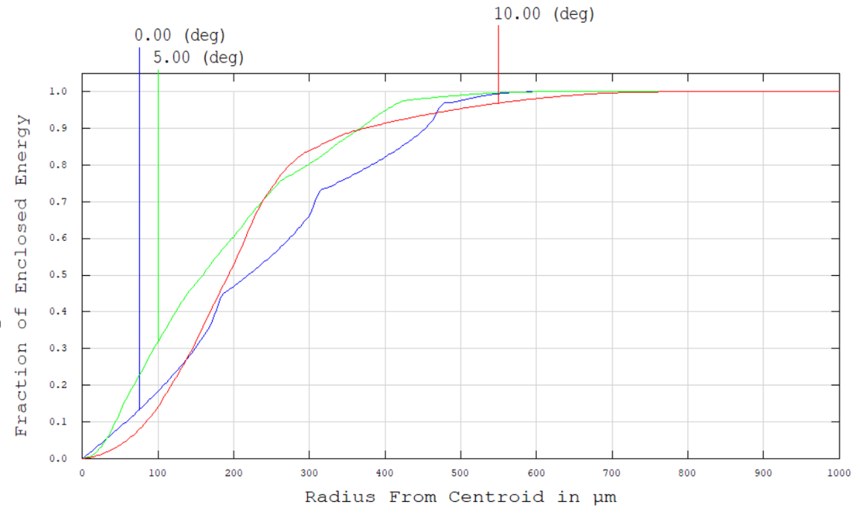
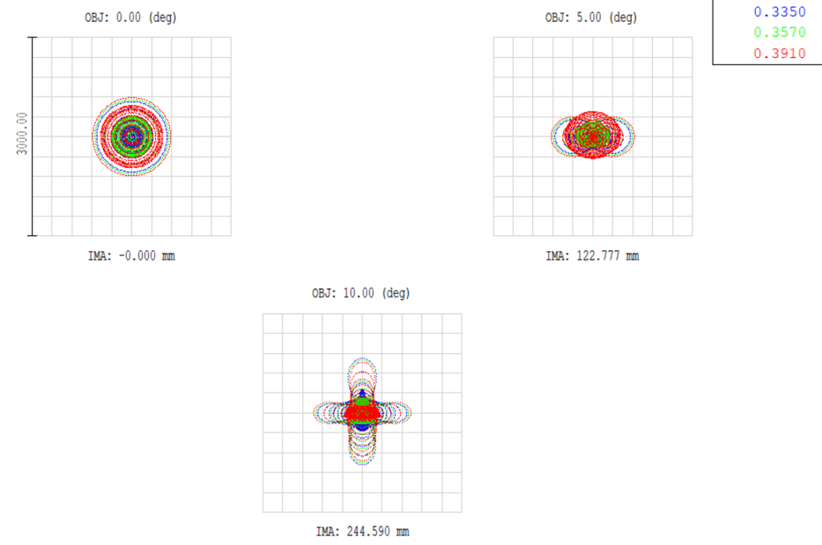
ERA optical system II
High-quality focusing over a wide field of view (up to 10 degrees).
Relative simplicity of the OS (spherical mirror).
Angular resolution: 2.1 mrad (850 m on the Earth's surface, at an altitude of 400 km and a pixel size of 3 mm).
Surface area covered: 20,000 km² (PAO: 3,000 km²)

Slide 18
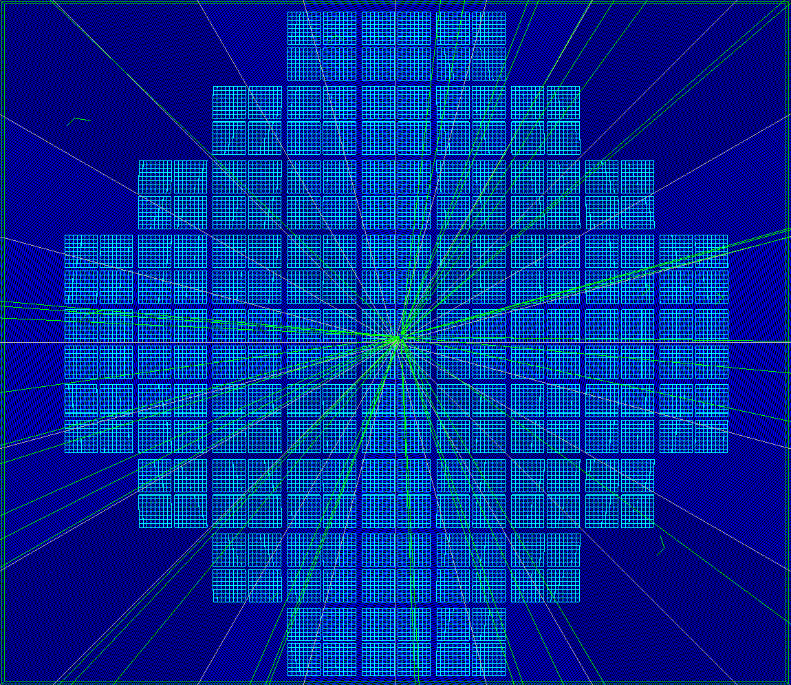
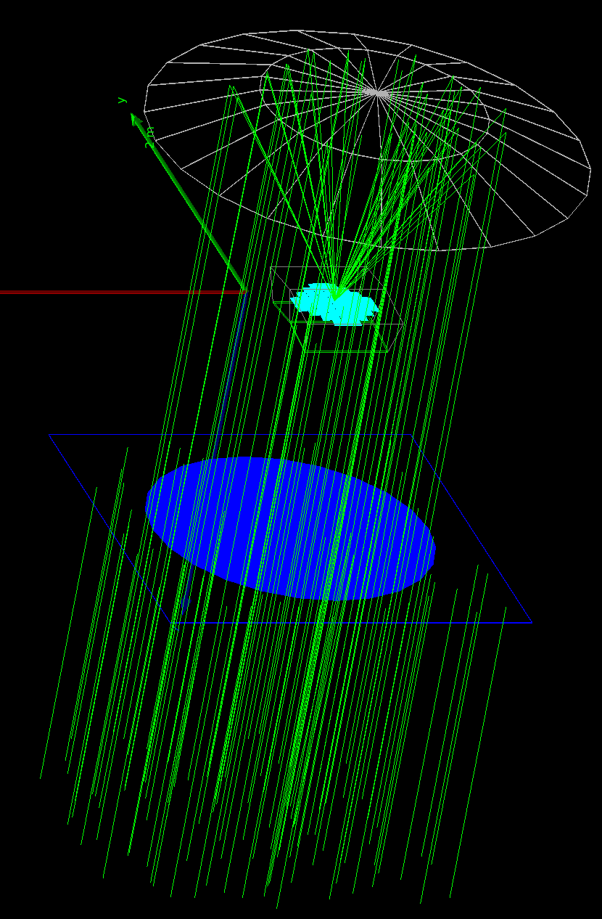
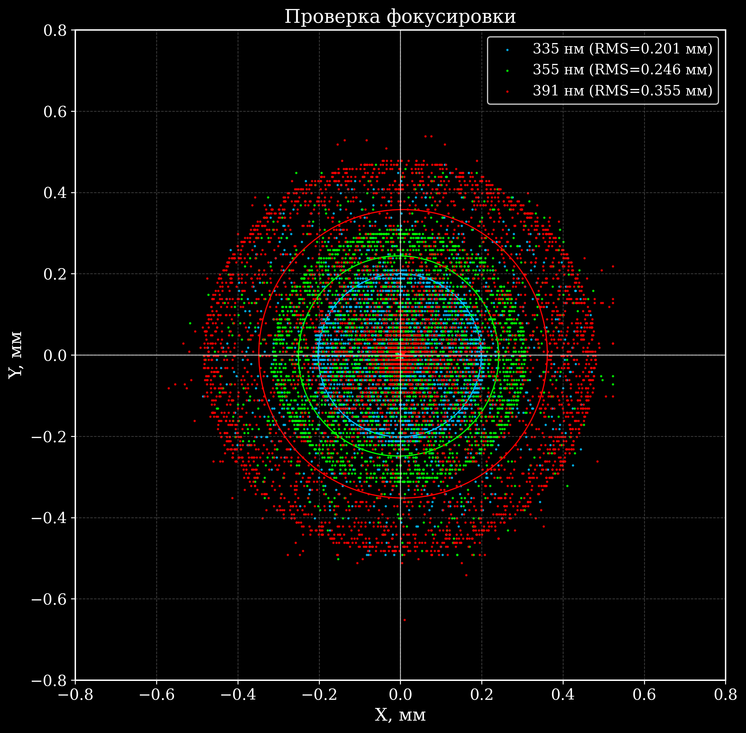
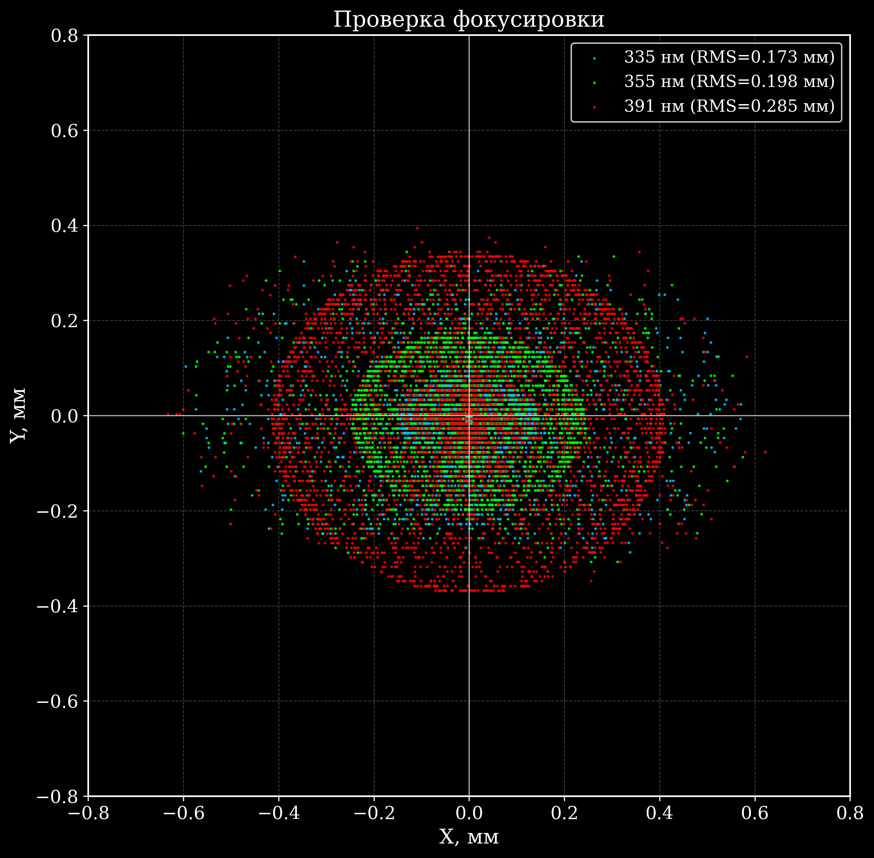
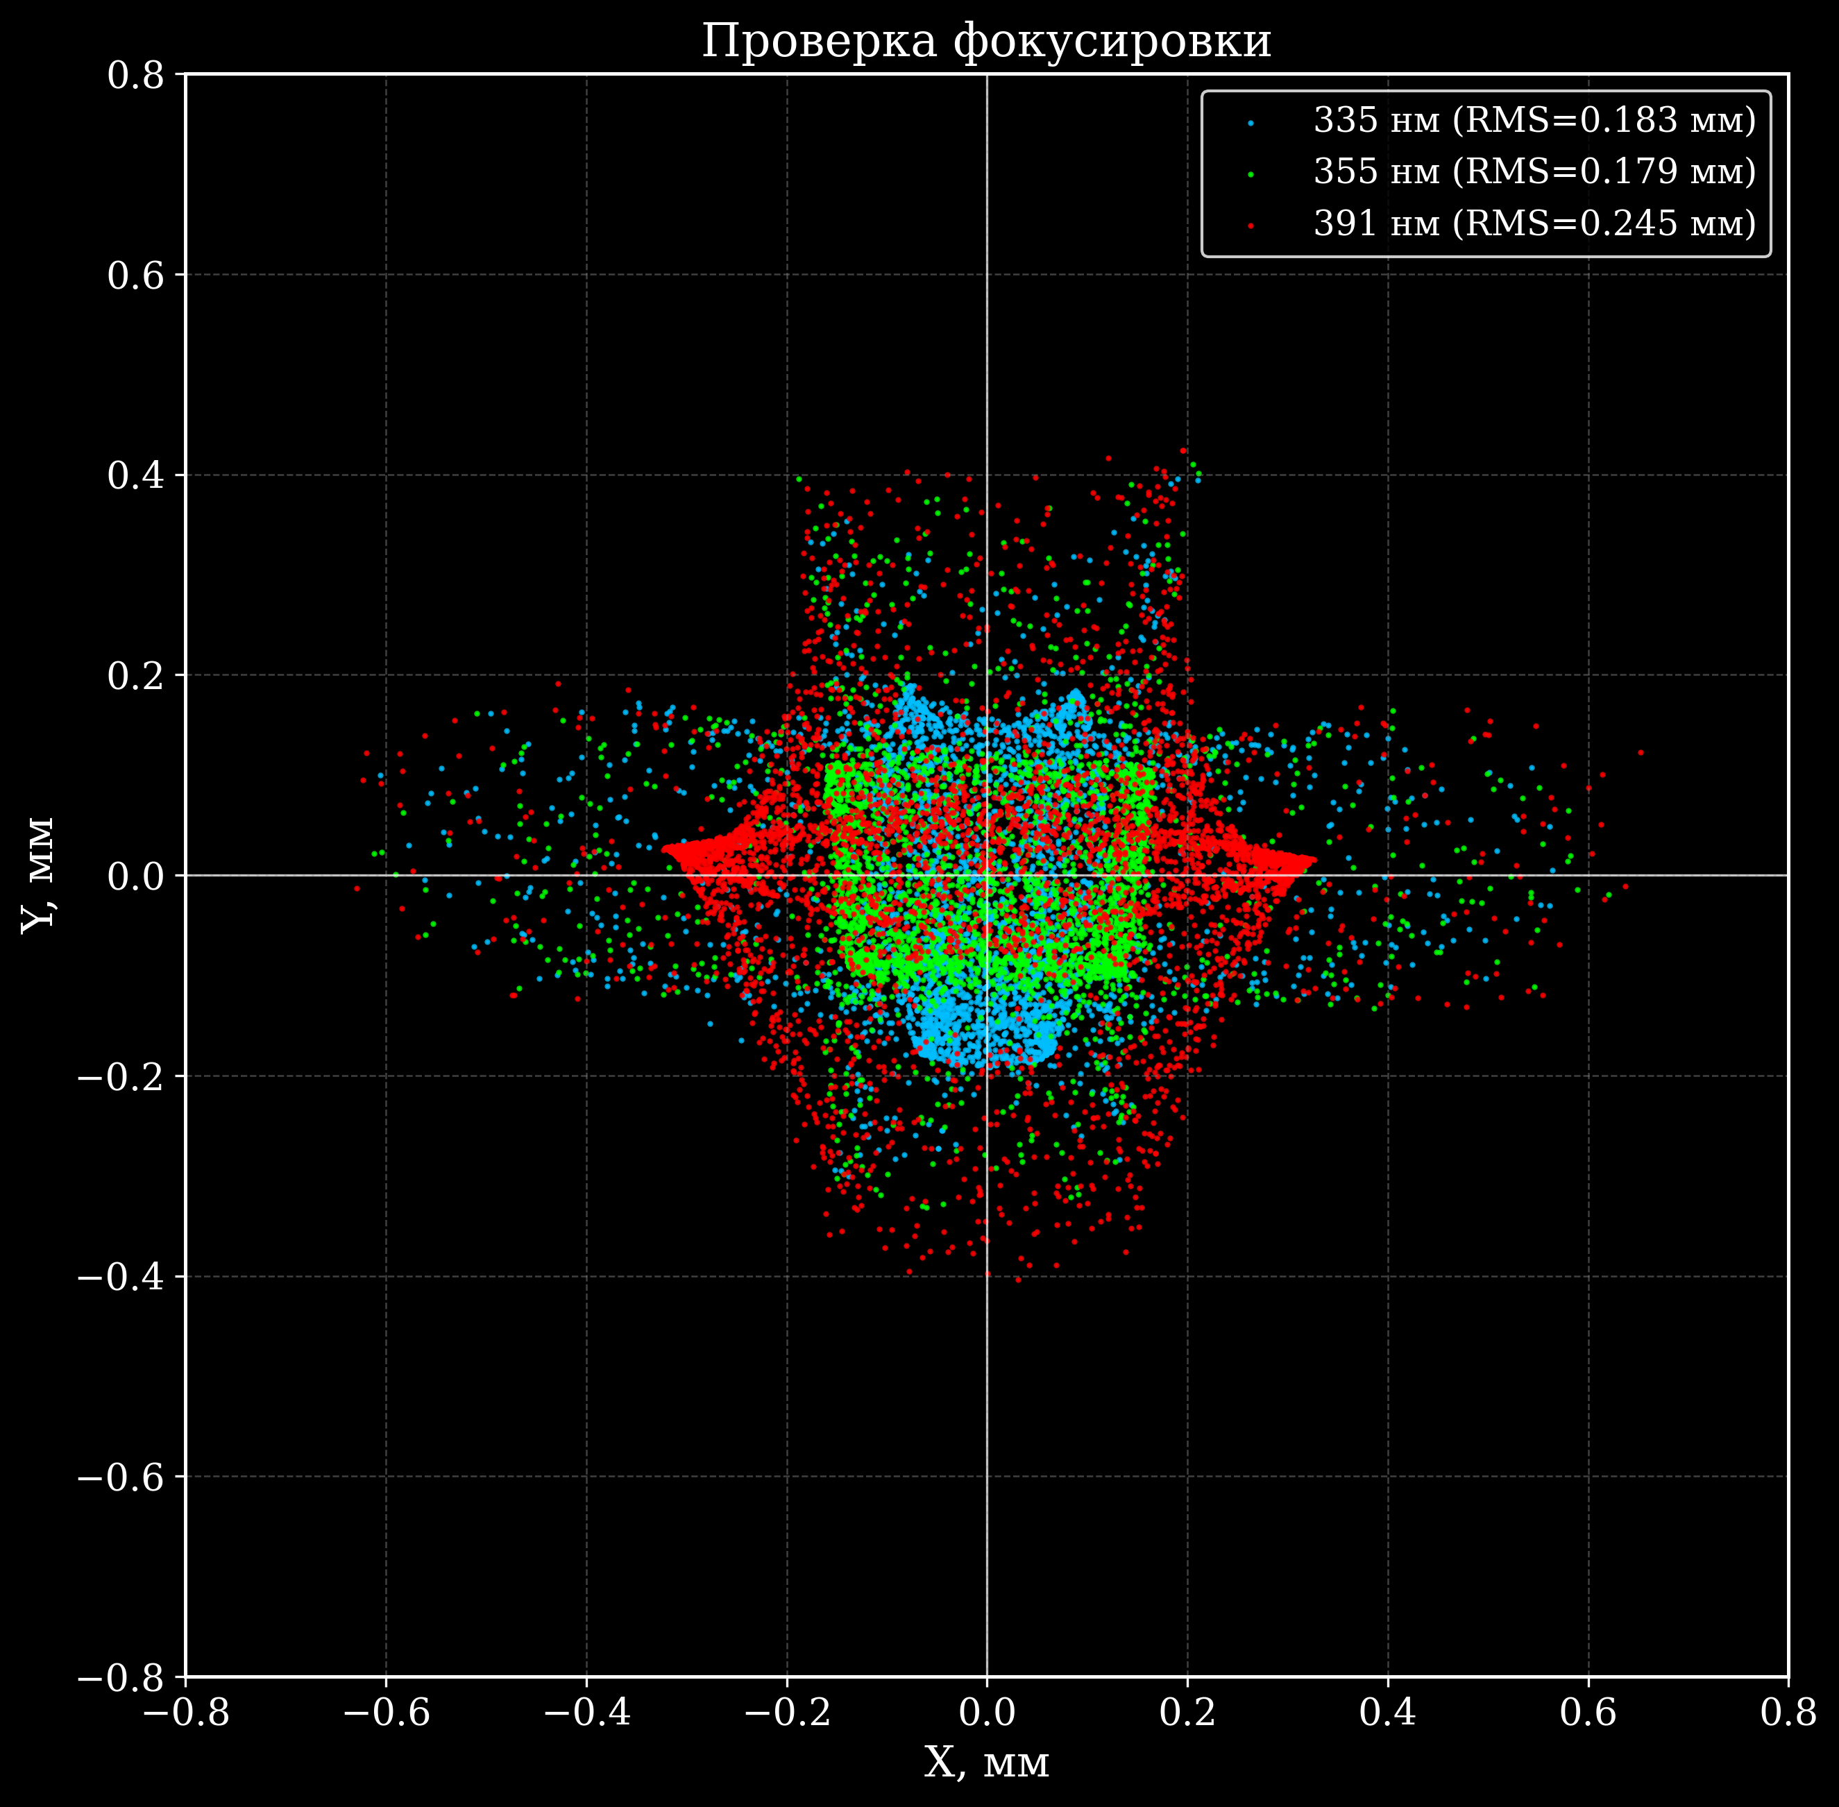
EUSO-OffLine
ERA simulations I
Abe S. et al. EUSO-Offline: A comprehensive simulation and analysis framework //Journal of Instrumentation. 2024.
γ = 0°
RMS₃₉₁ = 0.355 mm mm
γ = 4.6°
RMS₃₉₁ = 0.285 mm mm
γ = 9.4°
RMS₃₉₁ = 0.245 mm mm

Slide 19
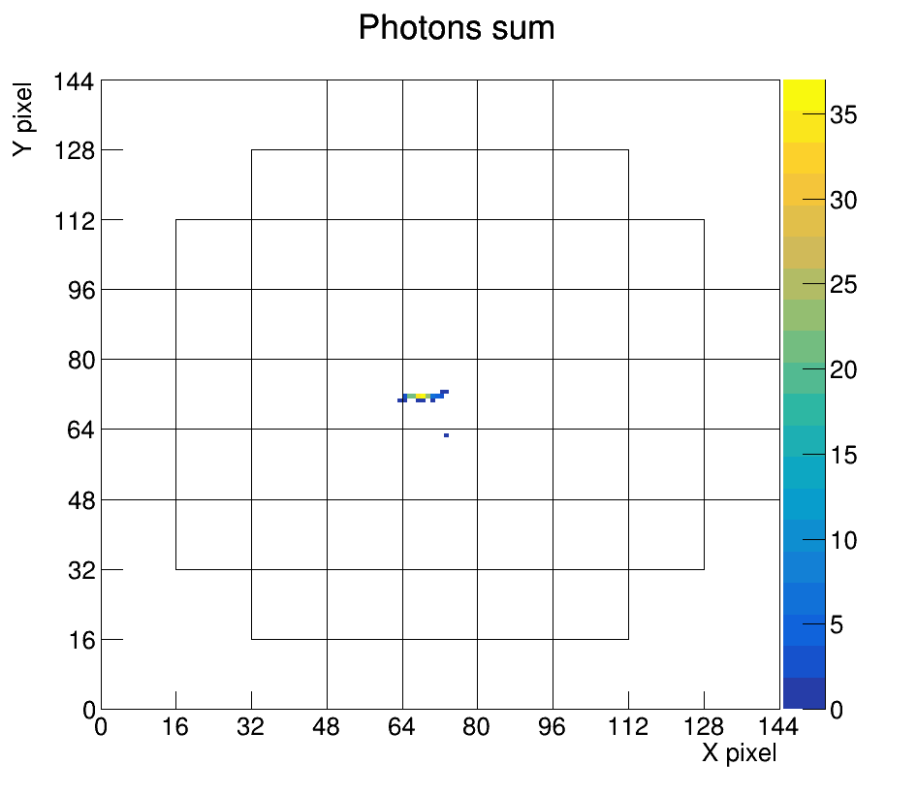
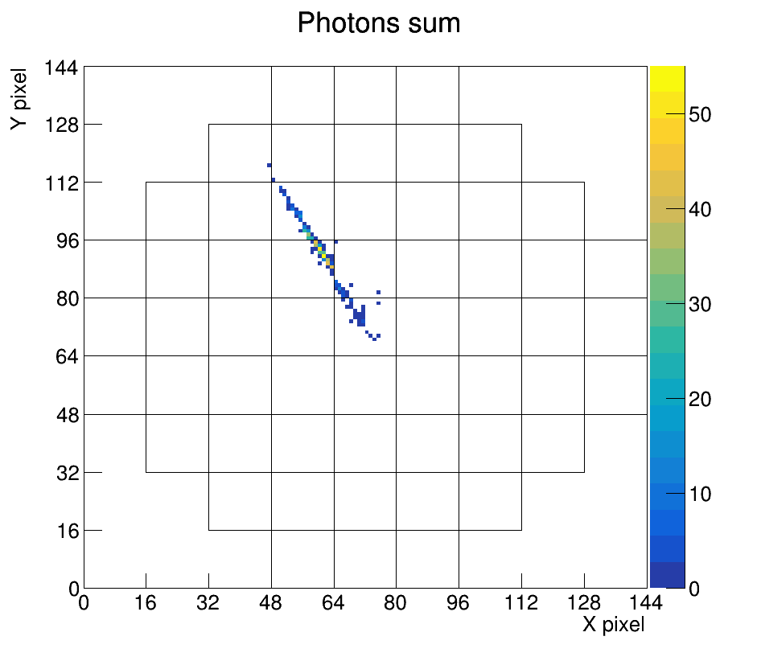
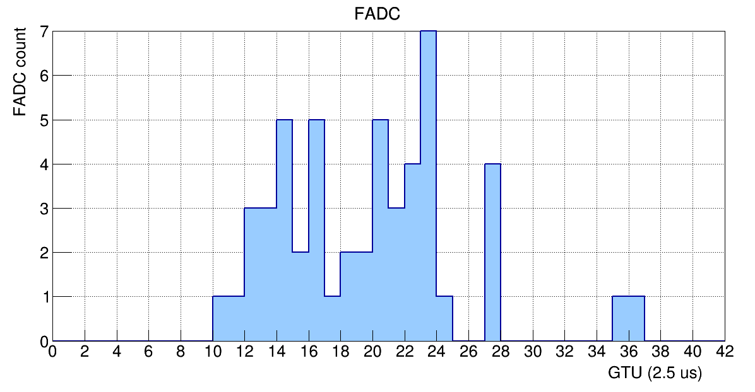
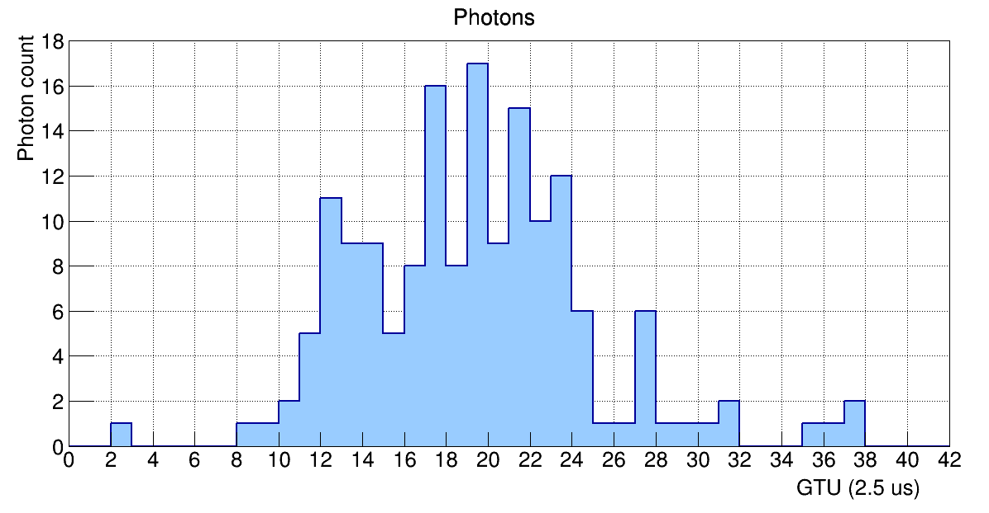
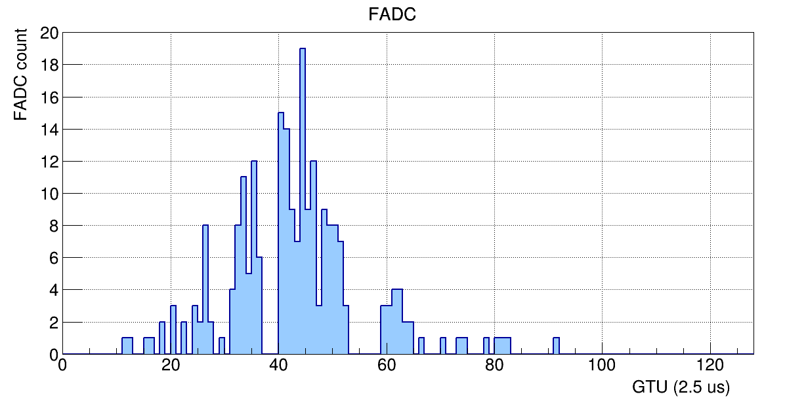
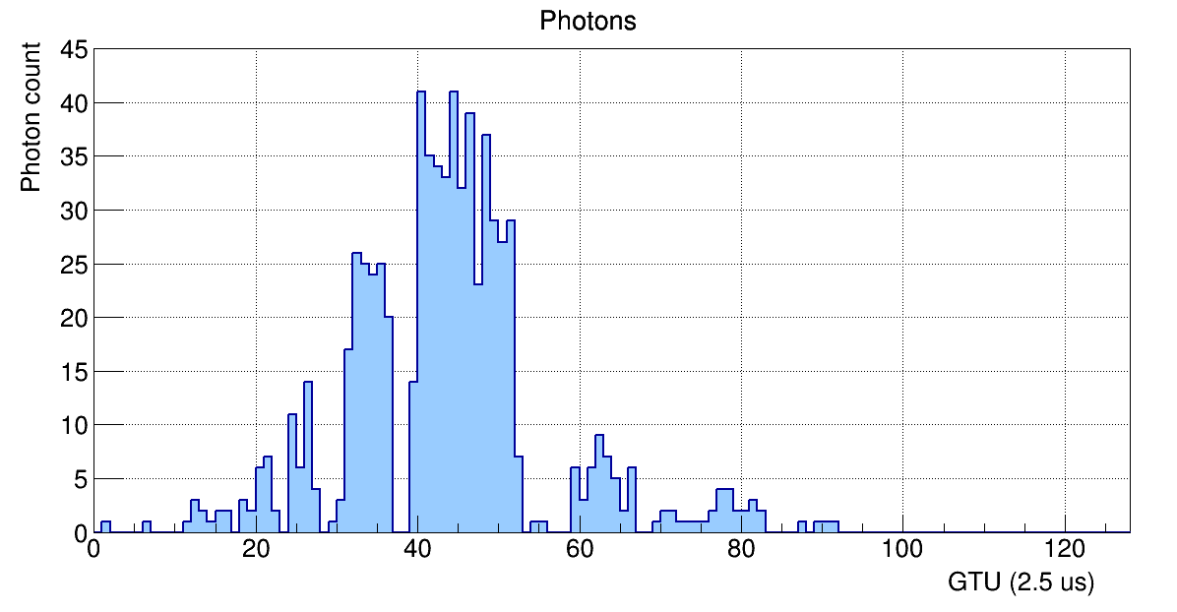
ERA simulations II
E = 10²⁰ eV
Θ = 38°
E = 10²⁰ eV
Θ = 70°

Slide 20
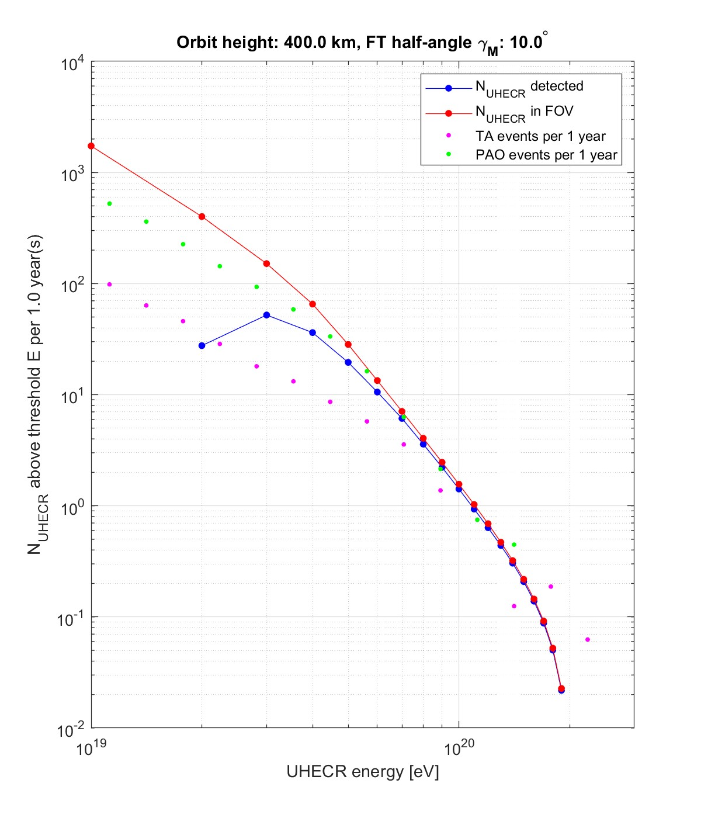
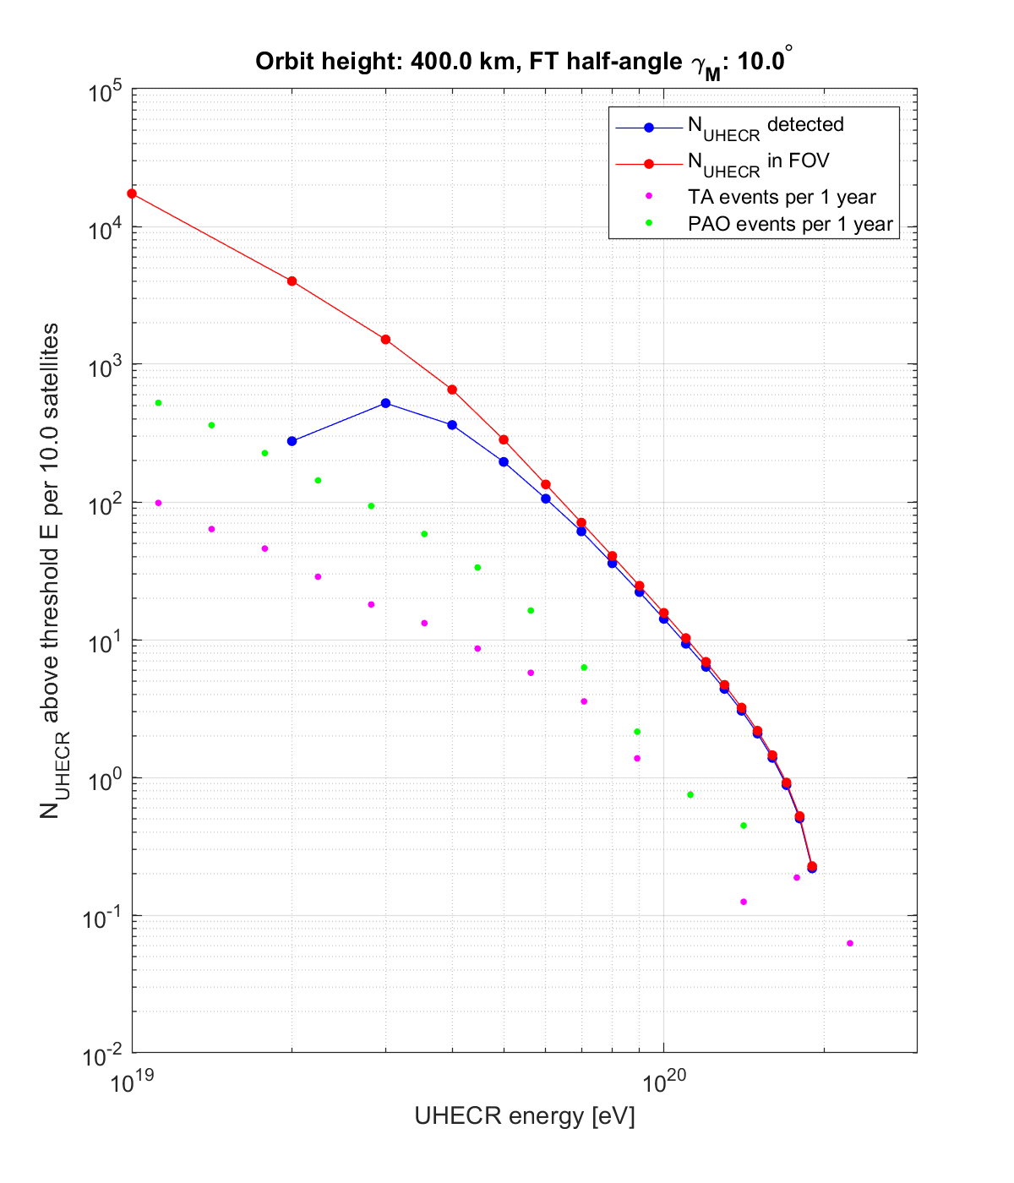
Expected scientific results
Parameters of one telescope:
Entrance pupil area S_{EP} = 2 m².
Effective area S_{EFF} = 1.4 m².
Field of view: γ_{max} = 10°.
Angular resolution: 2.1 mrad.
H_{sat} = 400 km
Expected number of events*:
One telescope 1 year:
N(E>50 EeV) = 20, N(E>100 EeV) = 1.5,
Two telescopes (1 year in mono):
N(E>50 EeV) = 40, N(E>100 EeV) = 3,
Whole project (10 telescopes, 5 years):
N(E>50 EeV) = 1000, N(E>100 EeV) = 75,
* Trigger system efficiency for the K-EUSO detector, calculated using the PAO spectrum, taking into account all factors affecting exposure: daytime part of the orbit, cloudiness, anthropogenic glow.

Slide 21
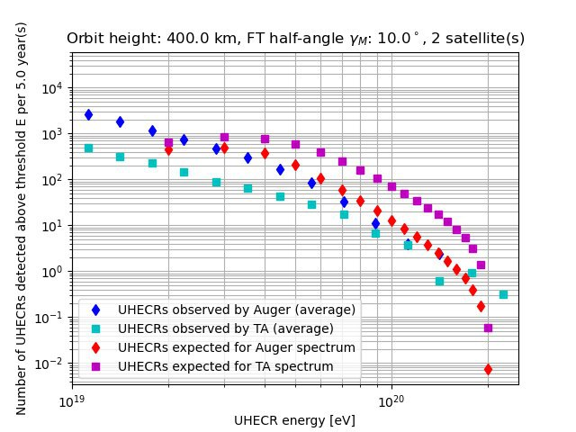
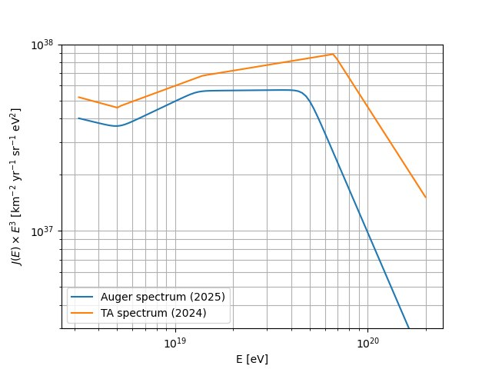
Expected scientific results
Both hemispheres will be observed by a single detector, which is important for verifying the differences between the PAO and TA.
Over the two years of operation of the two ERA satellites,
the spectral difference will be measured at a statistically significant level.

Slide 22
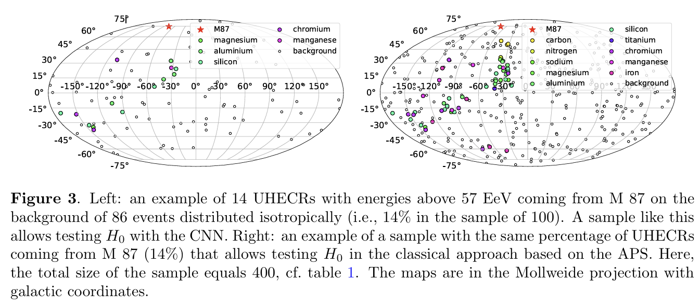

Study of the anisotropy of ultraviolet cosmic rays. Testing the hypothesis of a nearby source.
The number of events with energies above 57 EeV required to test the hypothesis of the existence of a nearby source (AGN) within a sphere with a radius of 20 Mpc (with uniform observation of the celestial sphere by a single detector).
APS – angular power spectrum
CNN – convolutional neural network
Oleg Kalashev, Maxim Pshirkov and Mikhail Zotov JCAP11(2020)005
Over the 3 years of operation of the two ERA satellites, a hypothesis test will be conducted for the nearby sources indicated in the table, with their contribution to the total flux at a level not exceeding 15%.

Slide 23

Observing Extreme Energy Particles – Searching for Nearby Sources
Telescope Array collaboration., Science 382 (2023) 903
M. Kuznetsov, JCAP 04 (2024) 042
The source must be no further than 4.7 Mpc with 95% C.L.!
Conservative: no further than 13.5 Mpc
Extensive statistics at high energies can allow us to identify a nearby source, even with significant deviations in the UHECR.
If particles with energies above 244 EeV are observed, we will know the source is even closer!
The 10 ERA detectors can register such events within approximately 3-4 years of operation.

Slide 24

UHECR composition estimations
Two approaches to estimating mass composition:
X_{max} measurement.
Mono mode – low X_{max} resolution (~100 g/cm² at E=100 EeV).
Stereo mode – X_{max} resolution ~30 g/cm² at E>50 EeV.
Estimating mass composition using anisotropy
Telescope Array collaboration., Phys.Rev.Lett. 133 (2024) 041001
Advantage of the ERA detectors: increased statistics with full sky coverage.
Expected result:
Verification and refinement of the composition estimate for E > 50 EeV
Ability to obtain, for the first time, a composition estimate in the range 50 < E < 100 EeV without using Xmax

Slide 25


Satellite requirements
Spacecraft mass – up to 150 (200) kg
Dimensions – determined by the launch capability
Electric power – approximately 160 W
Orbit: circular, altitude approximately 400 km
Orbit correction (altitude maintenance) is required.
Field-of-view convergence is required for stereo mode operation (controlled orientation of the small spacecraft).
Onboard memory – up to 200 GB. Daily data volume is approximately 20 GB. Optimization is possible through a trigger system or onboard data compression.
A high-speed communication link is required for downlinking scientific and telemetry data.
Orientation accuracy – 0.5 mrad (~0.03 deg) (1/2 the photodetector pixel size).

Slide 26


ERA satellite development
Preliminary studies of the spacecraft design
During transportation, the device fits under the fairing of the Soyuz rocket without folding.

Slide 27

Conclusions
THANK YOU FOR YOUR ATTENTION!
UHECR laboratory, Skobeltsyn Institute of Nuclear Physics, Moscow State University
(https://uhecr.sinp.msu.ru/)
P.A. Klimov
Pavel.Klimov@gmail.com
For the first time in the world, a system of orbital fluorescence telescopes (FTs) will be created, the main goal of which is to solve the fundamental mystery of the nature and origin of cosmic rays beyond the Greisen-Zatsepin-Kuzmin (GZK) cut-of.
The first observations of the entire celestial sphere will be carried out with a single instrument with uniform exposure.
Significant statistics of UHECR events with uniform exposure across the celestial sphere (more than 1000 events over 5 years of work) will be obtained and the reason for the discrepancies between the PAO and TA spectra will be clarified.
Independent estimates of the spectrum, arrival directions, and types (mass composition) of primary UHE particles will be conducted. This will allow us to test hypotheses about the existence of a nearby (at a distance of no more than ~20 Mpc) source of the corresponding CRs and, possibly, identify such a source.
The development of a swarm of satellites will make the project more reliable, cheaper and multifunctional.

Slide 29

Научные задачи проекта ЭРА
1) Физика космических лучей сверхвысоких энергий
Основная задача проекта — изучение космических лучей (КЛ) за пределом Грейзена-Зацепина-Кузьмина (ГЗК) с целью разрешения проблемы их природы и происхождения.
2) Физика элементарных частиц за пределами возможностей современных ускорителей.
Проверка моделей адронных взаимодействий при энергиях, по крайней мере на порядок превосходящих достижимые на Большом адронном коллайдере в ЦЕРН-е (в системе центра масс)
Поиск новой физики за пределами Стандартной модели (нарушение лоренц-инвариантности, распад сверхтяжелой темной материи)
3) Физика атмосферы
Транзиентные атмосферные явления, земные гамма всплески, авроральное свечения, метеоры
Эксперимент ЭРА сможет разрешить разногласия между результатами ведущих наземных экспериментов Pierre Auger Observatory и Telescope Array в части энергетического спектра КЛ ПВЭ, их химического состава и анизотропии направлений прихода в области энергий за пределом ГЗК.

Slide 30




Задел. Проект «КЛПВЭ» (K-EUSO) для МКС
Проработаны 2 варианта «КЛПВЭ»:
камера Шмидта и линзовый телескоп
Проведено моделирование работы аппаратуры с помощью пакета ESAF.
Эффективность 50% достигается около 40 ЭэВ.
Предполагая спектр Оже, ожидаемая частота регистрации КЛ ПВЭ: ~65 событий в год c E>50 ЭэВ, включая ~4 с E>100 ЭэВ.
Энергетическое разрешение: 15–25 %.
Угловое разрешение: 1–7° (зависит от энергии и зенитного угла).
Coleman A. et al. Astroparticle physics. – 2023. – Т. 149. – С. 102819.

Slide 31


Оптическая система «КЛПВЭ»
Характеристики системы, полученные в результате оптимизации параметров СЧ ОС.
Параметр | Значение, мм
Диаметр корректора (КОЭ) | 2500
Диаметр зеркала (СЗК) | 4000
Диаметр световой ФП | 1280
Радиус кривизны зеркала | 3450
Радиус кривизны ФП | 1800
Осевая длина системы | 3426
Осевое расстояние от зеркала до ФП | 1615
Полевой угол | 0˚ | 5˚ | 10˚ | 15˚ | 20˚
Доля энергии в пикселе | 0,74 | 0,92 | 0,89 | 0,75 | 0,55

Slide 32


Моделирование работы детектора
Трек ШАЛ на фотоприемнике «КЛПВЭ», снизу - в увеличенном виде изображен модуль фотоприемника, куда попал сигнал. Цветом обозначен интегральное значение сигнала (для простоты фон выключен).

Slide 33


Реконструкция параметров частицы
Энергетическое разрешение: 15-25 %
Угловое разрешение:
1° - 7° (зависит от энергии и зенитного угла).
Точность определения Xmax: 50-90 г/см²

Slide 34




Задел. Исследование фоновых условий регистрации КЛ ПВЭ в эксперименте «УФ атмосфера»
«УФ атмосфера» – прототип детектора КЛ ПВЭ на борту МКС.
Предполагая отсутствие луны и типичные соотношения доли земли/океана и ясной/облачной атмосферы, равные 30/70, средний уровень фона составляет 1,3 отсчета/пиксель/GTU (GTU – один такт измерения, равный 2,5 мкс). Ожидаемое соотношение фона (R) между НА «УФ атмосфера» и «КЛПВЭ» составляет:
$$R={\left(\frac{L_{UV}}{L_{КЛПВЭ}}\right)}^{2}×\frac{A_{UV}}{A_{КЛПВЭ}}×\frac{ε_{UV}}{ε_{КЛПВЭ}}$$
Ожидаемое отношение УФ-фона должно быть R = 1,4±0,3, т.е. ожидаемое среднее значение фона для «КЛПВЭ» составляет (0,93±0,20) отсчетов/пиксель/GTU.

Slide 35



Научная аппаратура. Механическая конструкция. Вариант 2.
Транспортировочное положение
Рабочее положение
Диаметр зеркала D_{M} = 2460 мм
Диаметр корректора D_{C} = 1600 мм
В транспортировочном состоянии прибор помещается под обтекателем РН «Союз» без складывания.
Процесс развертывания

Slide 36

светозащитный материал
блок электроники
светозащитный материал
Составной корректор
Составное зеркало R=2700 мм
штанга

Slide 37


1 Весь светозащитный материал условно не показан Радиус кривизны 2700 мм. 2 Эффективная площадь составного зеркала - 2,7 м^2
Вариант 1. Габаритные размеры
Свернутый светозащитный материал
Составное зеркало
блок электроники
Составной корректор

Slide 38




Транспортировочное положение
Раскрытие и рабочее положение

Slide 39


Вариант 2. Транспортировочное положение.

