Slide 1
Beable-guided structure of measurement
Presenter: Aleksei M. Aleshin. Based on the works:
Aleksei M. Aleshin, Vladimir V. Nikitin, Petr I. Pronin // Beable-guided measurement theory. 2024. arXiv:2404.09934v1.
Aleksei M. Aleshin, Vladimir V. Nikitin, Petr I. Pronin // Memoirs of the Faculty of Phys. 2023. № 4. 2341511.

Slide 2
Plan
Measurement problem
Measurement model in the de Broglie-Bohm theory
Quantum indeterminism in deterministic theory
Quantum contextuality

Slide 3
Measurement problem
Unitarity evolution of the system before measurement
$$\left.|ψ\right\rangle =\hat{U}\left.{|ψ}_{0}\right\rangle →i\frac{∂\left.|ψ\right\rangle }{∂t}={\hat{H}}_{1}\left.|ψ\right\rangle ,$$
$${\hat{F}}^{′}=\hat{U}\hat{F}{\hat{U}}^{−1}→i\frac{∂\hat{F}}{∂t}=\left[{\hat{H}}_{2},\hat{F}\right], \hat{F}\left.{|φ}_{n}\right\rangle =φ_{n}\left.{|φ}_{n}\right\rangle , \left\langle φ_{n} | φ_{m}\right\rangle =δ_{nm}$$
$\left.|ψ\right\rangle =\sum_{n}{c_{n}\left.{|φ}_{n}\right\rangle }, c_{n}=\left\langle φ_{n} | ψ\right\rangle$ - superposition principle,
$w\left(φ_{n} | ψ\right)=c_{n}^{2}=\left\langle ψ | φ_{n}\right\rangle \left\langle φ_{n} | ψ\right\rangle =Tr\left({\hat{ρ}}_{ψ}{\hat{ρ}}_{φ_{n}}\right)$ - Born’s rule,
Von Neumann projective postulate after measurement
$$\left.{|φ}_{n}\right\rangle =\frac{{\hat{ρ}}_{φ_{n}}\left.|ψ\right\rangle }{\sqrt{w\left(φ_{n} | ψ\right)}}$$
Can we derive von Neumann postulate from unitarity evolution?

Slide 4
von Neumann measurement theory
Measurement is entanglement between device $\left.|I\right\rangle$ and QS $\left.{|ψ}_{0}\right\rangle$
$$\hat{U}\left.{|ψ}_{0}\right\rangle \left.|I\right\rangle =\exp{(i{\hat{H}}_{I}δt)}\left.|ψ_{0}\right\rangle \left.|I\right\rangle =\sum_{n}{c_{n}\left.{|φ}_{n}\right\rangle \left.|I_{n}\right\rangle },$$
$$\left[{\hat{H}}_{I},{\hat{F}}_{ψ}\right]=0→\hat{H_{I}}=\hat{H_{I}}\left({\hat{F}}_{ψ},{\hat{F}}_{I}\right),$$
the simplest case
$${\hat{H}}_{I}={\hat{F}}_{ψ}{\hat{F}}_{I}=\frac{∂}{∂f}\frac{∂}{∂f_{I}}$$
Density matrix for QS
$${\hat{ρ}}_{ψ}=Tr_{I}\left.|ψ\right\rangle \left\langle ψ|\right.=\sum_{n}{\sum_{m}{c_{n}c_{m}\left.{|φ}_{n}\right\rangle \left\langle φ_{m}|\right.}\sum_{i}{I\left(f_{i}−λf_{n}t\right)I\left(f_{i}−λf_{m}t\right)}},$$
$I\left(f_{I}−λft\right)I\left(f_{I}−λf′t\right)=0, f≠f′$ - diagonalization of density matrix.

Slide 5
The de Broglie-Bohm theory
Unitarity evolution of wave function
$$i\frac{∂ψ}{∂t}=\hat{H}ψ,$$
Guidance equation
$$\frac{d\vec{x}}{dt}=\frac{\vec{j}}{ρ}$$
Here $ρ={\left|ψ\right|}^{2}$ - probability density,
$j$ – probability flow density.
$$\frac{∂ρ}{∂t}+div\vec{j}=0$$
The pilot wave - quantum liquid.
de Broglie particles – particles of the liquid.

Slide 6
Measurement model
The classic character of the device:
Device wave-function is real. For gaussian-form
$$I\left(f_{I}−λft\right)=\frac{1}{\sqrt{σ}\sqrt[4]{2π}}\exp\left(−\frac{1}{2σ}{\left(f_{I}−λfT\right)}^{2}\right),$$
$T=\frac{6σ}{λ\left(f−f^{′}\right)}$ - measurement time.
2) Devise is massive.
$\hat{H_{I}}=λ\hat{F}\frac{∂}{∂r}$ - interaction Hamiltonian,
$ψ\left(q,r,t\right)=\int{df^{′}F\left(f^{′},q,t\right)I\left(r−λf^{′}t\right)}$ - wave function.
Beable dynamics
$$\vec{v_{q}}=\frac{d\vec{q}}{dt}=\frac{\vec{j_{ψ}}}{ρ}, \vec{v_{r}}=\frac{d\vec{r}}{dt}=\frac{\vec{j_{I}}}{ρ}$$
Device arrow velocity $v_{r}$ encoded measurement result.

Slide 7
Tasks
Modelling of QS beable behavior in measurement process of canonical-conjugate observables.
Establishment of the unpredictability of measurement results in deterministic theory.
Investigation of opportunities to break uncertainty principle in dBB-formalism.

Slide 8
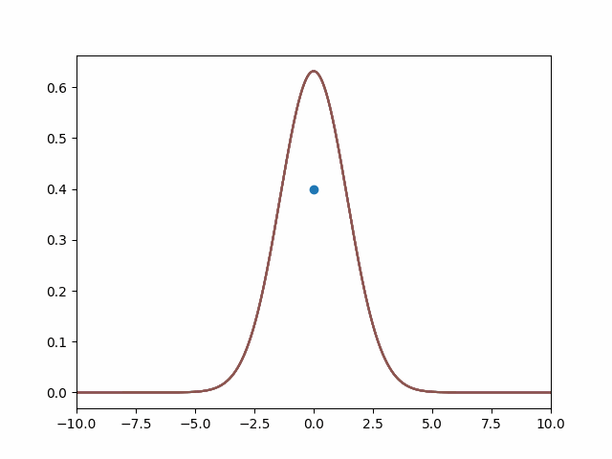
Coordinate measurement
Interaction Hamiltonian
$${\hat{H}}_{I}=−iλq\frac{∂}{∂r}$$
The wave-function
$$ψ=\int{δ\left(q−q^{′}\right)Q\left(q^{′}\right)R\left(r−λq^{′}t\right)dq^{′}}$$
Density matrix
$$ρ_{ψ}=Q\left(q\right)Q\left(q^{′}\right)\int{drR\left(r−λqt\right)R\left(r−λq^{′}t\right)}$$
Guidance equation for particles
$$v_{q}=0, v_{r}=λq$$

Slide 9
Momentum measurement
Interaction Hamiltonian and corresponding wave-function
$${\hat{H}}_{I}=−λ\frac{∂^{2}}{∂q∂r},$$
$$ψ=\int{dp^{′}K\left(r−λp′t\right)P\left(p^{′}\right)\exp\left(i\left(p^{′}q−\frac{{p^{′}}^{2}}{2m}t\right)\right)}.$$
In the case $P\left(p′\right)=A_{1}δ\left(p^{′}−p_{1}\right)+A_{2}δ\left(p^{′}−p_{2}\right)+…+A_{n}δ\left(p^{′}−p_{n}\right)$ guiding equation
$$v_{r}=\frac{λ}{2}\frac{\sum_{i=1}^{n}{\sum_{j=1}^{n}{A_{i}A_{j}K_{i}K_{j}\left(p_{i}+p_{j}\right)\cos{α_{ij}}}}}{\sum_{i=1}^{n}{\sum_{j=1}^{n}{A_{i}A_{j}K_{i}K_{j}\cos{α_{ij}}}}},$$
$$v_{q}=\frac{v_{r}}{λm} + \frac{λ}{2}\frac{\sum_{i=1}^{n}{\sum_{j=1}^{n}{A_{i}A_{j}K_{i}K_{j}\left(\frac{K_{j}^{′}}{K_{j}}+\frac{K_{i}^{′}}{K_{i}}\right)\sin{α_{ij}}}}}{\sum_{i=1}^{n}{\sum_{j=1}^{n}{A_{i}A_{j}K_{i}K_{j}\cos{α_{ij}}}}},$$
Here $K_{i}=K\left(r−λp_{i}t\right), K_{i}^{′} =\frac{∂K\left(r−λp_{i}t\right)}{∂r}, α_{ij}= \left[\left(p_{i}−p_{j}\right)q +\frac{1}{2m}\left(p_{j}^{2}−p_{i}^{2}\right)t\right].$
Density matrix
$$ρ_{ψ}=\iint{dpdp^{′}P\left(p\right)P\left(p^{′}\right)\exp{iα_{ij}}\int{drK\left(r−λpt\right)K\left(r−λp^{′}t\right)}}=\sum_{i=1}^{n}{\sum_{j=1}^{n}{A_{i}A_{j}K_{i}K_{j}\exp{iα_{ij}}}}.$$

Slide 10
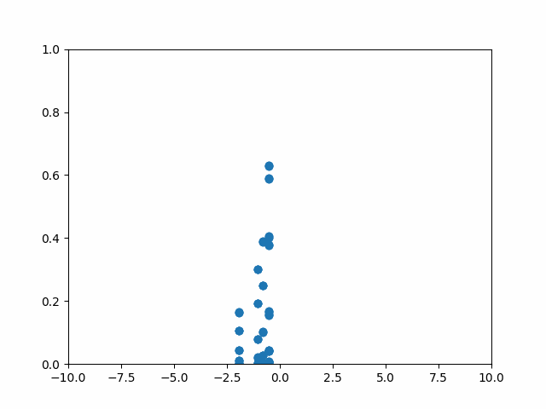
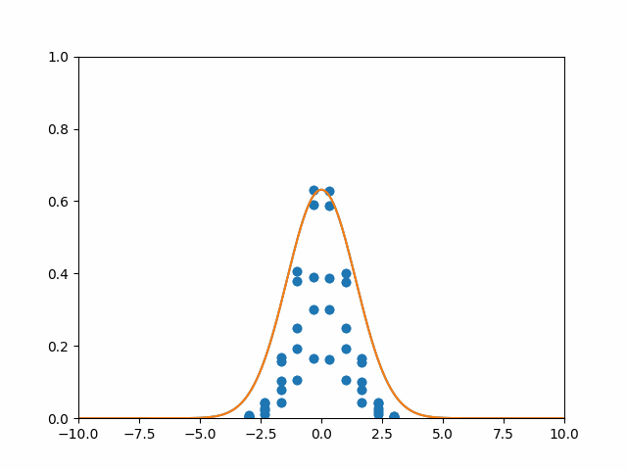
Numerical simulation
In the case $P\left(p^{′}\right)=A_{1}δ\left(p′−p_{1}\right)+A_{2}δ\left(p′−p_{2}\right)$.
$$ψ \left(p^{′}\right)=\frac{1}{\sqrt{2}}δ\left(p′−1\right)+\frac{1}{\sqrt{2}}δ\left(p^{′}+1\right)$$
$$ψ \left(p^{′}\right)=\frac{1}{\sqrt{10}}δ\left(p′−1\right)+\frac{3}{\sqrt{10}}δ\left(p^{′}+1\right)$$

Slide 11
Born's rule. Impulse probability distribution
If $p=p_{B}=m\frac{dx_{B}}{dt}$ then Born’s rule violate:
Kurt Jung // J. Phys.: Conf. Ser. 2013. 442. 012060.
Michael Nauenberg // Quanta. 2014. 3. P. 43.
Dennis M. Heim // arXiv. 2022. 2201.05971.
$p≠p_{B}=m\frac{dx_{B}}{dt}$ - beable isn’t observable.

Slide 12
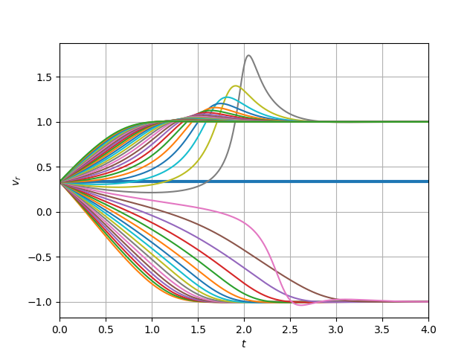
Quantum contextuality
Quantum system is not described by a specific physical quantity outside the context of its measurement.
Quantum potential is origin of QC in deBB-theory:
$$\frac{∂S}{∂t} +λ\frac{∂S}{∂r}\frac{∂S}{∂q}+\frac{1}{2m}{\left(\frac{∂S}{∂q}\right)}^{2}+Q= 0$$
$$Q=− λ \frac{A_{rq}^{′′}}{A} −\frac{1}{2m}\frac{A_{qq}^{′′}}{A}$$
Measurement outcomes depend on initial states of
device particles – quantum contextuality

Slide 13
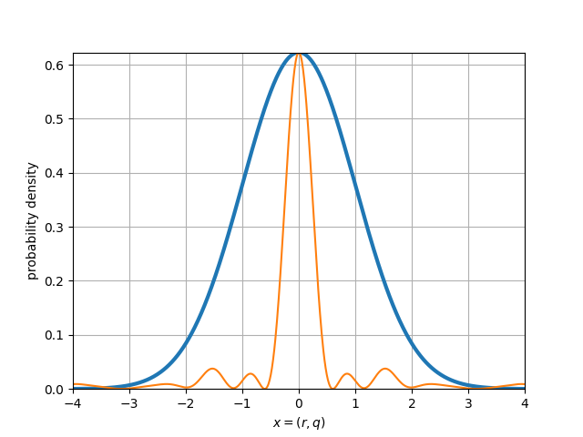
The Heisenberg principle
Is it possible to break the uncertainty relation in de Broglie-Bohm theory?
$$i\frac{∂ψ}{∂t}+iλ_{1}q\frac{∂}{∂r_{1}}θ\left(T_{1}−t\right)+λ_{2}\frac{∂^{2}ψ}{∂q∂r_{2}}Δθ_{p}+iλ_{3}q\frac{∂ψ}{∂r_{3}}Δθ_{q}+\frac{1}{2m}\frac{∂^{2}ψ}{∂q^{2}}=0$$
After the first coordinate measurement, the wave-function will be the (regularized) delta-function
$$δ\left(q−q′\right)=\int_{−∞}^{∞}{dp^{′}\exp\left(ip^{′}\left(q−q^{′}\right)\right)}→δ_{R}=\sum_{n=−N}^{N}{\exp\left(ip_{n}\left(q−q^{′}\right)\right)}$$

Slide 14
Conclusion
The QS beable behavior in projective canonical conjugate-observables measurement in the de Broglie-Bohm theory is modeled.
The unpredictability of measurement results in according to uncertainty principle in deterministic theory is established.
The anomalous models of measurement, in which uncertainty principle break is found.

Slide 15
Bibliography
[1] Aleksei M. Aleshin, Vladimir V. Nikitin, Petr I. Pronin// Memoirs of the Faculty of Phys. 2023. N 4.
[2] Aleksei M. Aleshin, Vladimir V. Nikitin, Petr I. Pronin // Memoirs of the Faculty of Phys. 2023. № 4. 2341511.
[3] Kurt Jung // J. Phys.: Conf. Ser. 2013. 442. 012060.
[4] Michael Nauenberg // Quanta. 2014. 3. P. 43.
[5] Dennis M. Heim // arXiv. 2022. 2201.05971.
[6] Olival Freire Jr, Guido Bacciagaluppi, Olivier Darrigol, etc // Oxford University Press. QC173.98.O94 2022.
[7] de Broglie L. // E ́lectrons et Photons. 1928. P. 105.
[8] Bohm D. // Phys. Rev. 1952. 85, 166.
[9] Bohm D. // Phys. Rev. 1952. 85, 180.
[10] Antony Valentini, Hans Westman // Proc.Roy.Soc.Lond. 2012. 468, N. 2140. P. 990.

