Slide 1

Axion-like particle emission from type Ia supernovae
Davydov Daniil
INR RAS, MSU
Physics Department, M.V. Lomonosov Moscow State University,
Institute for Nuclear Research of the Russian Academy of Sciences
Quarks-2024
19-24 May 2024
ppc.inr.ac.r1/19

Slide 2
Plan
- Main ideas of axion-like particles;
- Primakoff effect in stars ;
- Axion spectrum from type Ia supernova;
- Von Neumann formalism;
- Magnetic field models in Milky Way and M82;
- ALP-photon system propagation in different areas;
-Photon flux on Earth.
ppc.inr.ac.ru
ppc.inr.ac.r2/19

Slide 3
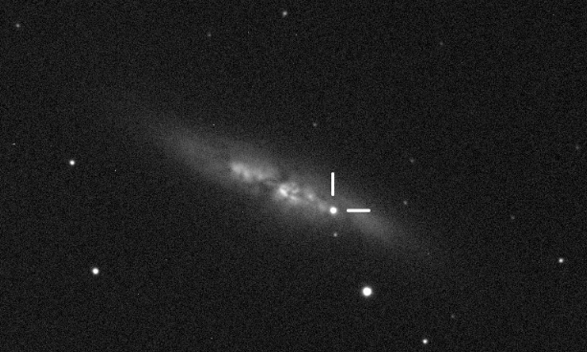
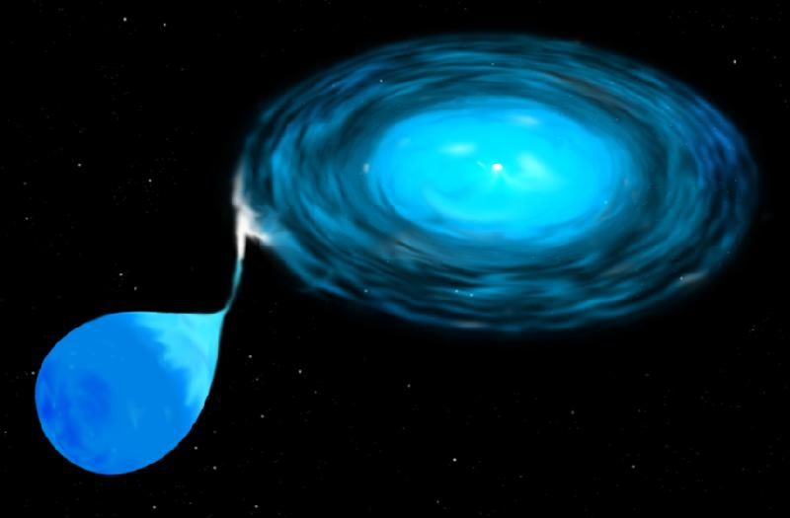
A Type Ia supernova is a type of supernova that occurs in binary systems (two stars orbiting one another) in which one of the stars is a white dwarf. Luminosity - 10⁴³ erg/sec, billions of times that of the Sun( ~10³³ erg/s).
Рис. 1 SN2014J in M82, view on 22 January 2014. The position of the supernova is marked.
Рис. 2 An accretion disc forms around a compact body (such as a white dwarf) stripping gas from a companion giant star. NASA image
The purpose of the work: to theoretically predict the number of photons from supernovae arriving on Earth due to action-like particles from SN2014J, and then searching for them in telescope data.
ppc.inr.ac.ru
ppc.inr.ac.r3/19

Slide 4


STEP 1
Axion-like particles
We will consider the interaction of the electromagnetic field A_{µ} and the ALP field a. The following Lagrangian can be described as:
where
The last term is responsible for axion-photon mixing in the external magnetic field.
ppc.inr.ac.ru
ppc.inr.ac.r4/19

Slide 5
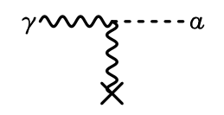
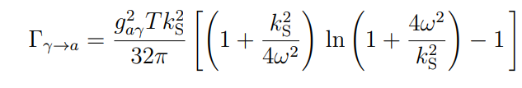
Primakoff process in stars
The two-photon coupling of pions or other pseudoscalars allows for the conversion a ←→ γ in an external electric or magnetic field by virtue of the amplitude.
Рис. 3 Сonversion between axions and photons in an external electromagnetic field via Primakov effect.
we consider only Primakoff effect to produce these particles. We can write an expression for the
transition rate ("decay rate") of a photon of frequency ω into an axion of the same energy
ppc.inr.ac.ru
ppc.inr.ac.r5/19

Slide 6

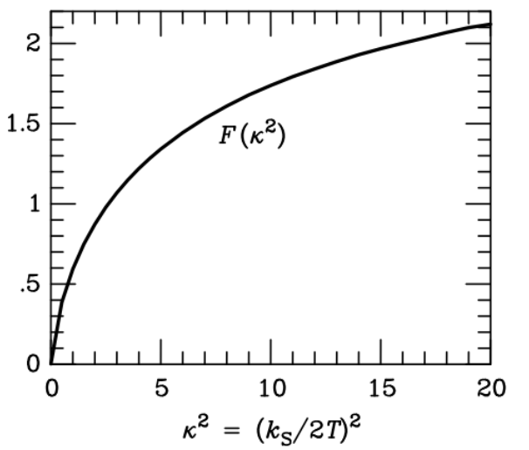

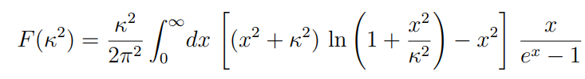

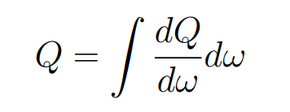
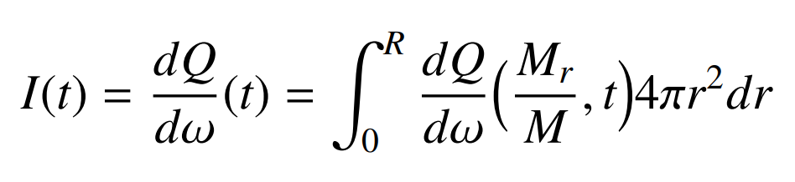
We can also write the energy-loss rate per unit volume:
where
and
with
We are interested in energy release per unit volume of axions with energies from ω to ω + dω, thus we rewrite:
Taking this integrand function over the volume, we obtain the spectrum of axions from the supernova:
ppc.inr.ac.ru
ppc.inr.ac.r6/19

Slide 7
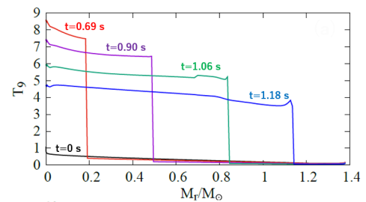
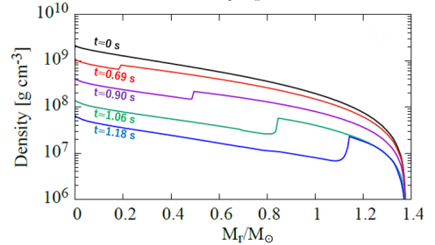

SN Ia model
In this study a W7 (Nomoto, Thielmann, Yokoi 1984) as the SN Ia model is adopted. Figures shows the profiles of the temperature and the density in the W7 model:
Рис. 5 The profiles of temperature and density n the SN Ia model as a function of the mass coordinate M_{r}
ppc.inr.ac.r7/19

Slide 8
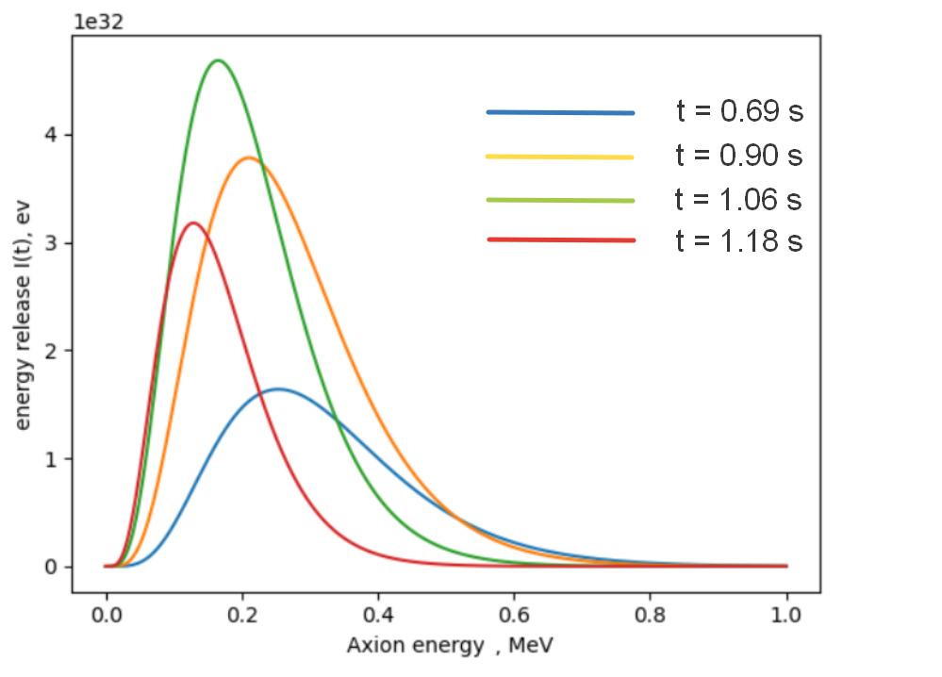
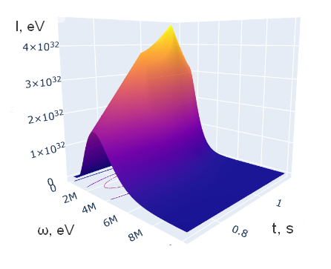
SN Ia axion spectrum
We are interested in the axion spectrum of SN Ia as a function of time after the ignition.
Spectrum from SN Ia
Рис. 6 ALP spectrum from a type Ia supernova at different times
after the explosion
Рис. 7 ALP spectrum from a type Ia supernova at different times after the explosion in 3d view.
ppc.inr.ac.ru
ppc.inr.ac.r8/19

Slide 9
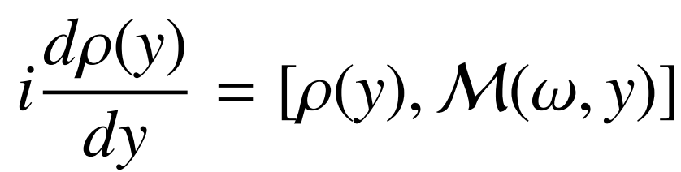
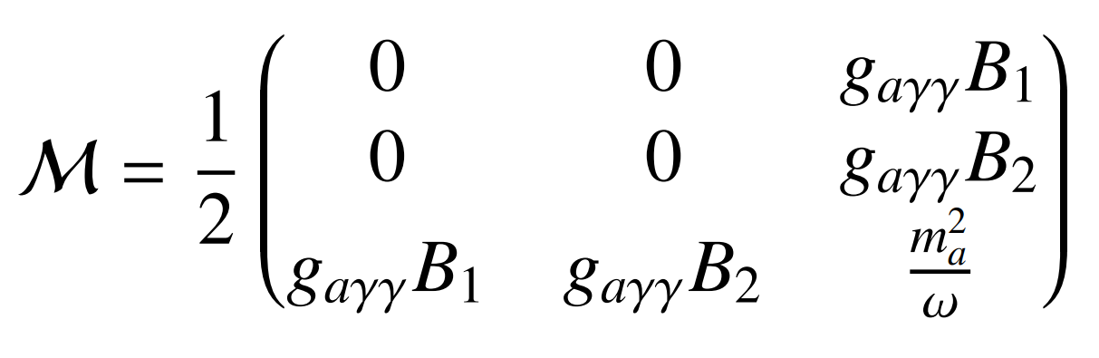
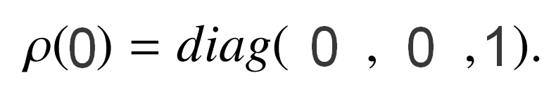
STEP 2
Von Neumann formalism
In this formalism the density matrix obeys the Liouville equation:
Где матрица смешивания выглядит следующим образом:
and the magnetic field components B1 and B2 are directed along two photon polarizations.
For an initial axion state:
ppc.inr.ac.ru
ppc.inr.ac.r9/19

Slide 10
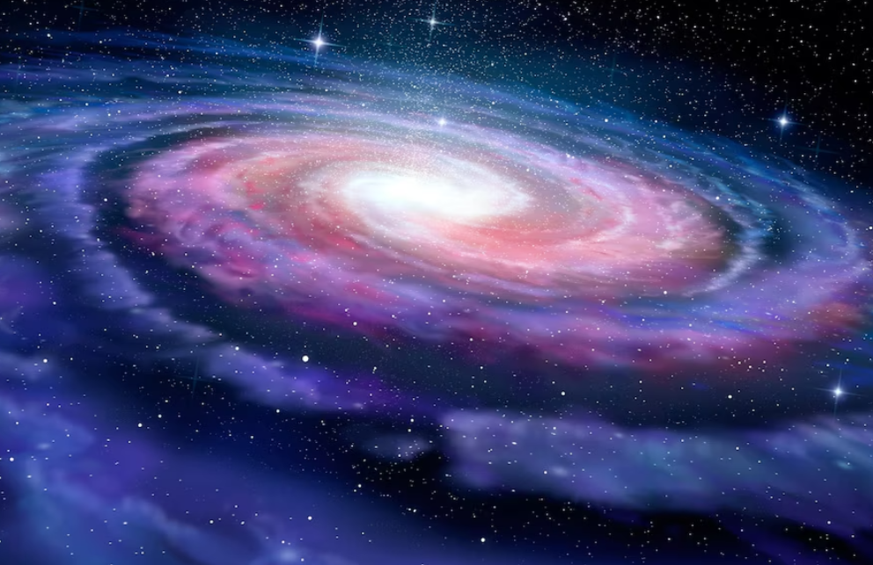
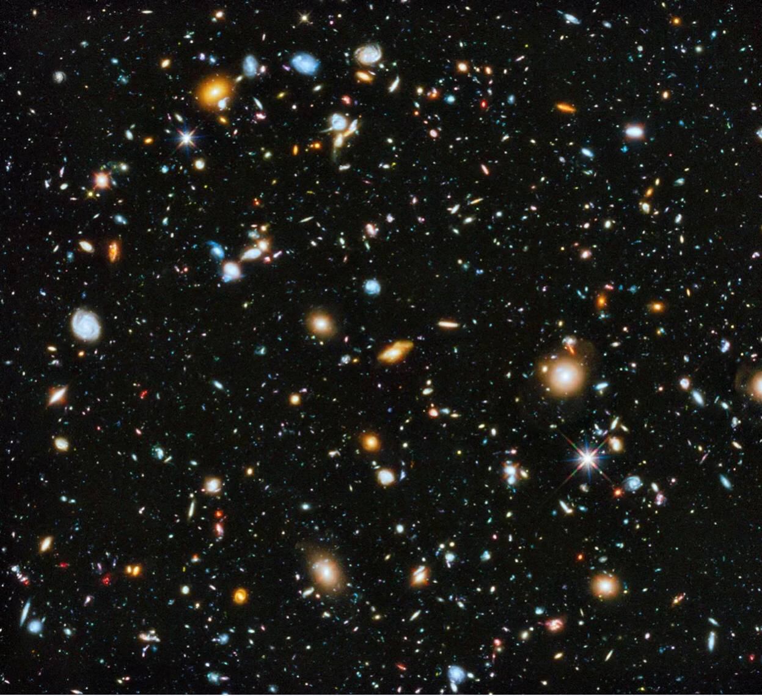
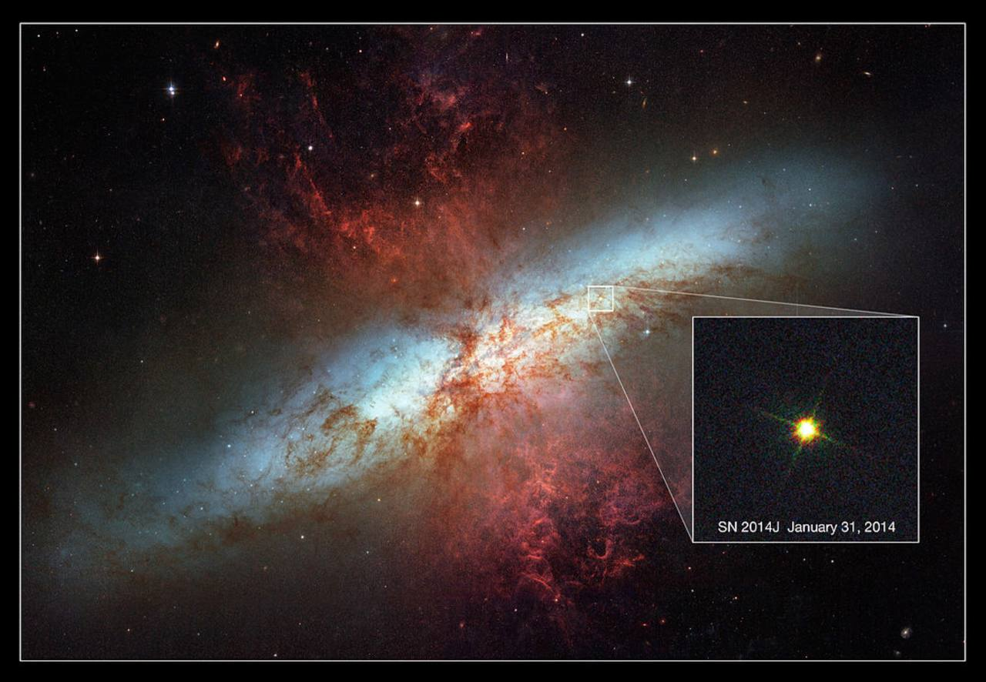


STEP 2
Main idea
Milky Way
Intergalactic space
Starburst galaxy M82
Magnetic field of Milky Way
Intergalactic magnetic field
Magnetic field
of M82
SN 2014J
Some Photons may be detected
ALP + Photons
ALP + Photons
ALP
ppc.inr.ac.r10/19

Slide 11
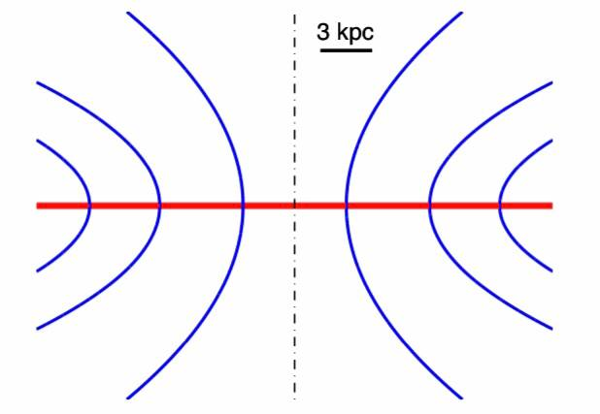
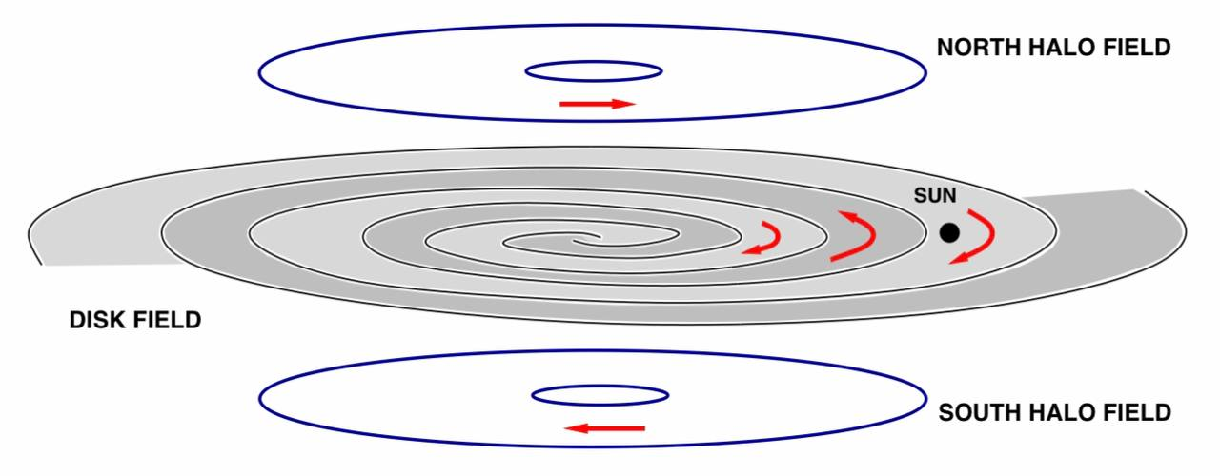
STEP 2
Magnetic field of Milky Way
We adopt a general model of the Galactic magnetic field consisting of two different components (disk field and a halo field) with additional component of the halo field (X-shape):
Sketch of the structure of the magnetic field (M. S. Pshirkov, P. G. Tinyakov, P. P. Kronberg and K. J. Newton-McGee )
X-shape magnetic field
ppc.inr.ac.ru
ppc.inr.ac.r11/19

Slide 12
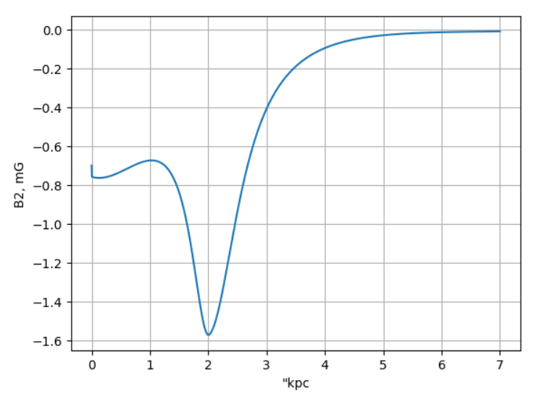
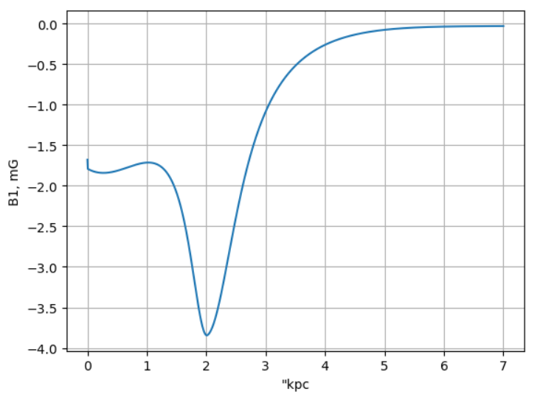
STEP 2
Magnetic field of Milky Way
With this model we can obtain magnetic field components B1 and B2, which occurs in mixing matrix.
ppc.inr.ac.ru
ppc.inr.ac.r12/19

Slide 13
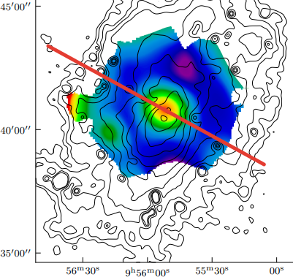
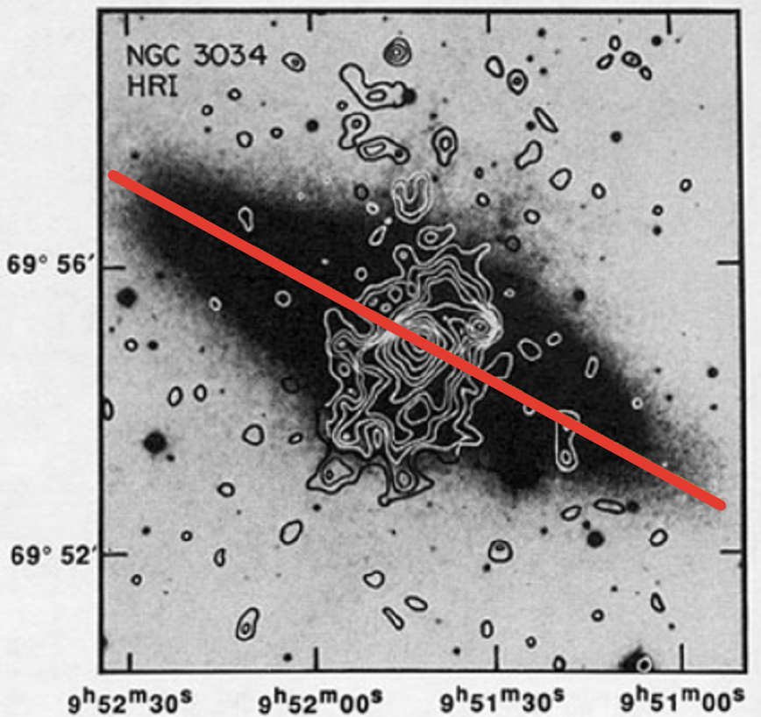
STEP 2
Magnetic field of M82
First, we take observations of MF in M82:
Observations of strength magnetic field
Xray Spectral region, NASA/IPAC Extragalactic Database (Einstein telescope)
To obtain the magnetic field across the galactic disk we take a slice (red line).
ppc.inr.ac.ru
ppc.inr.ac.r13/19

Slide 14
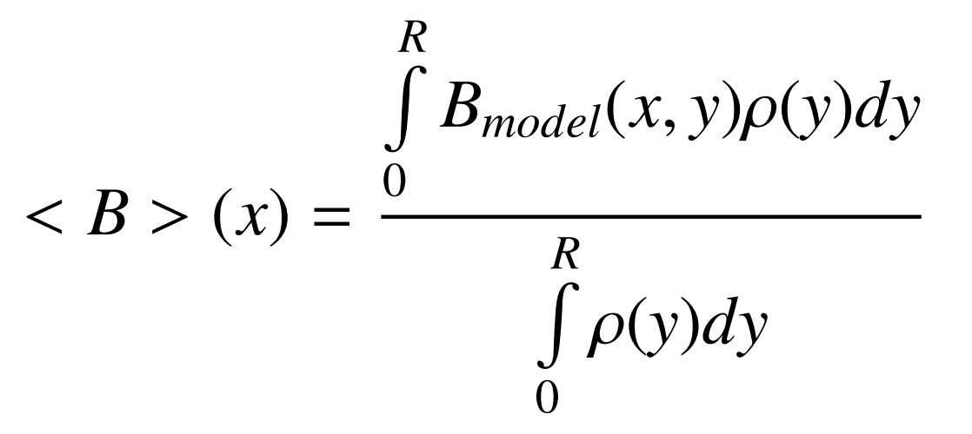
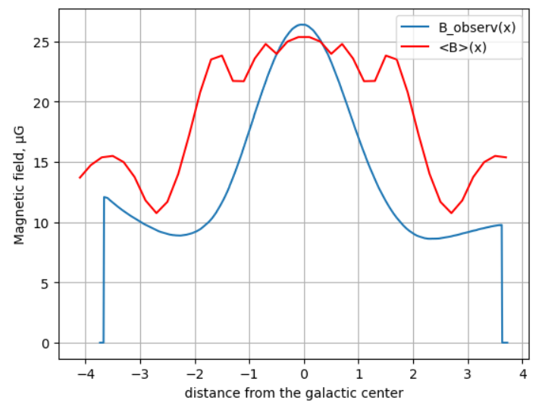
STEP 2
Magnetic field of M82
1.) To match the model with observations we define (z = 0):
2.) Then we plot both magnetic fields to obtain the best fit between them:
2.) As a result, we get the definition of some parameters (B₀ for disk field and B₁ for X-shape MF).
ppc.inr.ac.ru
ppc.inr.ac.r14/19

Slide 15
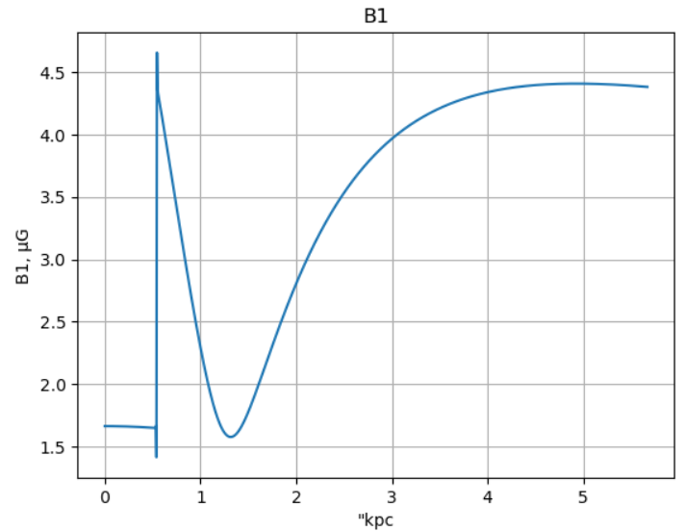
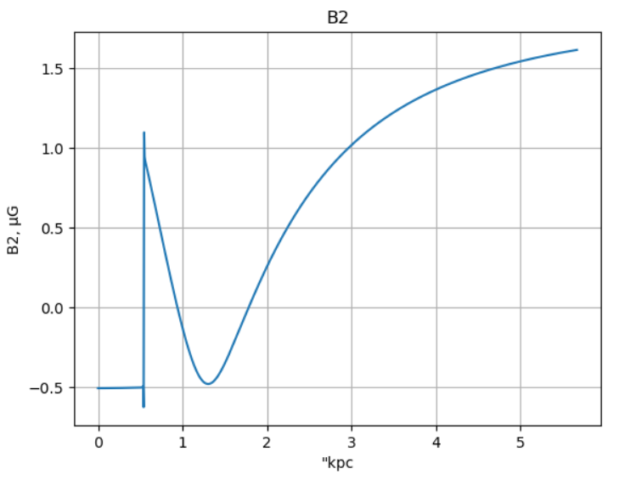
STEP 2
Propagation of ALP in M82
Now we can plot B1 and B2 magnetic fields in M82, which are perpendicular to the propagation of ALPs from SN2014J to Milky Way:
ppc.inr.ac.ru
ppc.inr.ac.r15/19

Slide 16
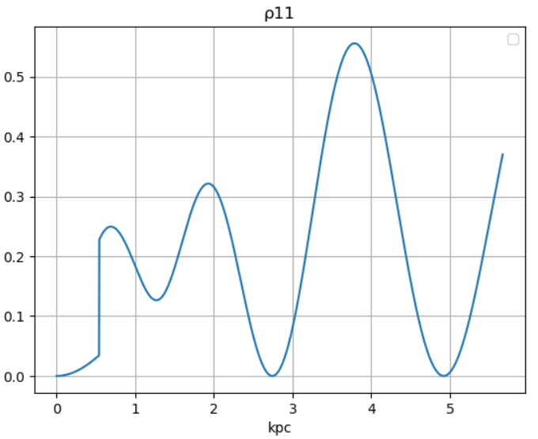
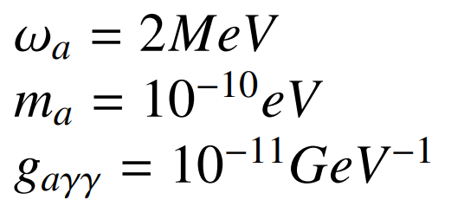
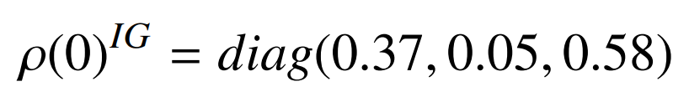
STEP 2
Propagation of ALP in M82
Substituting the magnetic fields in the mixing matrix, we numerically solve the Liouville equation of the ALP-photon oscillations in the M82 galaxy:
ρ₁₁ = 0.37
Parameters:
The final state of ρ₁₁ (ρ₂₂ and ρ₃₃) in the M82 corresponds to the initial condition of ρ₁₁(0) in the intergalactic space, thus
ppc.inr.ac.ru
ppc.inr.ac.r16/19

Slide 17
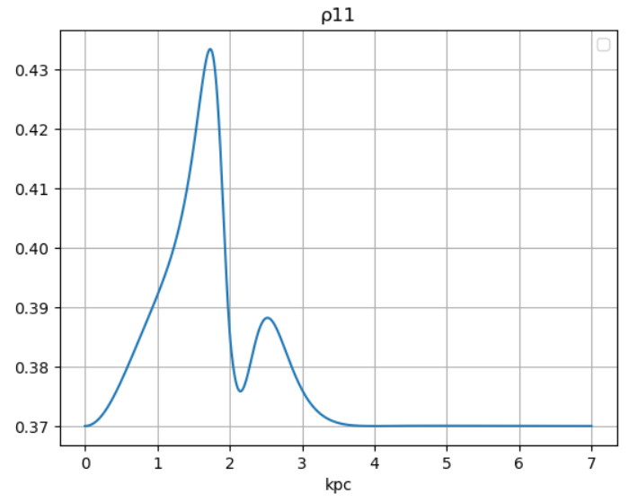
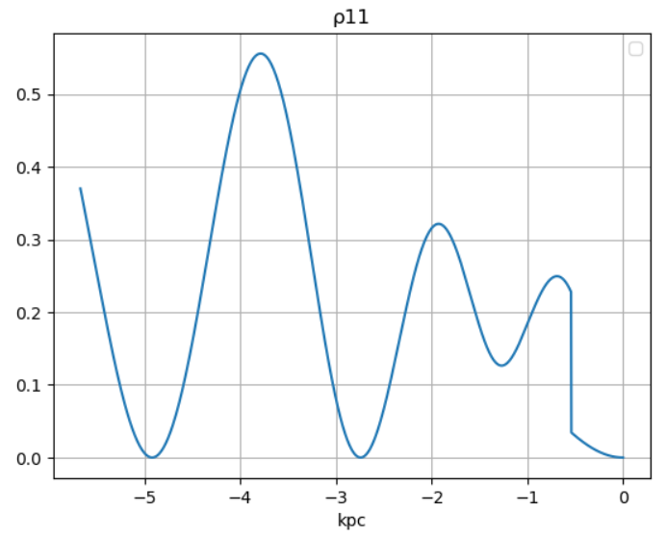
Propagation of ALP from M82 to the MW
STEP 2
Solving the same equation in the intergalactic space and Milky Way, we obtain:
ρ₁₁ = 0.37
Propagation almost without oscillations
Magnetic field of Milky Way
Intergalactic magnetic field
Magnetic field
of M82
ppc.inr.ac.r17/19
ALP + Photons
ALP + Photons

Slide 18
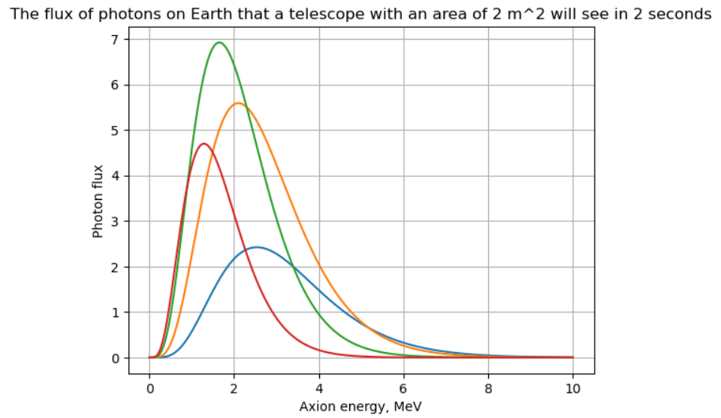
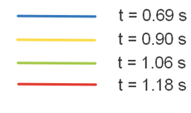
Photon flux
STEP 2
ppc.inr.ac.r18/19

Slide 19
Conclusion and future plans
1.) We constructed the axion spectrum from type Ia supernova;
2.) We analyze the behavior of ALPs-photon system propagation and found the probability to observe photon on Earth, thus theoretically predict the photon flux of photons on Earth.
3.) Our future plan is related to experimental part of our work; we will compare theoretical number of photons with observational data.
The study of axion spectrum and photon flux is supported by Russian Science Foundation,
grant 22–12–00215 (DD).
Thanks!
ppc.inr.ac.r19/19

