Slide 1
Conundrum of higher derivative quantum gravity: Hořava model, renormalization group and asymptotic freedom
A.O.Barvinsky
Theory Department, Lebedev Physics Institute, Moscow
and
ITMP, Moscow University
with D. Blas
M. Herrero-Valea
A. Kurov
S. Sibiryakov
C. Steinwachs

Slide 2
Plan
Horava gravity:
1) Renormalizable Hořava gravity: projectable models
2) Asymptotic freedom in (2+1)-dimensional model
3) Beta functions and RG fixed points in (3+1)-dimensions
4) RG flows and AF in (3+1)-dimensions
5) Riddles of higher derivative gravity models:
complexity of operator dimensions;
renormalizability and AF of nonprojectable HG?;
tadpoles, IR divergences and modification of beta functions in quadratic gravity (Donoghue et al);
no running of G and --- metamorphosis of the running scale

Slide 3
Renormalization of Horava gravity
Saving unitarity in renormalizable QG
Einstein GR
nonrenormalizable
Higher derivative gravity
Stelle (1977)
Fradkin, Tseytlin (1981)
Avramidy & A.B. (1985)

Slide 5
Foliation preserving diffeomorphisms
ADM metric decomposition
space dimensionality
Anisotropic scaling transformations and scaling dimensions
extrinsic curvature

Slide 6
Basic versions of Horava gravity: ``projectable’’ theory vs ``non-projectable” theory
kinetic term -- unitarity
Projectable Horava gravity action
relevant
Potential term in (3+1) dimensions
Extra structures in
non-projectable theory

Slide 7
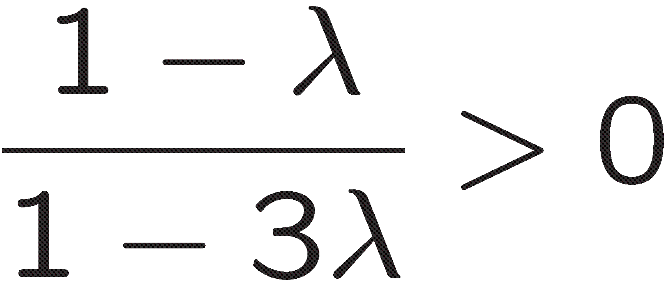
Physical spectrum in d+1=4: TT-graviton and scalar
Unitarity domain (no ghosts)
tachyon in IR (whichever sign of )
No general relativistic IR limit!
Phenomenologically useless model in contrast to nonprojectable HG which has a healthy IR limit fitting GR [D. Blas, O. Pujolas, S.Sibiryakov, JHEP04(2011)018].
GR: active lapse,

Slide 8
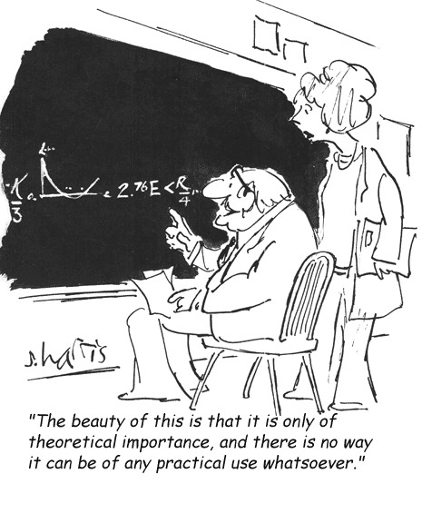
Single example of local, unitary, renormalizable and asymptotically free
(consistent in UV limit) quantum gravity – projectable Hořava gravity
Consider UV limit dominated by marginal operators, disregard relevant cosmological and Einstein terms and check AF.

Slide 9
Long list of problems to be solved that have been solved:
Renormalizability -- projectable HG is
renormalizable in any d
(nonprojectable?)
D. Blas, M. Herrero-Valea,
S. Sibiryakov C. & A.B.,
PRD 93, 064022 (2016),
arXiv:1512.02250
Gauge invariance of counterterms: preserving BRST structure of renormalization
D. Blas, M. Herrero-Valea,
S. Sibiryakov C. Steinwachs & A.B.,
JHEP07(2018)035, arXiv:1705.03480,
Asymptotic freedom of (2+1)-dimensional
model
D. Blas, M. Herrero-Valea,
S. Sibiryakov C. Steinwachs & A.B.,
PRL 119, 211301 (2017), arXiv:1706.06809
Beta-functions of (3+1)-dimensional model
A.Kurov, S.Sibiryakov & A.B.,
PRD 105 (2022) 4, 044009
arXiv: 2110.14688
RG flows of (3+1)-dimensional model and asymptotic freedom
A.Kurov, S.Sibiryakov & A.B.
PRD 108 (2023) 12, L121503,
arXiv:2310.07841

Slide 10
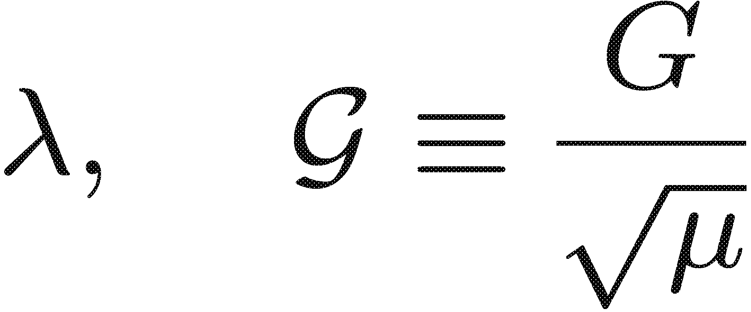
Asymptotic freedom in (2+1)-dimensions
Off-shell extension
is not unique:
Essential coupling constants:

Slide 11
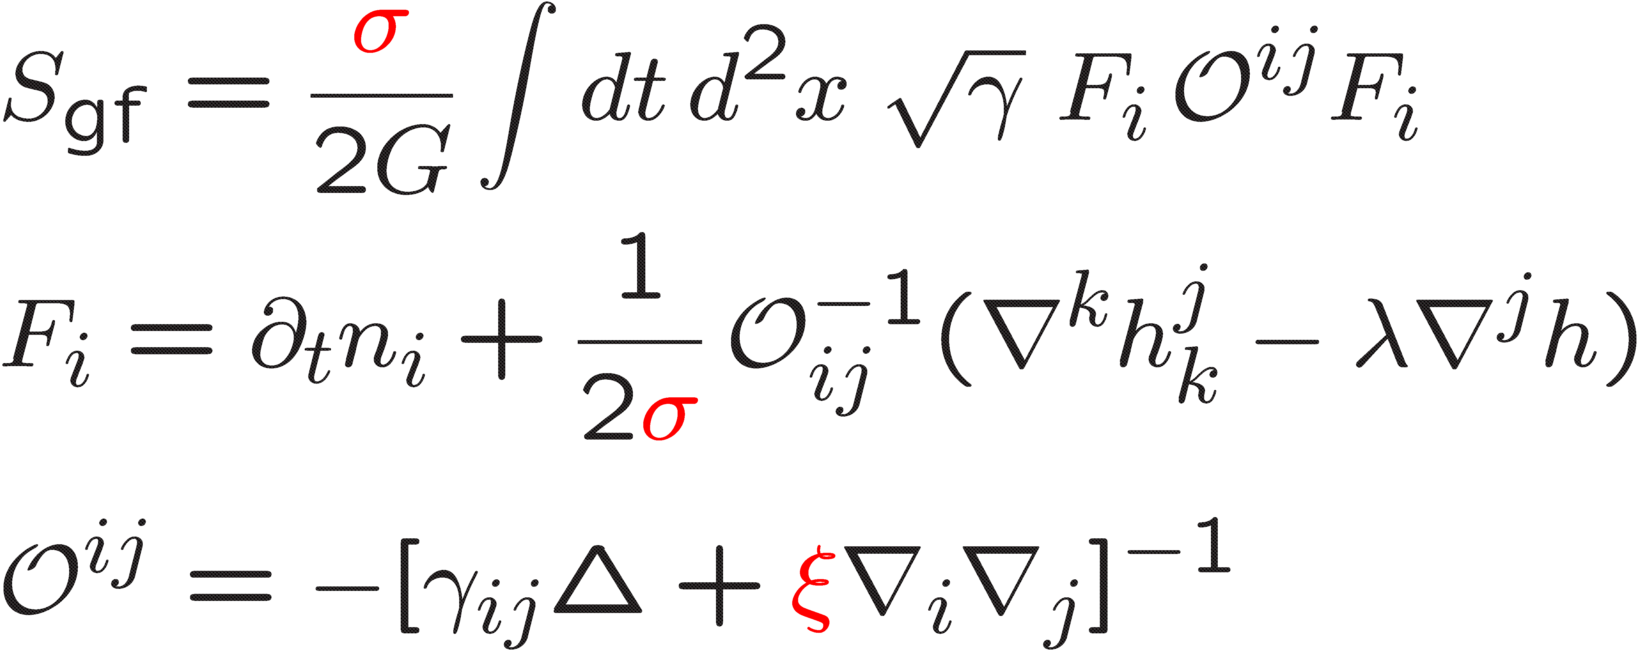
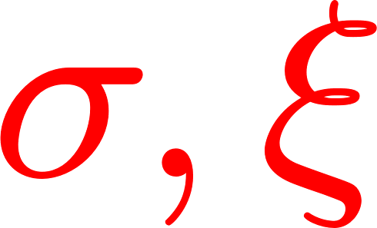
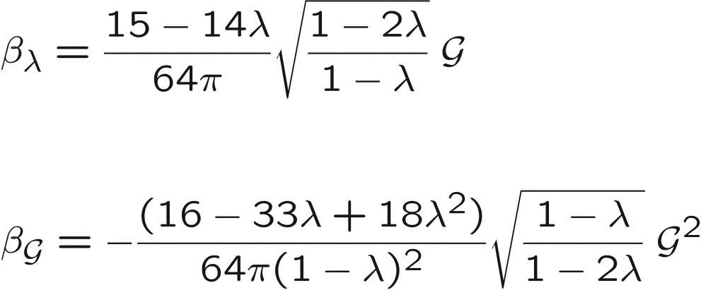
background covariant
gauge-fixing term
– free parameters
Mathematica package xAct

Slide 12
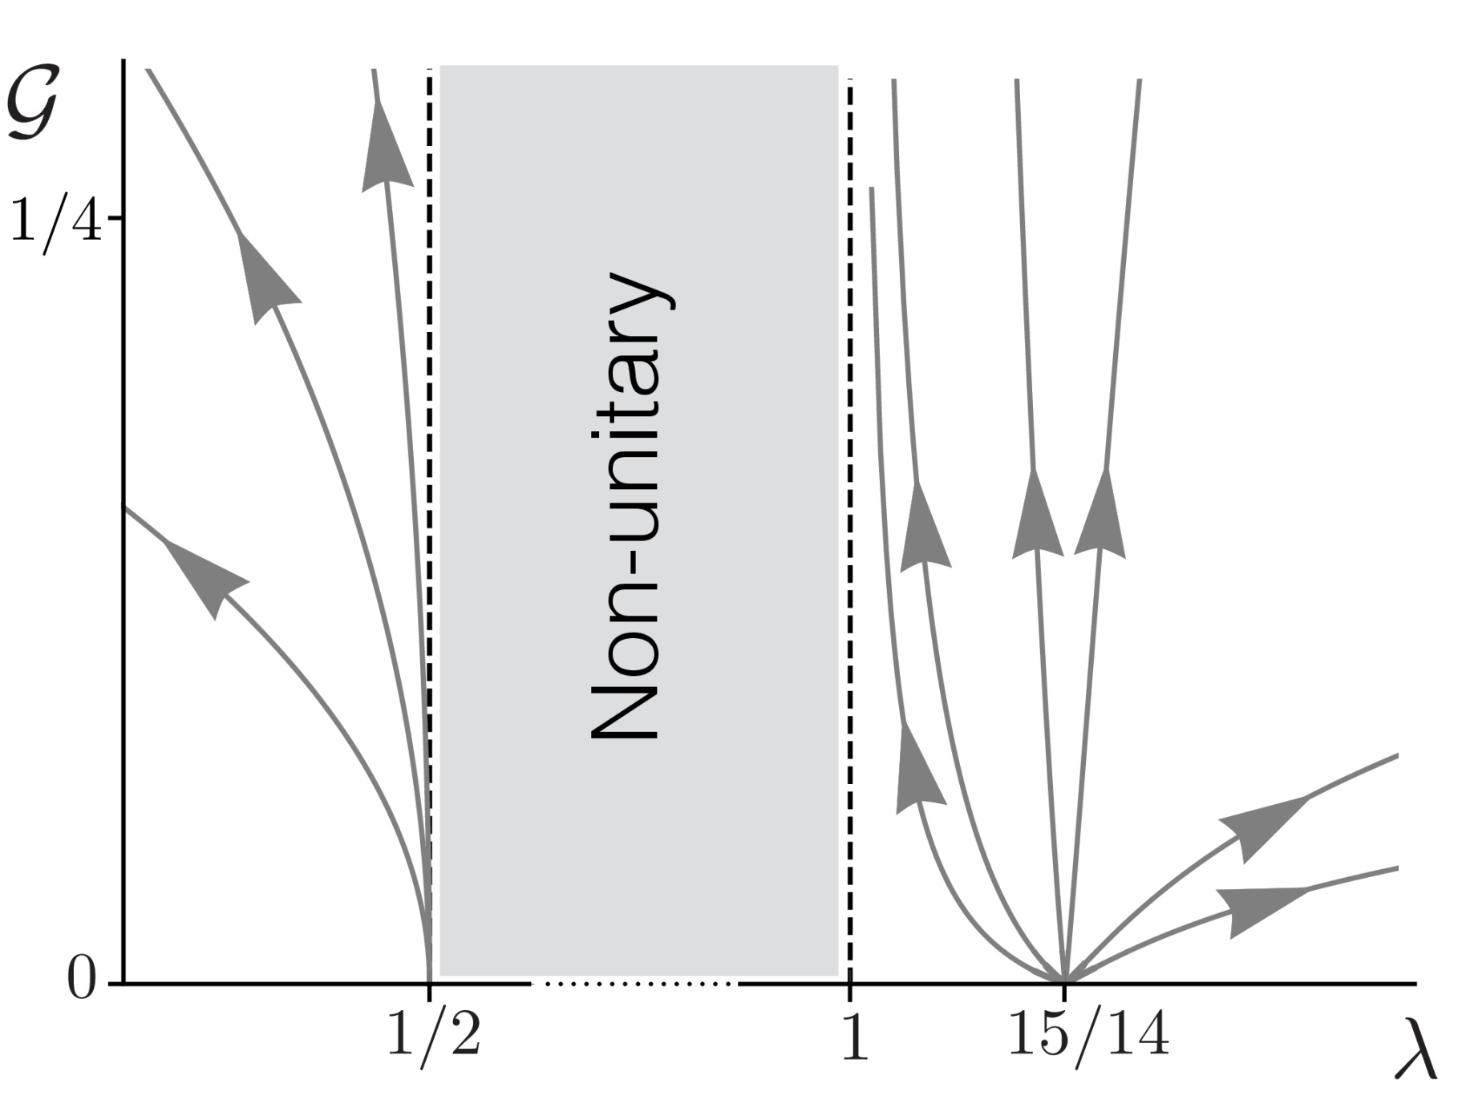
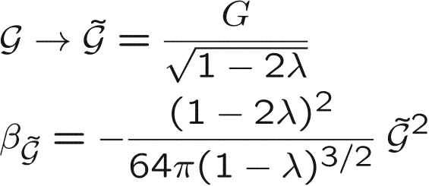
Renormalization flows:
strongly coupled fixed point
AF UV fixed point

Slide 13
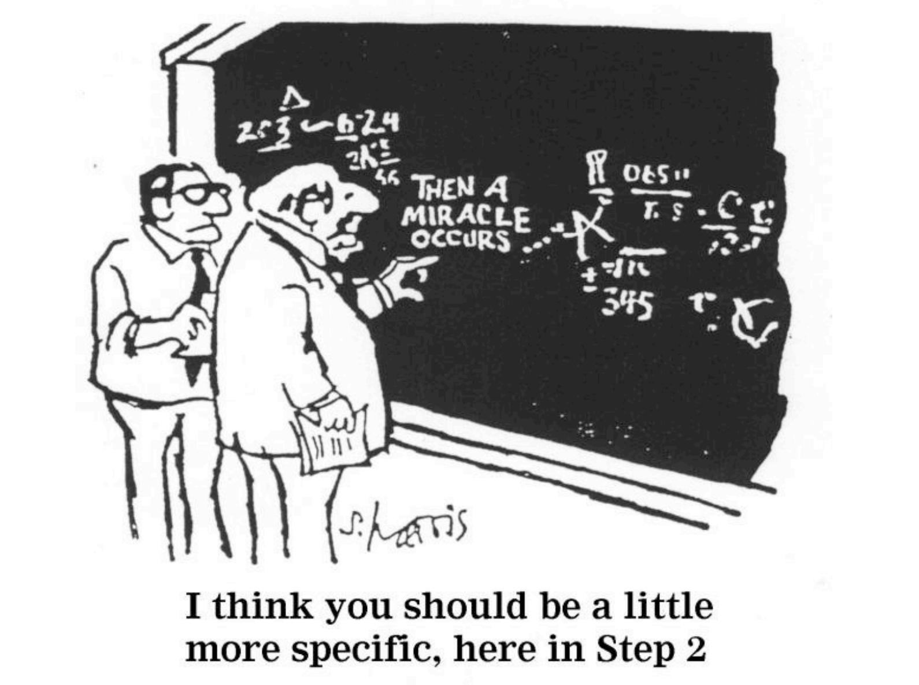
(3+1)-dimensional Horava gravity
Six essential coupling constants

Slide 14
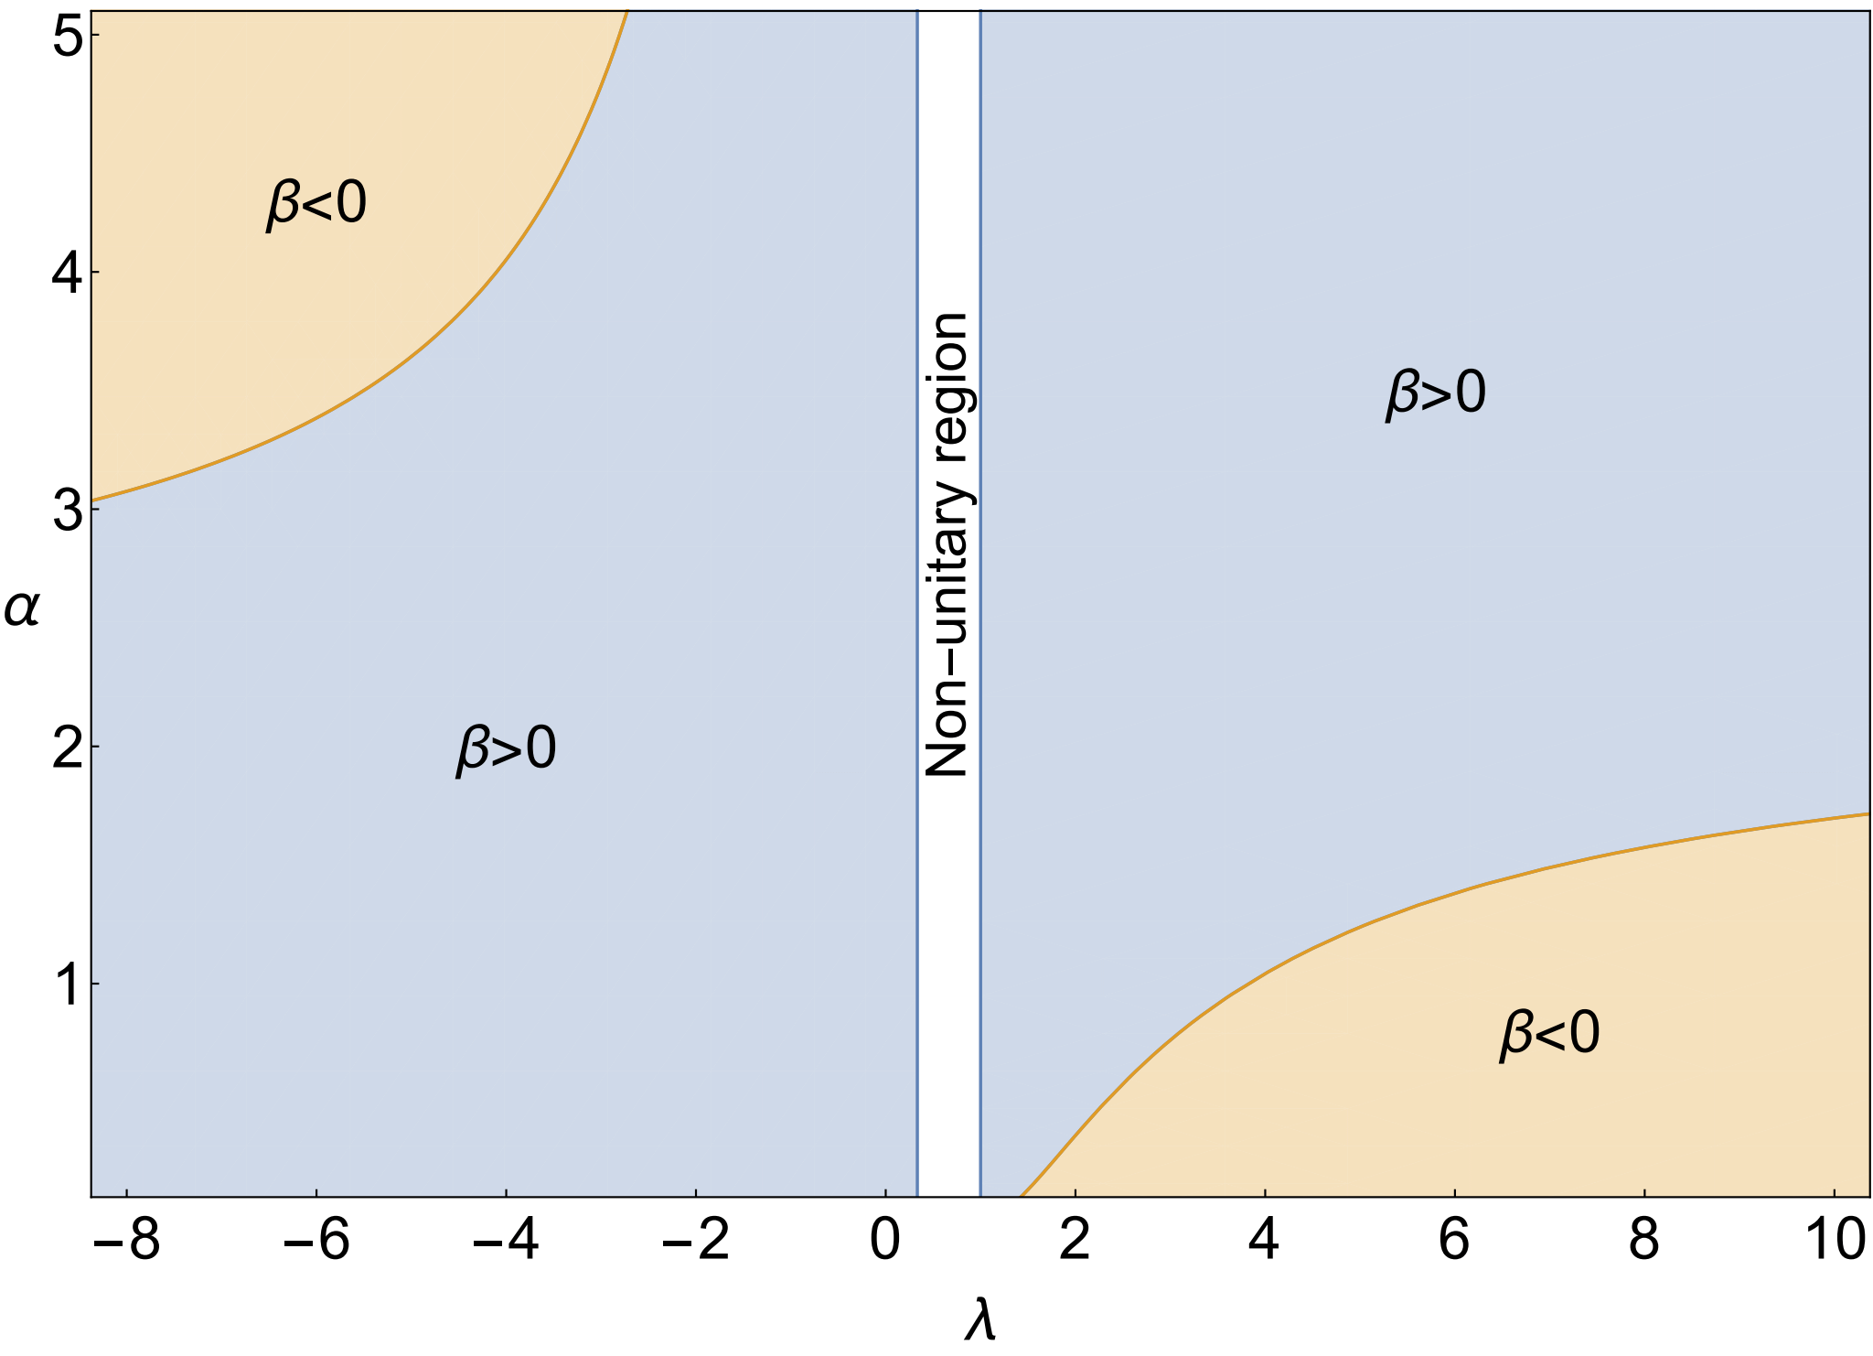
obtained by usual Feynman diagrams
M. Herrero-Valea, S. Sibiryakov & A.B., PRD100 (2019) 026012
The curves correspond to potential location of fixed points of the full RG flow. The region λ ∈ [1/3,1] is excluded by the requirement of unitarity.

Slide 15
Background field method + heat kernel method + dimensional reduction
One-loop effective action
Action Hessian
acting in the space of fields
Heat kernel (Schwinger-DeWitt) expansion for minimal second order operators
Schwinger-DeWitt (Gilkey-Seely) coefficients
One-loop divergences

Slide 16
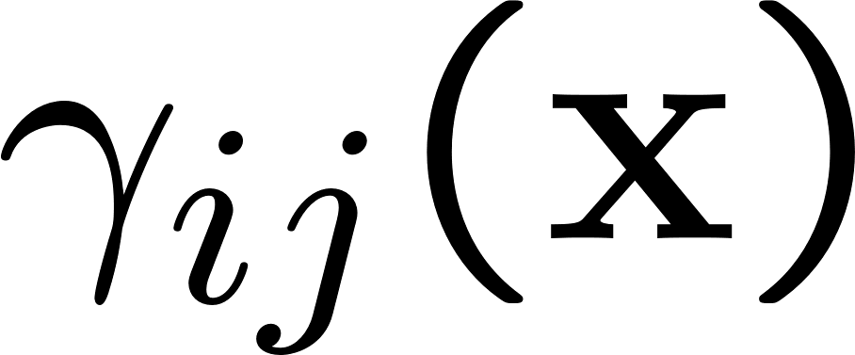
However, in Horava gravity operators are nonminimal
Set of quantum fields
Structure of operators on a static 3-metric background with generic 3-metric
space parts of metric and vector
(shifts and ghosts) operators:
Example – for the ghost operator in -family of gauges:

Slide 17
Extension to non-minimal and higher-derivative operators -- the method of universal functional traces (I. Jack and H. Osborn (1984), G.A.Vilkovisky & A.B., Phys. Rept. 119 (1985) 1)
Idea:
universal functional traces
Schwinger-DeWitt expansion

Slide 18
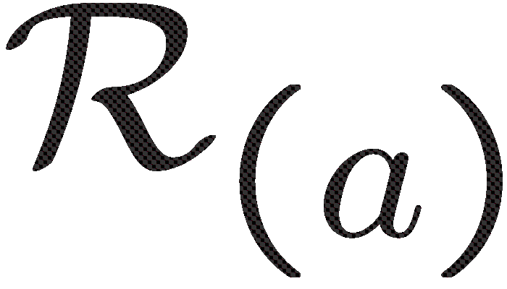
Dimensional reduction method on a static background with generic 3-metric
square root
How to proceed with the square root of the 6-th order differential operator?
Pseudodifferential operator – infinite series in curvature invariants
3D universal
Functional traces

Slide 19
Results for beta functions of (3+1)-dimensional Horava gravity
Six essential coupling constants

Slide 20
Use of Mathematica package xAct
Example (one of the longest ones):
Check of the results: independence of essential beta functions on the choice of gauge ( - family of gauge conditions) and spectral sum method in dimensional and zeta-functional regularization.

Slide 21
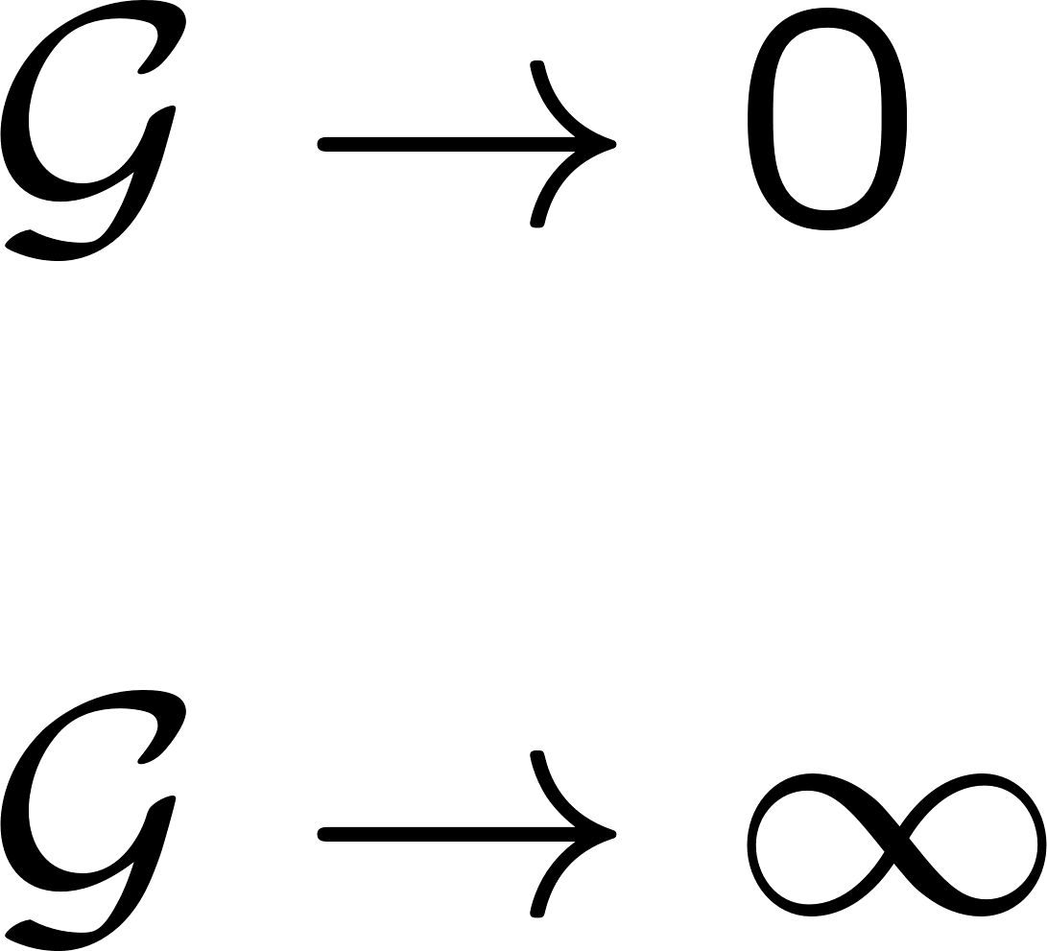
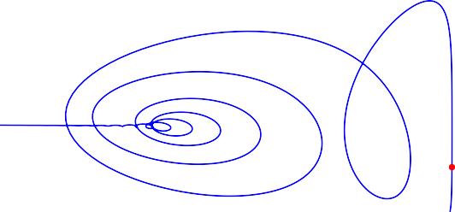
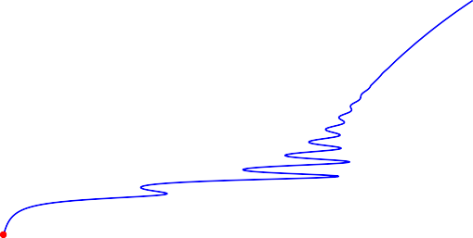
asymptotic freedom
Fixed points equations:
Landau pole
i
Fixed points at finite . All of them are asymptotically free but they RG run into Landau poles.
0.21
^{λ} 0.20
v₂ 0
-5
0.19
-10
0.18
-3×10⁶
-2×10⁶
-10⁶
0
-2 -1
0
v₃
1
2
3
v₁
0.22
0.21
^{λ} 0.20
0.19
0.18
0
2×10³ 4×10³ 6×10³ 8×10³
u_{s}
10⁴ 1.2×10⁴

Slide 22
Special limit:
(cosmology implication, A.E. Gumrukcuoglu, S. Mukohyama, 1104.2087)
Fixed points at
A
B
Special fixed points: A is AF, B is not AF

Slide 23
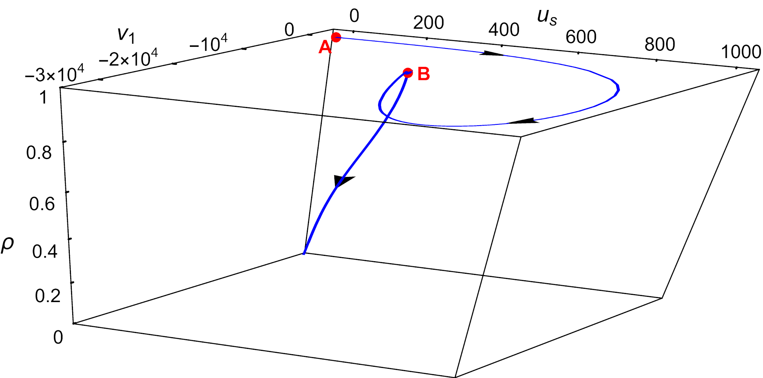
Fixed point B as a transient of RG flow from AF UV point A to IR limit with
hyperplane
Behavior of G on the flow:
₁₀-5

III
II
I
₁₀-10
₁₀-15
0.01
0.1
1
10
λ - 1
10
2
10
3
10
4
+
Behavior of G as a function of (λ − 1) along an RG trajectory connecting the point A to λ → 1 .
k
In regions I, II and III the dependence is well described by the power law G ∝ (λ − 1) with k_{I} = −13.69,
k_{II} = 3.84, k_{III} ≈ 0.37.

Slide 24
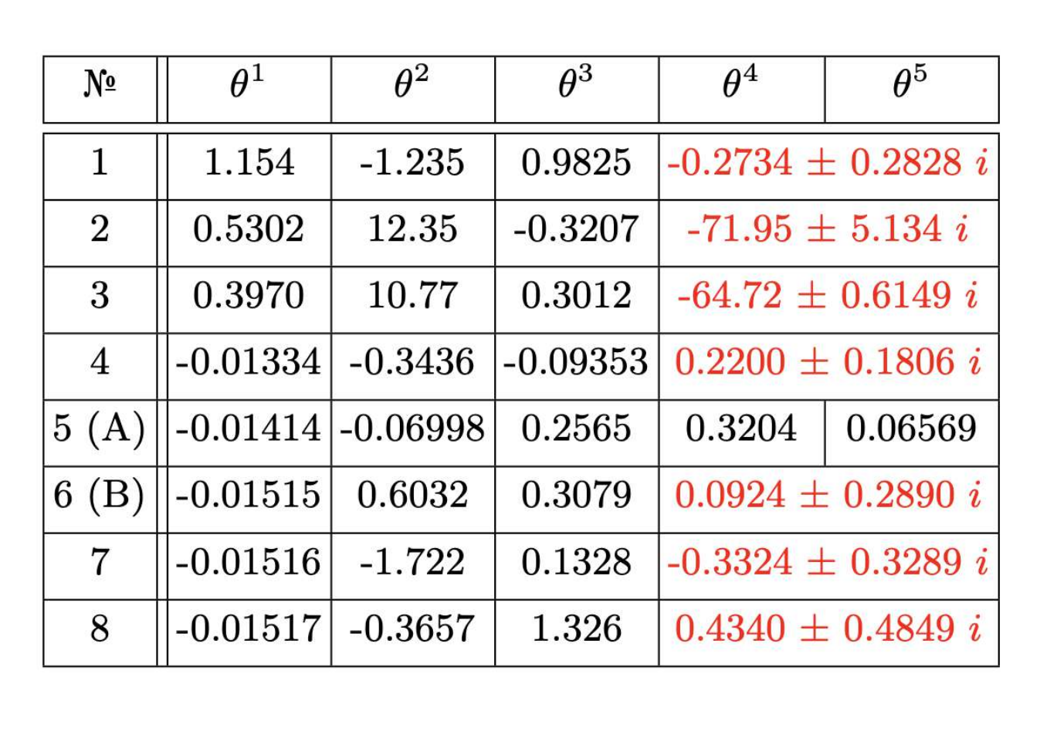
Riddles of higher derivative gravity models
1. Complexity of operator dimensions – eigenvalues of stability matrices.
Violation of LI or lack of gauge invariant operators ?
2. Renormalizability and AF of nonprojectable HG?
It has healthy IR limit fitting GR [D. Blas, O. Pujolas, S.Sibiryakov, JHEP04(2011)018].There are indications that it is renormalizable.
J. Bellorın, C. Borquez, B. Droguett,
Phys. Rev D 106, 044055 (2022), 2207.08938
arXiv:2405.04708

Slide 25
3. Tadpoles, IR divergences and modification of beta functions in quadratic gravity (Donoghue et al)
The problem of running and G
Running coupling constant = nonlocal form factor in effective action
running scale
Tadpole (total derivative) nature problem for running and G
p
q
no running

Slide 26
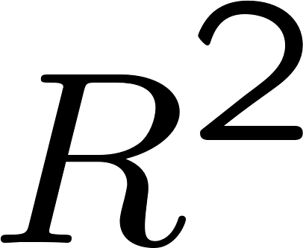
Quadratic gravity action and propagator
UV finite and IR divergent at M=0
p-q
p
p
q
running constant
of -- action
D.Buccio,J.Donoghue,
G.Menezes, R.Percacci,
arXiv:2403.02397
Modification of beta-functions by UV finite terms!

Slide 27
4. No running of G and --- metamorphosis of the running scale
Renormalization group in covariant curvature expansion
Invariant curvature monomes of order N and dimension m
Covariant perturbation theory
G.A.Vilkovisky & A.B. (1986-1990)
Monomes in metric
perturbations
RG scale
dimensionless couplings
Effective action
nonlocal form factors

Slide 28
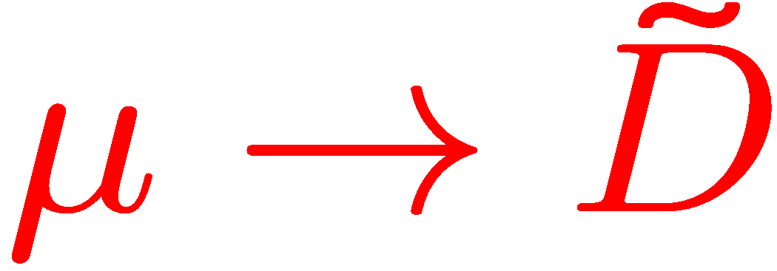
Employing RG:
for all
Choice of scale
Replacement and UV limit
Covariantization:

Slide 29
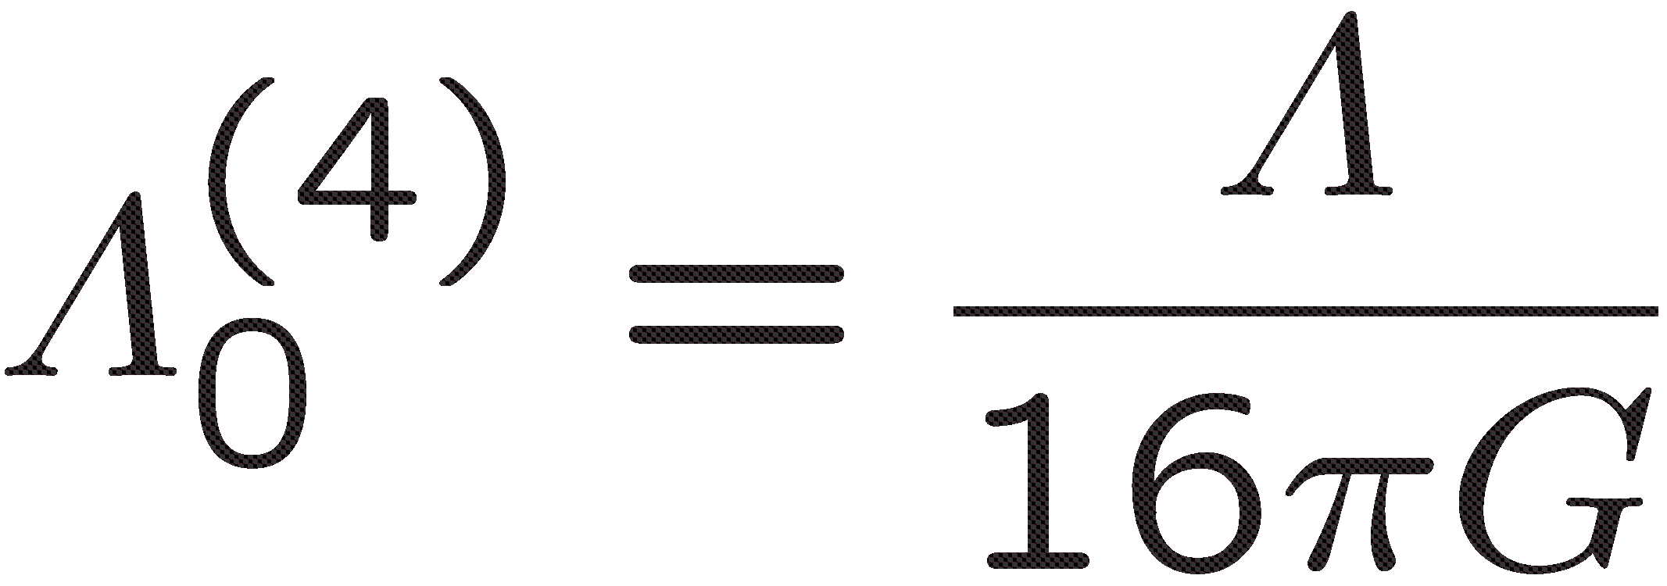
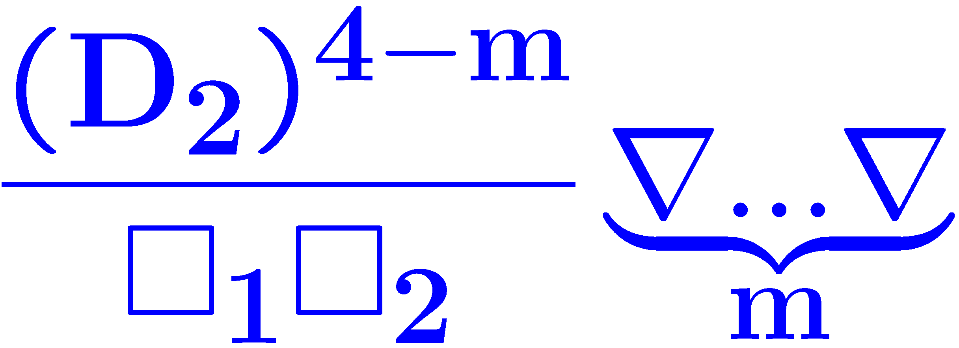
RG form factor
dimensionful factors
For a cosmological constant term:
all factors in
completely cancel out due to integration by parts !
dimensionless
RG form factors
Metamorphosis to high-energy partners of the cosmological constant
[J. F. Donoghue, Phys. Rev. D 105, 105025 (2022), 2201.12217]

Slide 30
Conclusions
Single, known now, example of local, unitary, renormalizable and
asymptotically free (consistent in UV limit) quantum gravity –
projectable Hořava gravity
Salvation of unitarity in local renormalizable QG via LI violation
Asymptotic freedom in (2+1)-dimensional theory
Beta functions and AF RG flows of (3+1)-dimensional HG
Enigma of higher-derivative gravity models
THANK YOU!

