Slide 1
Revisiting the study of extragalactic magnetic field:
A sensitive indicator, simulations and Fermi data
B.Stern, I.Tkachev
General idea: the field affectts abgular and temporal diatribution of GeV photons due to electtromagnetic cascade on soft extragalacttic background
- Kusenko: Stacking technique, a claim of the effect.
- Neronov et al. Falsifcation of that claim
- Neronov et al. An upper limit from the abscebce of delayed photons
- Chen et al — Revisiting Stacking method with 2.5 sigma signal
-Dzhatdoev, Podlesnyi, Rubtsov . An upper limit from GRBs(> 10⁻¹⁸)
- Fermi team: An upper limit from the lack of extended halos of BL — Lacs.

Slide 2
Let“s try to use the inclination of the jet
10 - 30 kpc
Jet axis
γ — γ → e+e-
Compton
on CMB
Observer
α ~ 1/Γ
~ 10² — 10³ Mpc
A toy jet model:
- An infinitely narrow jet, Γ = 20
- Isotropic emission in the jet frame
- The flat spectral energy distribution
- energy range 1 GeV - 100 TeV (rest frame)

Slide 3
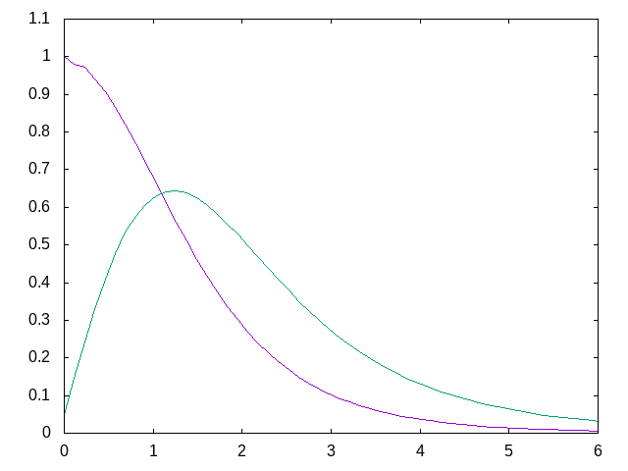
No one jet looks exactly towards us
Can we use this?
Photon flux
Flux X number of sources
Jet inclination, α, degrees

Slide 4
What should be measured?
- The extent of the souce? - The problem is a poorly known point spread function of Fermi LAT and background.
- The elongation of the source (different dispersion in different directions)? OK, but the problem is a large statistical noise.
- The offset of the average photon direction from the location (optical). Much smaller noise!

Slide 5
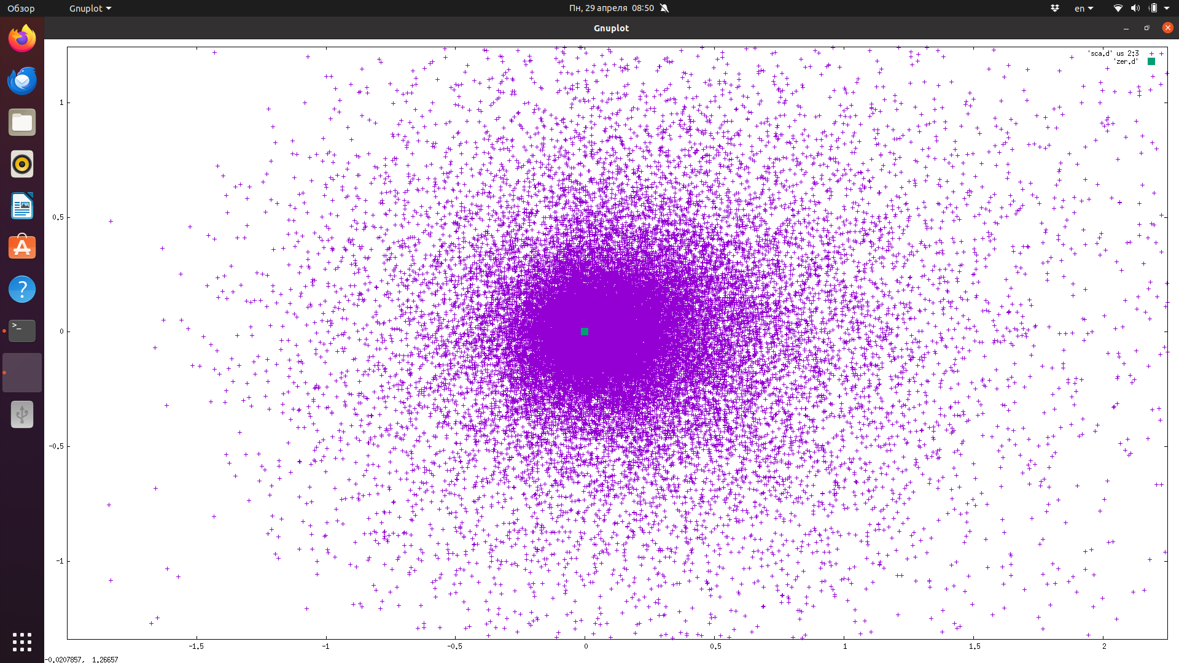
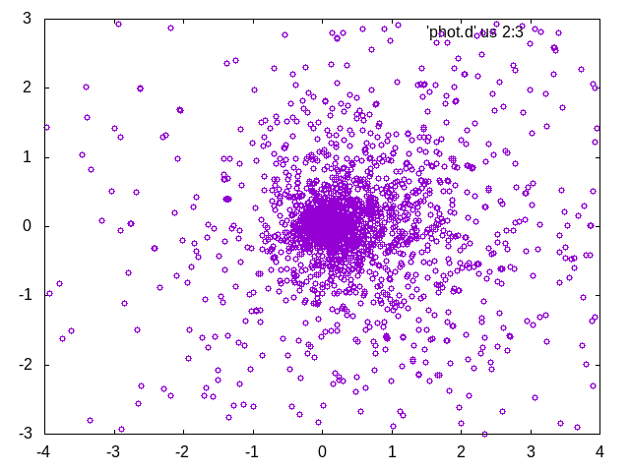
Cascade component only
Simulation
Mkn 421
(z = 0.03)
10⁻¹⁵ Gs
4º
The source

Slide 6
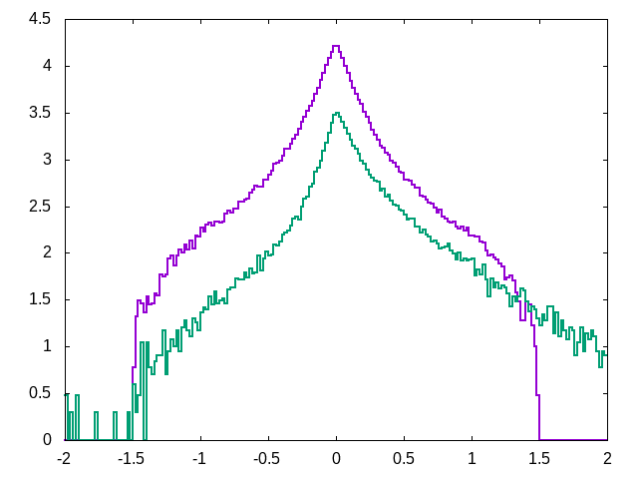
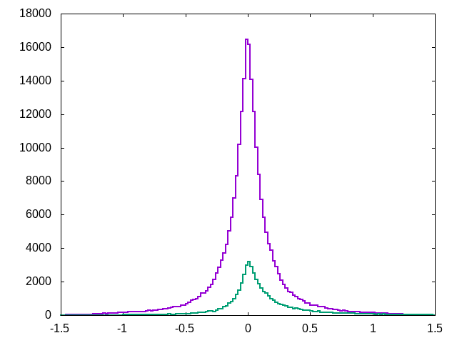
Prompt component (psf)
Scattered component
Simulation. Z = 0.36, H = 10⁻¹⁵G, α = 2º
Point sprerad function = data from Mkn 421

Slide 7
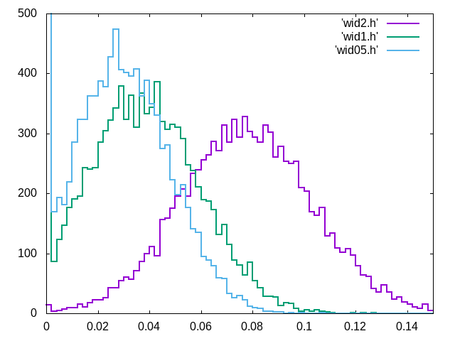
What sould we measure
to detect the scattered component?
θ = 0.5º
ϭ(promptt+scat)/ϭ(prompt) - 1
The size of the halo?
θ = 1º
θ = 2º
Bootstrap:
Simulated sample ~3 10⁵ photons
Test samples ~ 2 10⁴ photons

Slide 8
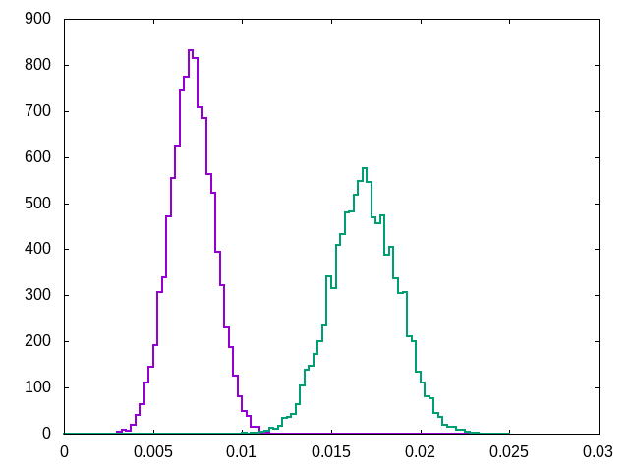
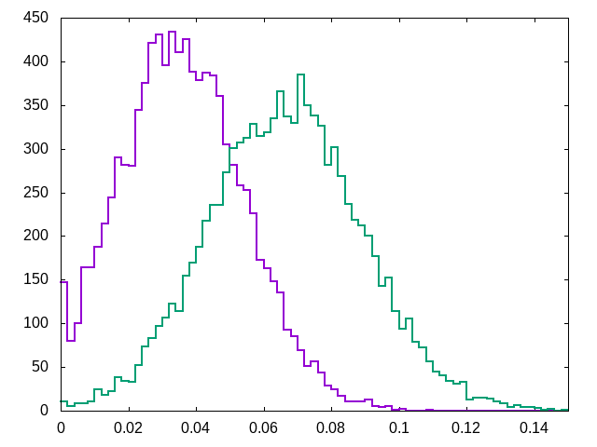
Offset facor δ
Σ(x - x₀)/N
θ= 0.5º
θ = 1º
Shape factor
ϭ(x)/ϭ(y) - 1
θ= 0.5º
θ = 1º
Offset, degrees
H = 10⁻¹⁵G z = 0.1, α = 2º

Slide 9
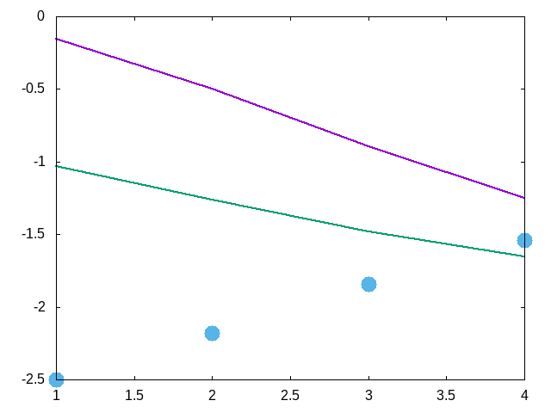
Prompt component
Log( F/Fo )
Scattered component
Offset δ in 0.5º field,
Log (δ(θ)), H = 10⁻¹⁵
Jet inclination, α, degrees

Slide 10
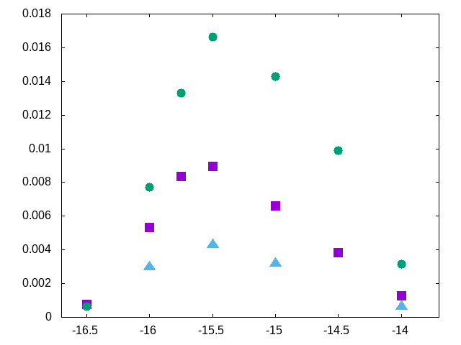
The offset versus jet inclination α and magnettic field
Offset, degrees
α = 3º
α = 2º
α = 1º
Log H

Slide 11
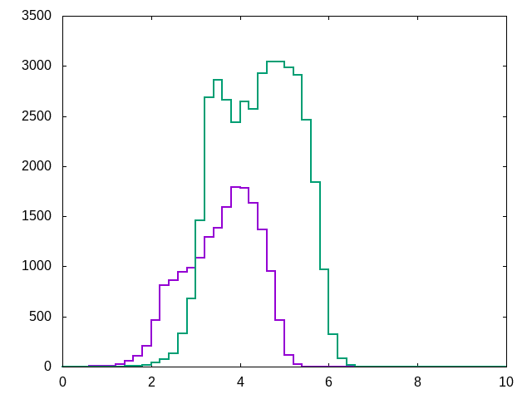
Conversion on CMB
Jet inclination = 2º
H = 10⁻¹⁵G
Conversion on EBL
Z = 0.36
Z = 0.03
Photon arrival delay, Log(years)

Slide 12
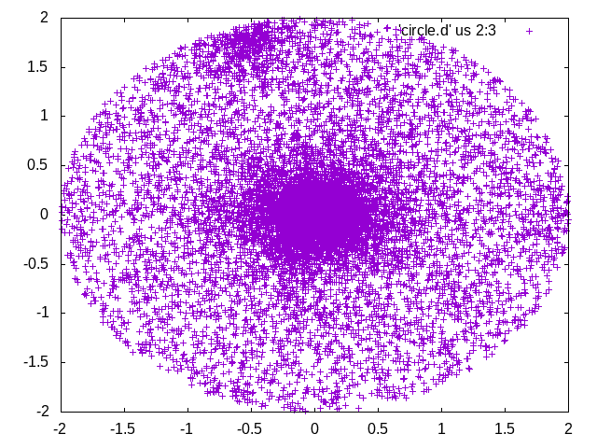
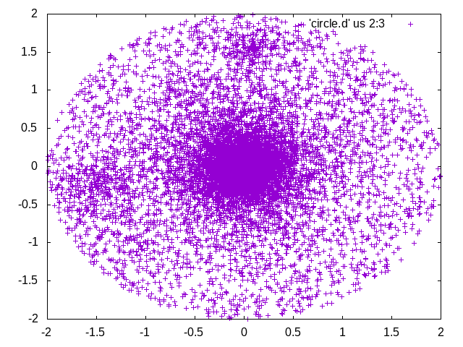
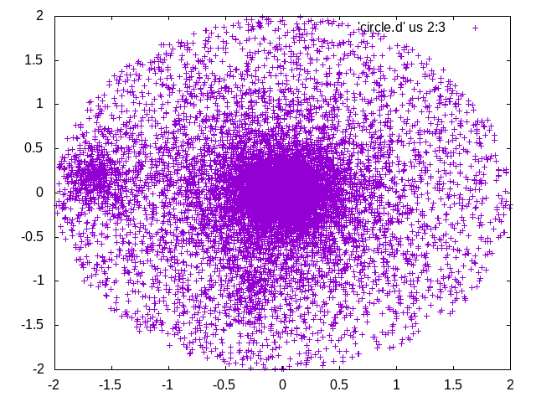
The data: 3 of 6 brightest BL Lacs
Set θ = 0.5º for all objects

Slide 13
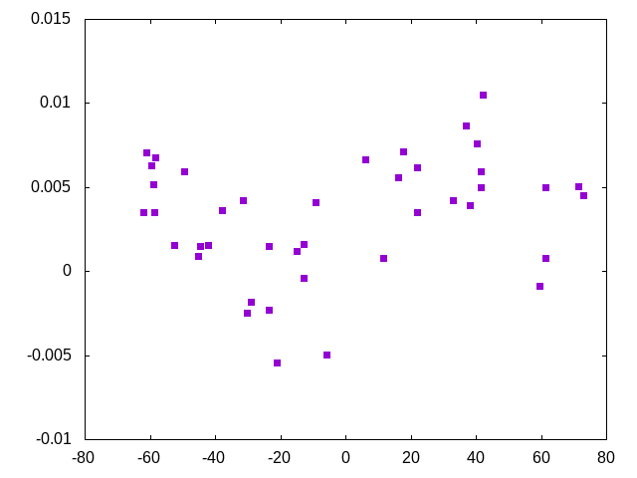
The best reference would be
the optical location.
BL Lac
But!
PSR
PSRs
Look at the declination dependent bias in Fermi photon localization
3C454.3
degrees
Difference Fermi vs. optical location in RA
Vela-X
Declination

Slide 14
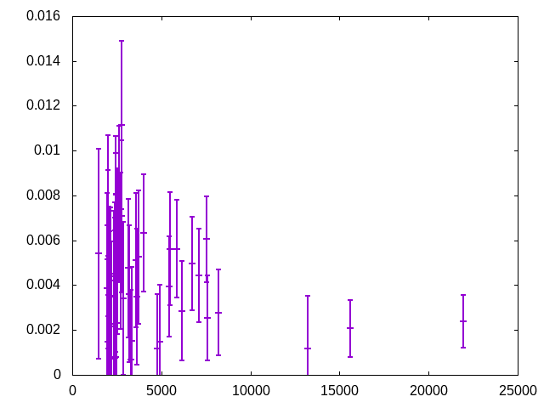
H┴ =10⁻¹⁵G, 3º
Offset in 0.5º field of view
The offset from Fermi localization
For 30 brightest BL-Lacs
Pg 1553
H┴ =10⁻¹⁵G, 2º
Mrk 421
BL Lac
H┴ =10⁻¹⁴G, 2º
Photon fluence for 15 years in 0.5º circle

Slide 15
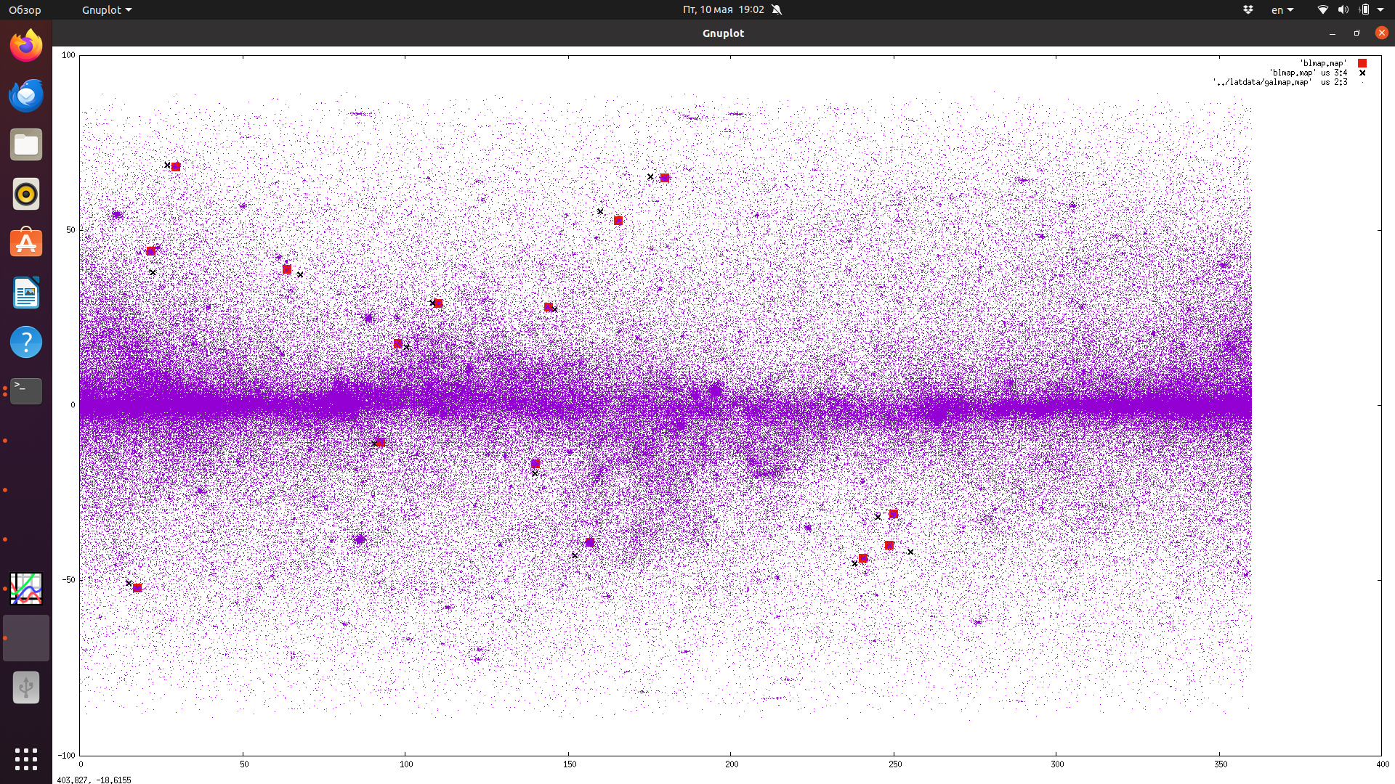
Location of 15 brightest «clean“ BL Lacs
Dashes show the direction of > 2 ϭ offsets

Slide 16
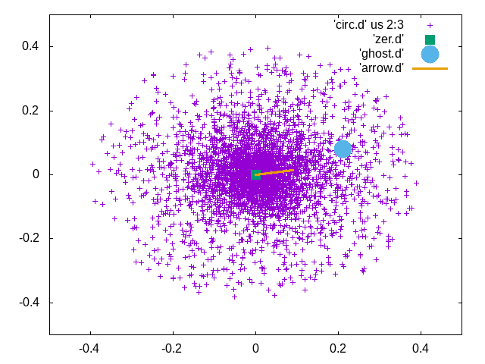
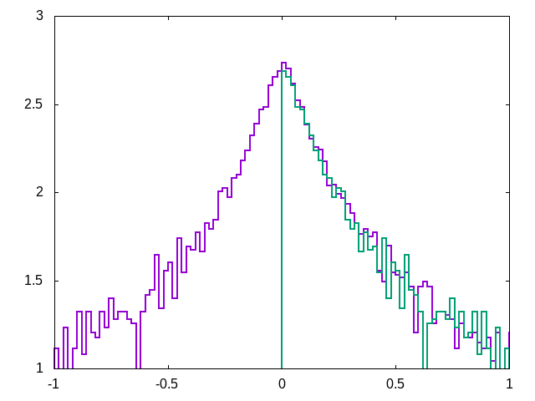
Suspicious objects: PG 1553 + 113
3 ϭ z=0.36
Fermi team puts a source here

Slide 17
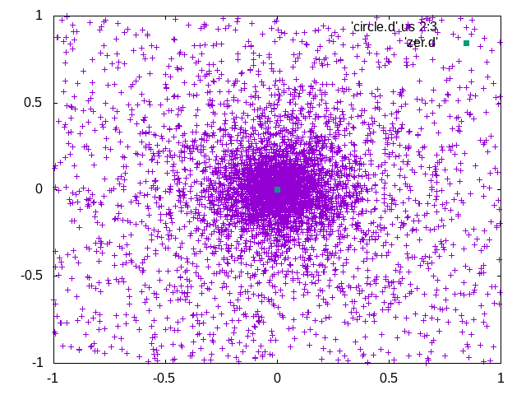
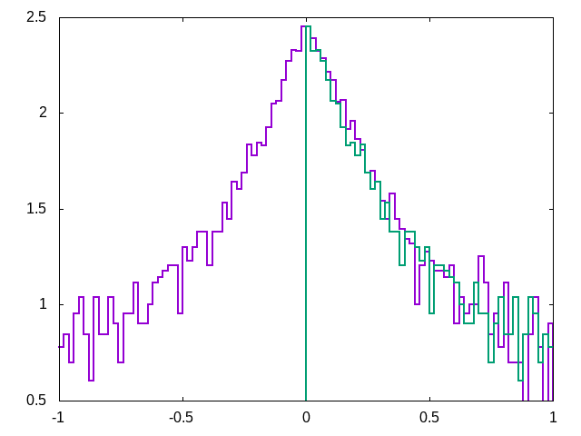
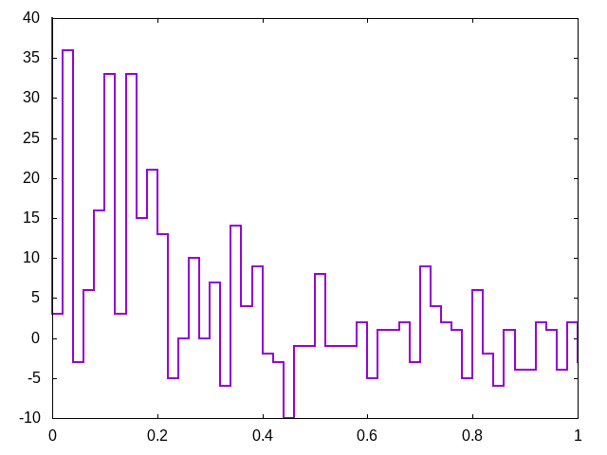
1H 1013+498
2.4 ϭ z = 0.212

Slide 18
Testing the null hypotesis
2 degrees of freedom for each BL-Lac — x and y offsets
N (Dof) 10 (20) 15(30) 20 (40) N of discarded
χ2 41.9 54.6 60.5 1
This is 3ϭ deviation
How to check the effect of the background?
Implanted BL Lacs!
The template: Mkr 421. Isotropization over the azimuthal angle and rescaling to 20 brightest BL Lacs in photon number

Slide 19
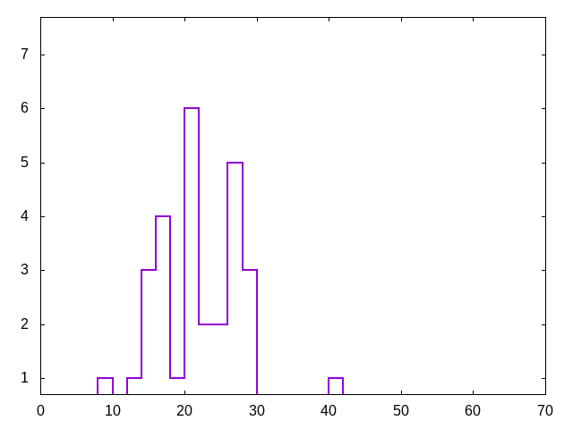
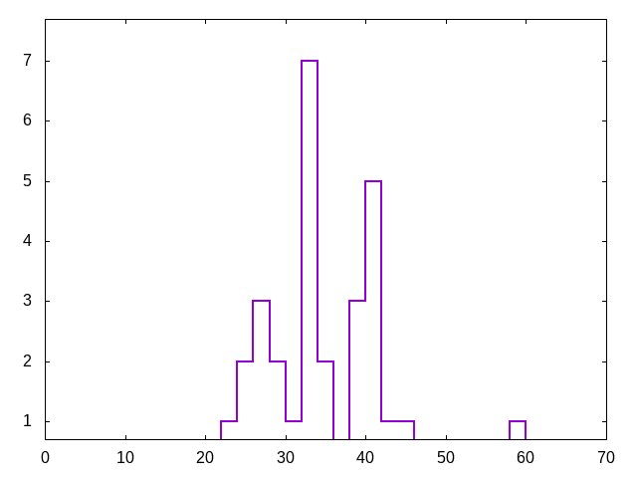
29 implants
with a visual check
for overlapping
sources
The real sample
The real sample

Slide 20
Conclusions
- A dominance of H ~ 10⁻¹⁶ — 10^{-14.5} in the bulk of space is disfavored (not strictly ruled out)
- A presence of H ~ 10⁻¹⁶ — 10^{-14.5} in some regions (probably in voids) is slightly favored. There are a few > 2ϭ candidates. Total significance still TBD.
- A further investigation with a careful background treatment and massive simulations can give a more definit conclusions with existing Fermi data
- Removal of latitude dependent bias in photon localization can improve the analysis

Slide 21
PG 1533 att E > 3 GeV
Maximum significance at r =0.4
P = 2 e-6
Offset from optical location = 0.0093º = 0.56'
Our claim: the source 4FGL 1556.5+1116 (blue oval) Is just a ghost of PG 1533
- It has no counterpart in another range
- It has insufficient brightness (~2% of PG 1533) to produce such offset (only 7' at real 45').
- there is nothing visible at its location
Probably it just makes the fit of PF1553 better, compensating the plume in that
direction

