Slide 1
Nuclear Emulsions for Wimp Search
with directional measurement
(NEWSdm)
Nikolai Starkov
National University of Sciences and Technology (MISiS),
Lebedev Physical Institute
on behalf of the NEWSdm Collaboration

Slide 2
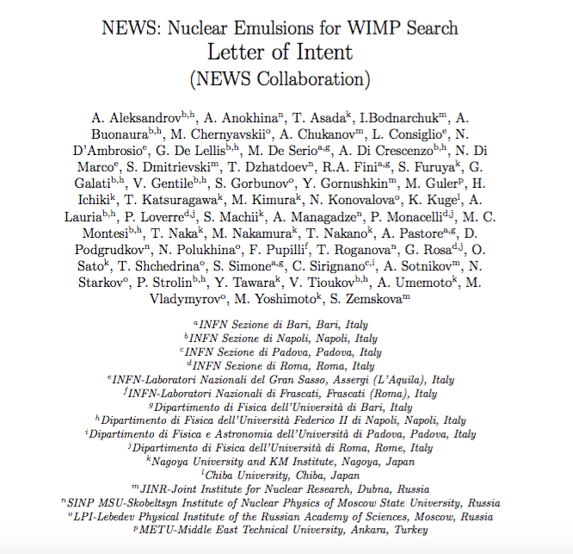
The NEWSdm Collaboration
Italy
Bari
GSSI
LNGS
Naples
Rome
Japan
Chiba
Nagoya
Russia
MISIS Moscow
LPI RAS Moscow
JINR Dubna
SINP MSU Moscow
Yandex School of Data Analysis Moscow
INR RAS Moscow
Turkey
METU Ankara
South Korea
Gyeongsang
http://news-dm.lngs.infn.it
LNGS-LOI 48/15
to the LNGS Scientific Committee
>70 physicists
https://arxiv.org/abs/1604.04199

Slide 3
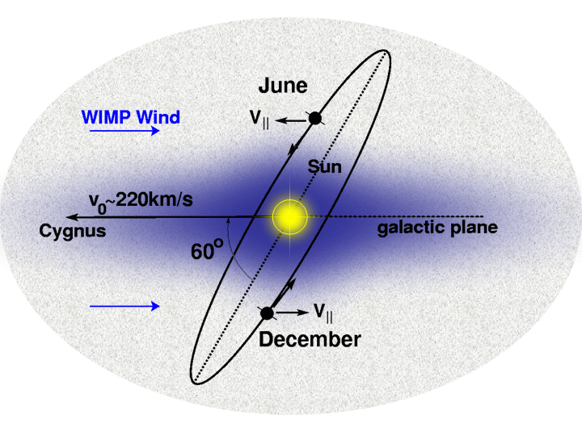
Solar System motion results in the Wind of Galactic WIMPs
Dark matter – Weak Interacting Massive Particles (WIMP)
Atoms
(5%)
DARK MATTER
(23%)
DARK ENERGY
(72%)
Earth motion leads to additional modulation of WIMP’s flux.

Slide 4
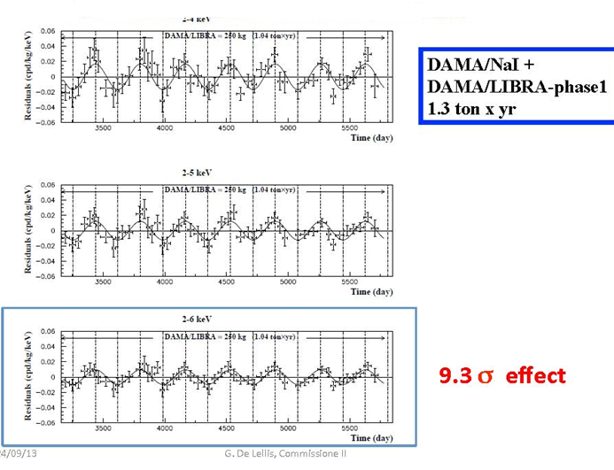
Seasonal residual rate modulation in DAMA experiment
(flux variations)
DAMA/LIBRA report on March 26th 2018 at Gran Sasso

Slide 5
DAMA report is controversial because many experiments excluded the region allowed by DAMA.
DAMA/LIBRA experiment

Slide 6
Experimental concept:
NEWSdm
(Nuclear Emulsion for Wimp Search with directional measurement)
The direct WIMP search paradigm - detect nuclear recoil ➔ tracking
In nuclear emulsion (a solid state detector) sub-μm recoil track lenghts ➔ nano-imaging
For the galactic DM a non-isotropic WIMP flux is expected on Earth…
earth@summer
DM
Target nuclei
Nuclear emulsion
DM
Direction of solar system
(220km/sec)
Dark matter wind
DM
earth@winter
Detection of recoiled nuclei as tracks
Directionality as a strong signature ➔ keep target pointed to DM wind (Cygnus)
Background ➔ Instrumental, intrinsic radioactivity, environmental, cosmogenic

Slide 7
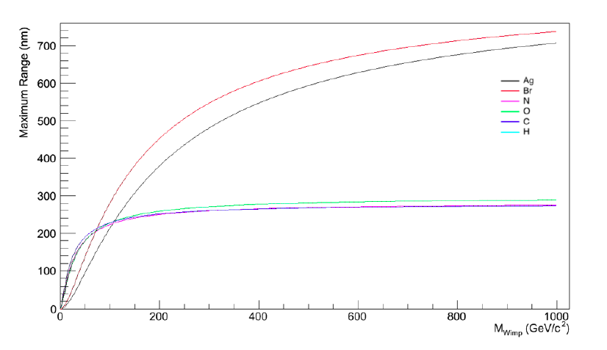
Nuclear emulsion

Slide 9
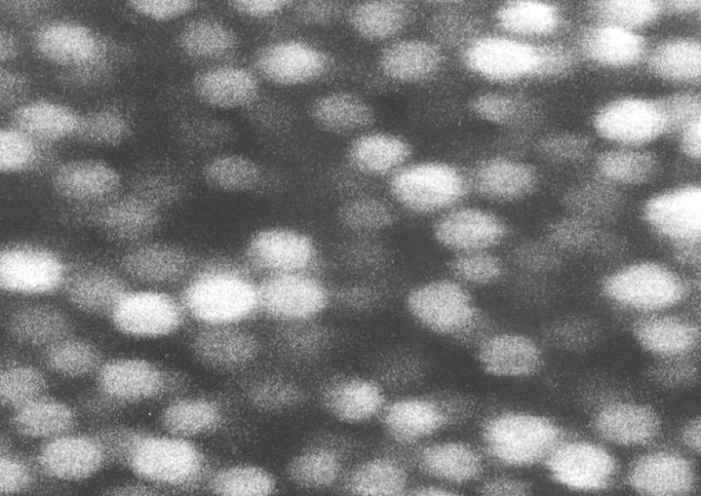
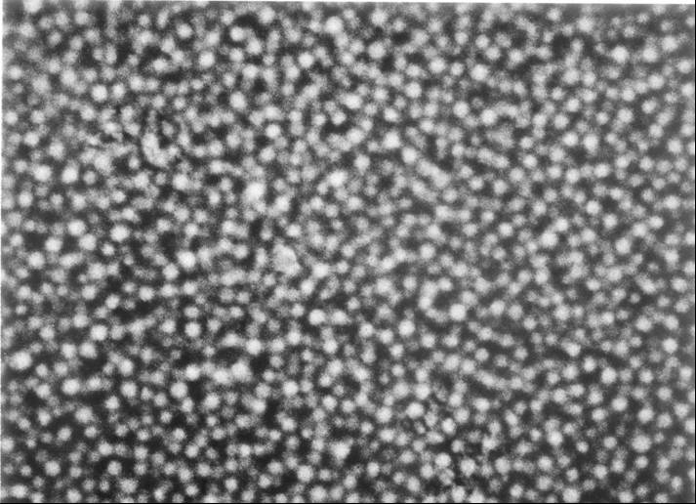
Nano Imaging Tracker (NIT‏)
OPERA
NIT
200nm
OPERA:AgBr crystal size ~200nm
NIT:AgBr crystal size ~40nm
2.3 AgBr/μm
11 AgBr/μm
5 times resolution for OPERA!
Notes:
9
9

Slide 10
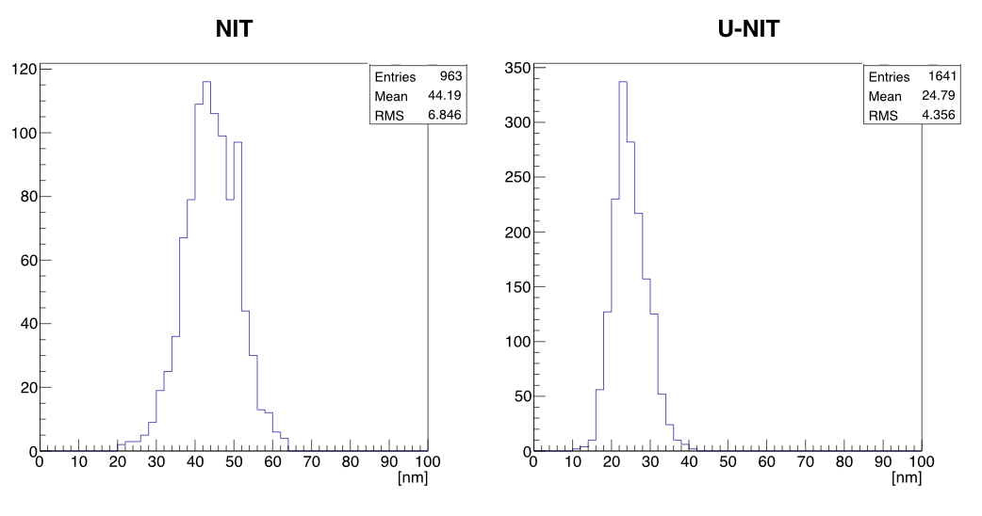
Distribution of the crystal diameter measured with an electron microscope

Slide 12
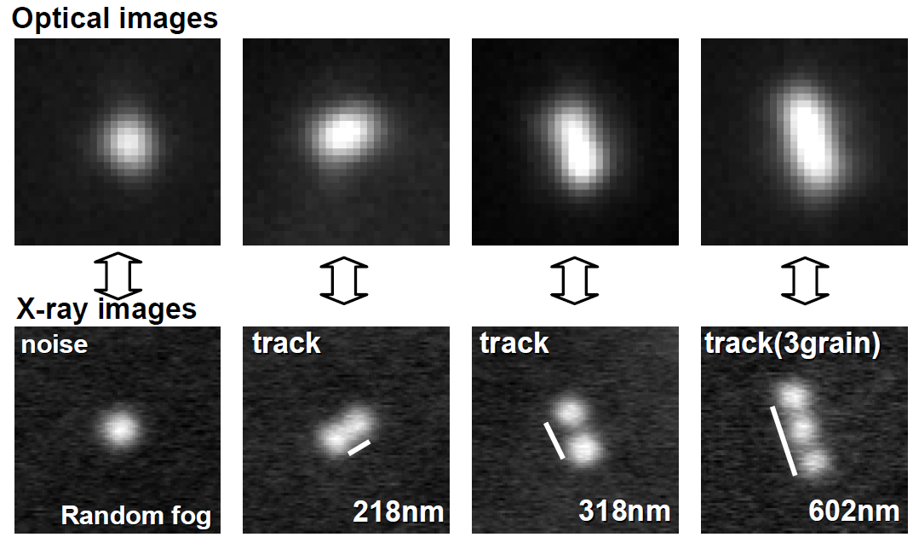
Comparison of cluster images on optical and X-ray microscopes

Slide 13
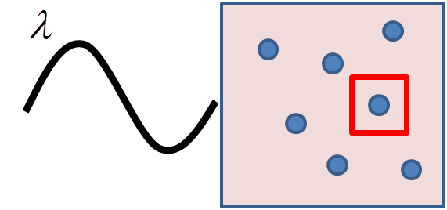
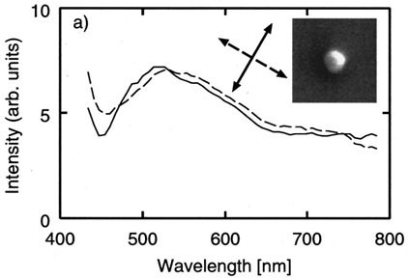
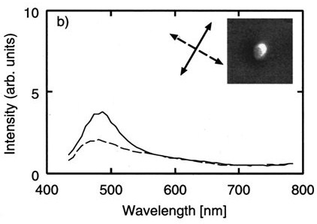
So far so good, but second step with X-ray is extremely uncomfortable,
and too slow (scaling up to large target mass out of reach)
➔ Compelling reasons to go beyond optical resolution
Exploiting Resonant Light Scattering
by Ag nanoparticles (spheroidal shape of single/multiple clusters)
λ_{l}
Nano-metal in dielectric medium
Plasma oscillation of e-cloud
Response spectrum depends on the light polarization and on the grain shape
See e.g. H.Tamaru et al ., Applied Phys Letters 80, 1826 (2002) - …and Nobel Prize for Chemistry 2014
Ag 100 nm spheroidal
polarizing property
Ag 100 nm spherical
no polarizing property

Slide 14
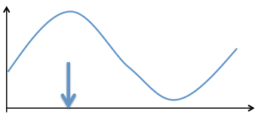
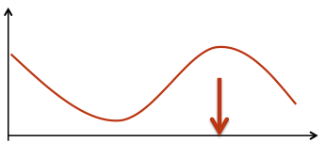
RESONANT LIGHT SCATTERING
14
Occurring when the light is scattering off a nanometric metallic (silver) grains are dispersed in a dielectric medium (Applied Phys Letters 80 (2002) 1826)
Sensitive to the shape of nanometric grains: when silver grains are not spherical, the resonant response depends on the polarization of the incident light.
Each grain is emphasized at different polarization values
polarization direction
polarization direction
Scattering intensity
Scattering intensity
polarization direction of incident light
polarization direction of incident light

Slide 15
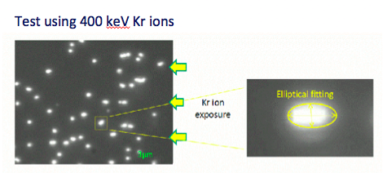
Optical Microscope Read-out: Step 1
100x objective lens with high N.A.
Fast CMOS sensor
4 Mpix, @560 fps
Magnifying lens
Resolution: 30 nm/pixel
View Size: 65 x 50 µm²
LED
Scanning with optical microscope
and shape recognition analysis

Slide 16
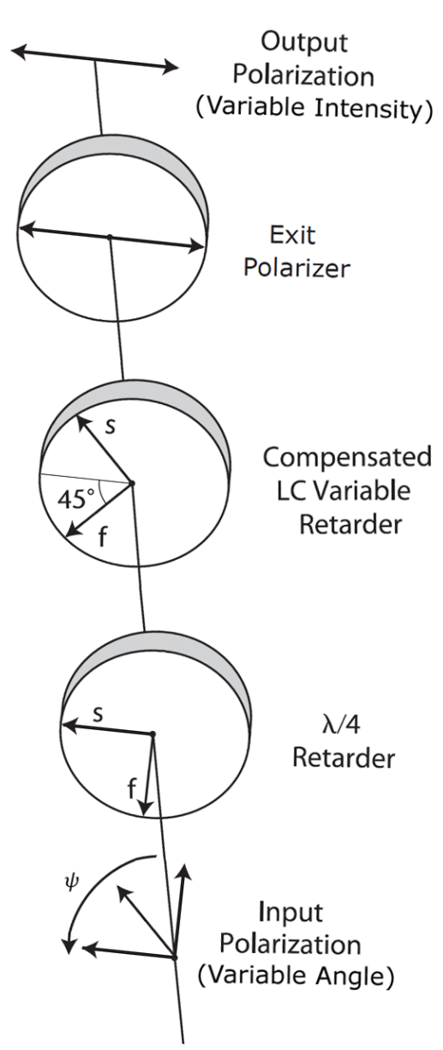
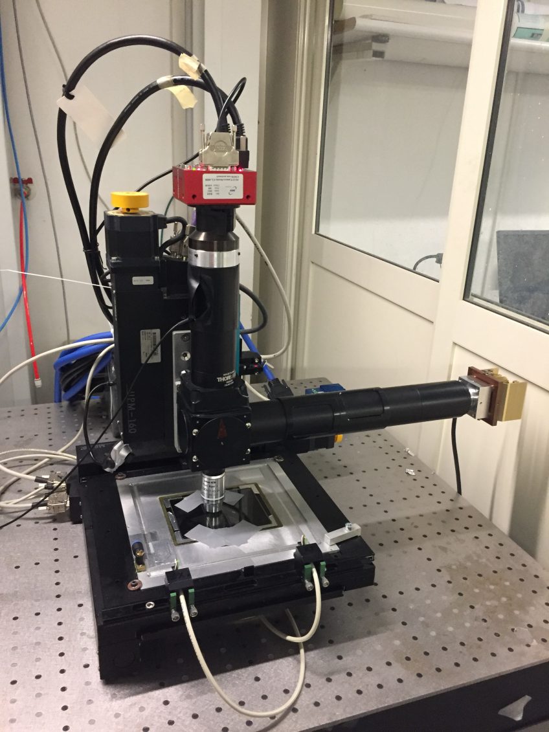
OPTICAL MICROSCOPE
16
Prototype assembled at the University of Naples
Equipped with liquid crystal polarization rotator
Exit polarizer plate
LC Polarization Rotator
Violet LED (λ = 405 nm)

Slide 17
Silver grains property composing track
Think about the optical response
TEM image of Carbon track after development
30keV Carbon ion
vertical implanted
λ is fixing
Scattering intensity
The direction of polarization of incident light
Surface of
emulsion
500nm
Optical response is strongly depended
on the polarization of incident light
Actually the form is different from each other

Slide 18
Silver grains property composing track
Track composed by two grains
TEM image of Carbon track after development
30keV Carbon ion
vertical implanted
λ is fixing
Scattering intensity
The direction of polarization of incident light
Surface of
emulsion
500nm
Optical responses are different behavior
because it is decided by grain form

Slide 19
Silver grains property composing track
Track composed by two grains
TEM image of Carbon track after development
30keV Carbon ion
vertical implanted
50nm
Track image when polarization is changing
Surface of
emulsion
500nm
Same as high resolution idea
Hope to new analysis
using optical microscope

Slide 20
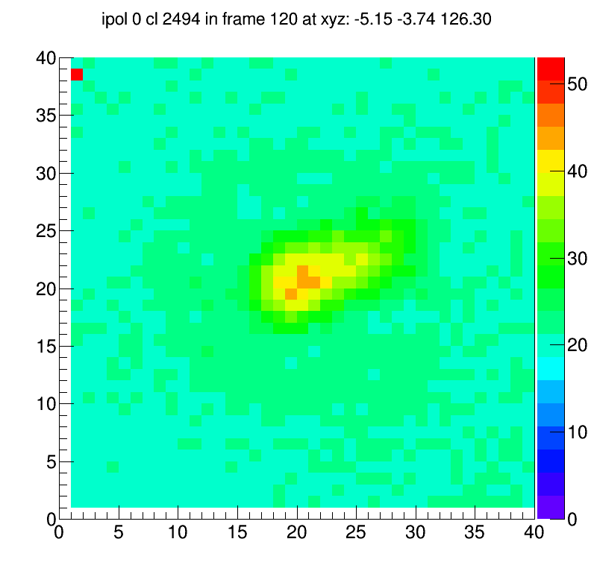
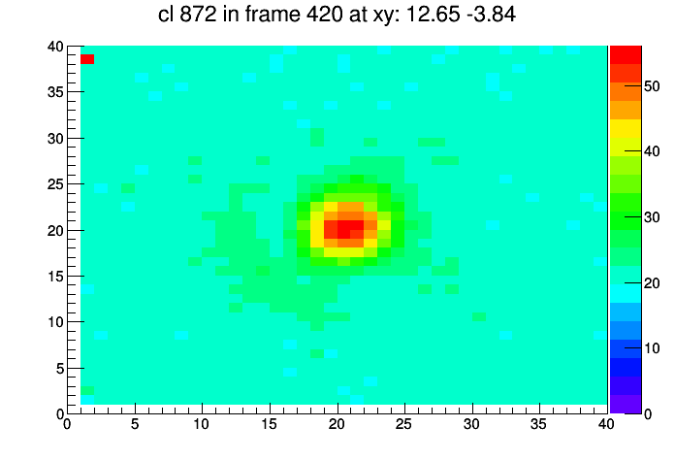
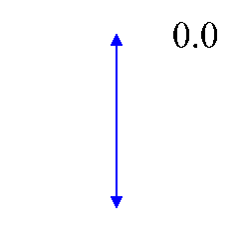
SUPER RESOLUTION ANALYSIS
20
Dynamic sequence of best focus clusters for each polarization angles
Cluster coordinates
(schematic representation)
Max barshift
pol angle
Barycenter shift (100keV C ion)
No barycenter shift

Slide 21
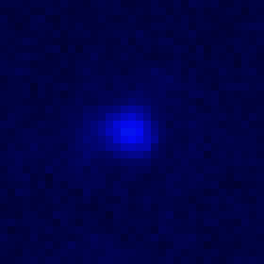
Carbon ion 30keV
1μm
Implant
255
3μm
0

Slide 23
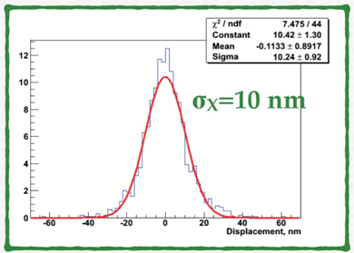
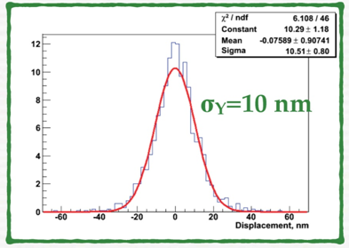
Position accuracy
Unprecedented accuracy 10 nm is achieved on both coordinates

Slide 24
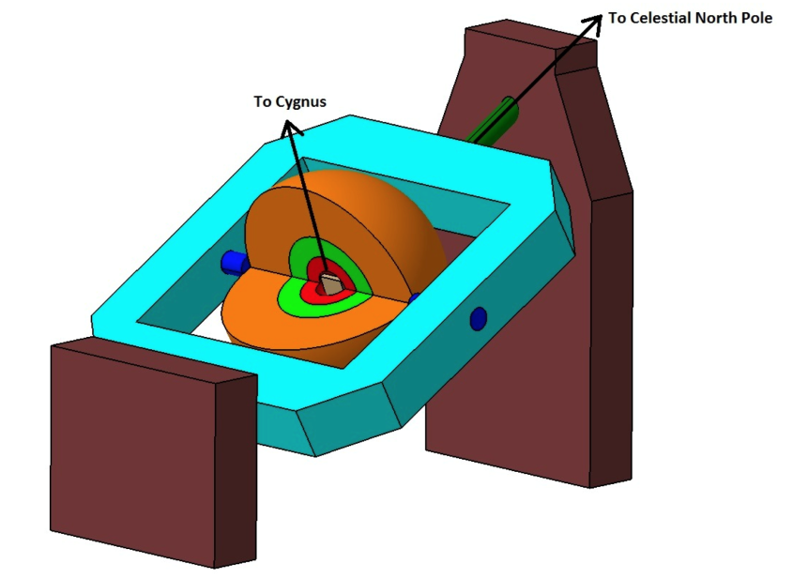
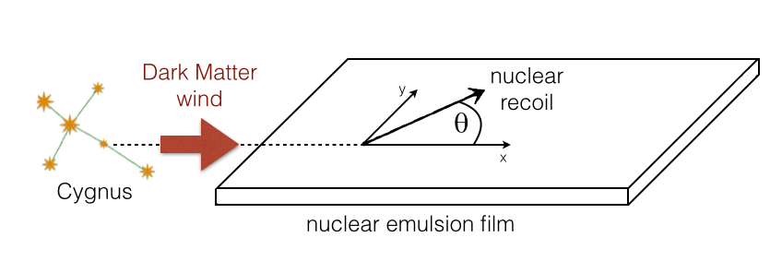
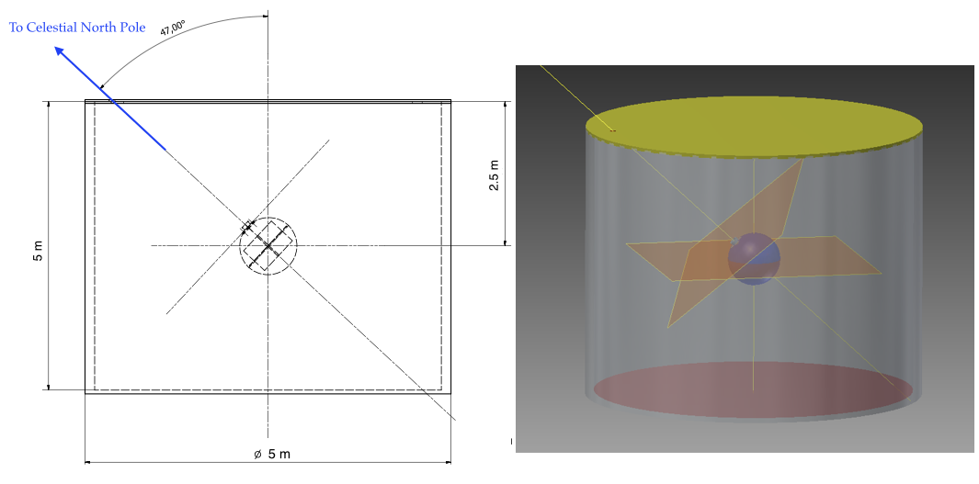
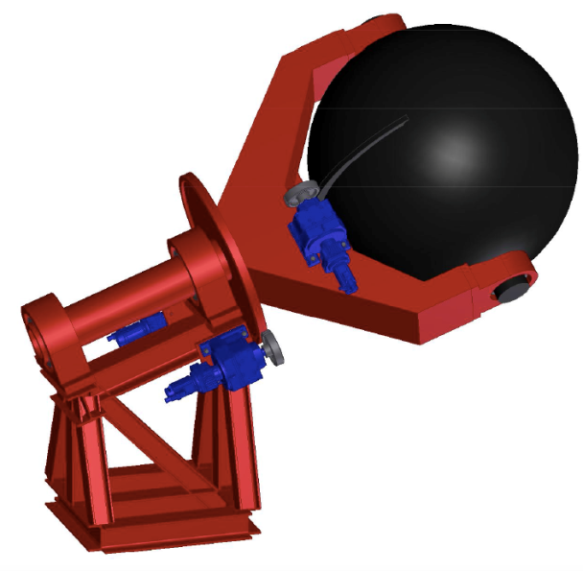
NEWSdm PRINCIPLE
Aim: detect the direction of nuclear recoils
Target: nanometric emulsions acting both as target and tracking detector
Background reduction: neutron and gamma shield surrounding the target
Fixed pointing: target mounted on equatorial telescope pointing to the Cygnus Constellation
Location: Underground
NEWSdm - G. De Lellis

Slide 25
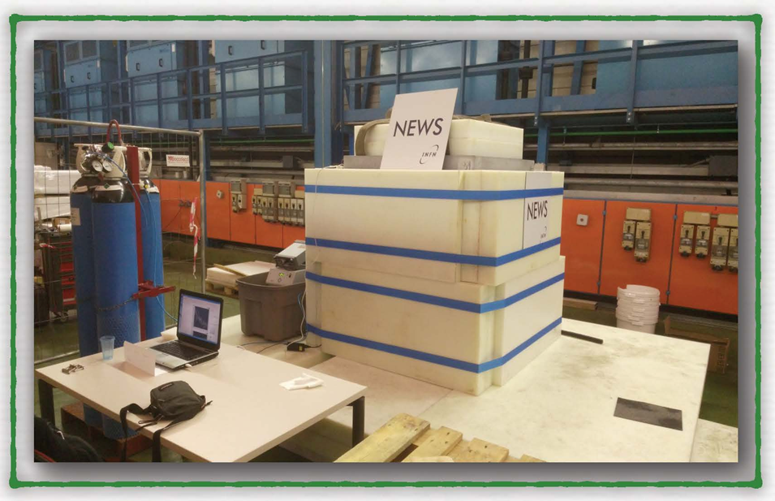
TECHNICAL TEST
In 2017 installed in Underground Gran Sasso INFN Laboratories
Now the emulsion films are processed.

Slide 26
Conclusions
A novel approach for directional Dark Matter is proposed in NEWSdm.
Use of fine-grained nuclear emulsion as target and tracking system is supposed.
Breakthrough in readout technologies to go beyond optical resolution is effected.
Test experiment on estimation of background value is performed.
New test (pilot) experiment is preparing in 2018 (1 kg 1 year).

